Slide 1

North Yorkshire Primary and Secondary School SENCO Network
11th February 2026

Slide 2
Agenda
1.00-1.20 Welcome & service updates - Carol ann Howe
1.20-1.30 Education Psychology Service updates - Dr Emma Derby, North Yorkshire EPS
1.30-1.45 Health Updates - Demi Parker, Designated Clinical Officer for SEND, North Yorks & York
1.45-2.30 School Improvement OFSTED updates - Olivia Kelly
2.30-2.45 Access and Engagement updates - Julie Bunn
2.45-3.00 Comfort break
3.00-3.15 Digital EHCP update - Lucy Wade & Zoe Rouse
3.15-3.30 TMP update - Wendy Butterfield
3.30-3.45 Early Help update regarding Family First Partnership and Best Start - Barbara Merrygold
3.45-4.00 Closing session

Slide 3
National context
White paper due any moment- some announcements coming out eg finance – stat override arrangements
SEND reform principles:
  Early support
  Local
  Fair- every school fairly resourced
  Effective- grounded in best practice and evidence
  Shared- we should be working together

Slide 4
Early
Children should receive support as early as possible
Parent information on NYES- SEMH/ADHD/Autism- accessible before diagnosis- will be extending
Best Start programme will aim to increase numbers of children reaching a GLD- real focus on early language
Extending reach of Portage- more groups, more accessible early support
Hub drop ins- EP support
Inclusive Mainstream Toolkit

Slide 5
Local
More children educated locally with their peers
Selby free school breaking ground at last
Increase in TMPs to facilitate this- Wendy on later
Lucky to have ongoing hub and EP support to facilitate this- don’t forget NYES training is currently free
Hub referral form – shortened version coming soon

Slide 6
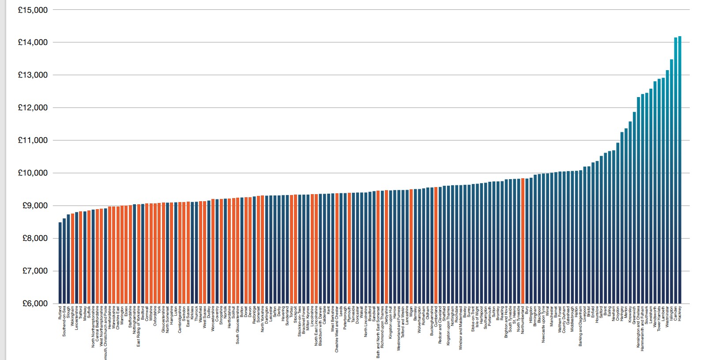
Fair
Home - f40
We are an f40 area - our schools and services are more poorly funded than our neighbours- yet we must provide support

Slide 7
Effective and shared
Ongoing SENCo networks to keep you informed – checkout NYES
Locality boards and clusters
Will be working with you, health colleagues and headteachers as we get to the detail to respond together – we need to build our partnership

Slide 8
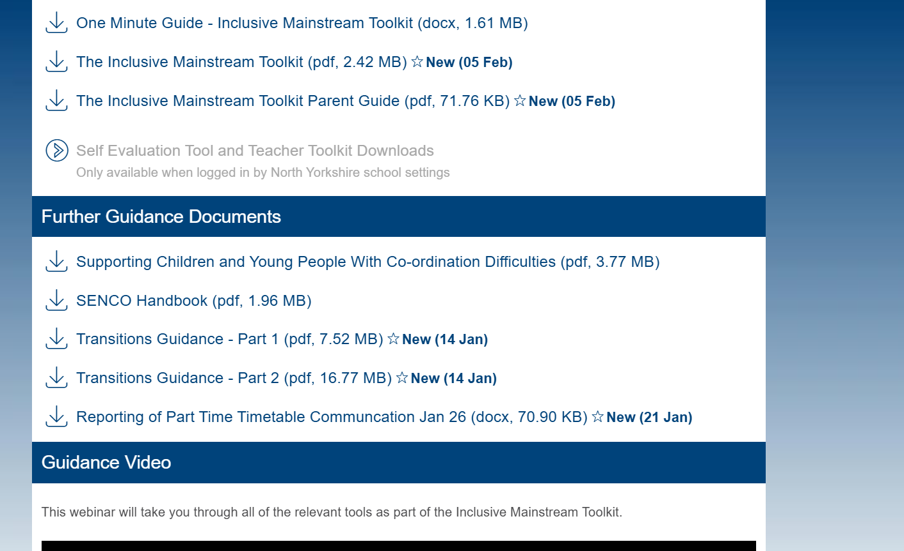

Slide 9


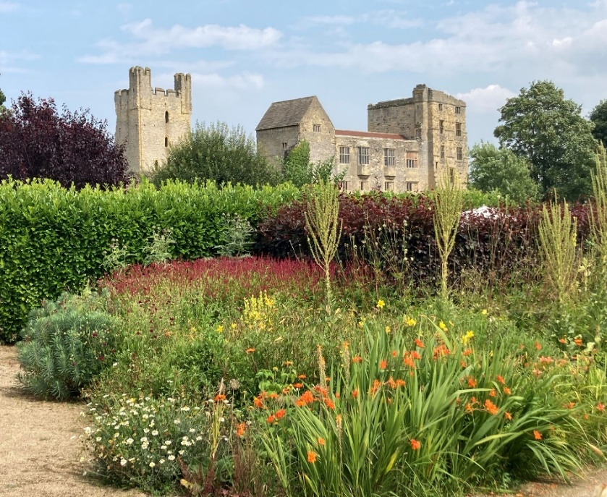
Educational Psychology Offer
2025-2026

Slide 10
Educational Psychology Team Offer 2025-26
All schools will be able to access:
Free online EPS Spotlights – see NYES
Statutory Offer – NYC EP team (and local Locum EPs) will prioritise EHC assessment work for the following year groups: Nursery, Reception, Y1, Y5 and Y7.
Cluster work – Delivered to a group of primary schools in a geographical area by a Link EPS member.
Assistant EP support – Supporting casework, Virtual School offer and some SEND directed work etc.
Also:
Specific offers - For secondary, specialist, TMP, PRS and LA nursery settings.
Targeted offers – Transitions project and Virtual School
Traded offer – Mainly ELSA (including ELSA Supervision) this year – see NYES
Notes:
Spotlights – Ten free Spotlight training sessions, delivered by the EP team online, over the year. The focus/priorities were identified at the SENCO networks e.g. PACE, Emotion Coaching, Loss and Bereavement, Working with Parents etc.
Statutory offer – Advice to the SEND team for EHC needs assessments and contribute to tribunals and complex cases. The NYC EP team (and local Locum EPs) will prioritise EHC assessment work for the following year groups: Nursery, Reception, Y1, Y5 and Y7. We continue to use locum EPs to support our statutory duties and have increased the number of locum EPs able to undertake face to face assessments alongside remote assessments.
Cluster work - Consider ‘clusters’ of schools nominated EPs would have sessions over the year for those clusters​. EPT have had initial conversations now, about needs in area/consider data, then a flexible offer e.g. offering consultation drop-ins, training/workforce development, some type of ‘supervision’ offer​
Assistant EP support – Supporting a range of work (see slide).
Secondary/specialist etc setting offer - Link EP will contact you to arrange an initial planning/support meeting. The EP will discuss our consultation approach and how to make the most out of the EP time available. You will then prioritise and plan the work for the upcoming year. EP work might include:
Consultations around individual children, or staff drop ins
Work on targeted cohorts
Whole school development/ support
Targeted offers – Transitions project: If your school is part of the transitions project you will receive additional EP time. You do not need to do anything to access this support. CYP have already been identified and consent gained from parents. And Virtual School: The EP team provide support to the Virtual School via a Specialist Senior EP. The EP team will offer trauma informed training for schools who are supporting a child who is looked after. This can be discussed with the Virtual school if required.
Traded offer – Mainly ELSA (including ELSA Supervision) this year.

Slide 11
Educational Psychology Team 2025-26
County Hall Campus
Scarborough/
Whitby/
Ryedale
Hambleton/
Richmond
Harrogate/
Knaresborough/
Ripon/Craven
Selby
Pam Melville
(Senior EP)
Sharon Lourd-Moyo
(Senior EP)
Nicola O’Driscoll
(Senior EP)
Ed Sugden
(Senior EP)
Hannah Rowark
(EP)
Bev Mnyandu
(EP)
Charles Persence
(EP)
Philip Tierney
(EP)
Karen Jessup
(Principal EP)
Helen Taylor
(EP)
Ruth Watson
(Trainee EP)
Yolanda Stainbank
(EP)
Shirley Gunthe
(EP)
Anna Lane
(Assistant EP)
Jen Gould
(Trainee EP)
Kate Kitchingman
(EP)
Robert Tweed
(EP)
Sarah Kerr
(Assistant EP)
Emma Derby
(Specialist Senior EP)
Vacant post
Heidi Milson
(Assistant EP)
Vacant post
Sophie Tennant
(Assistant EP)

Slide 12


Slide 13
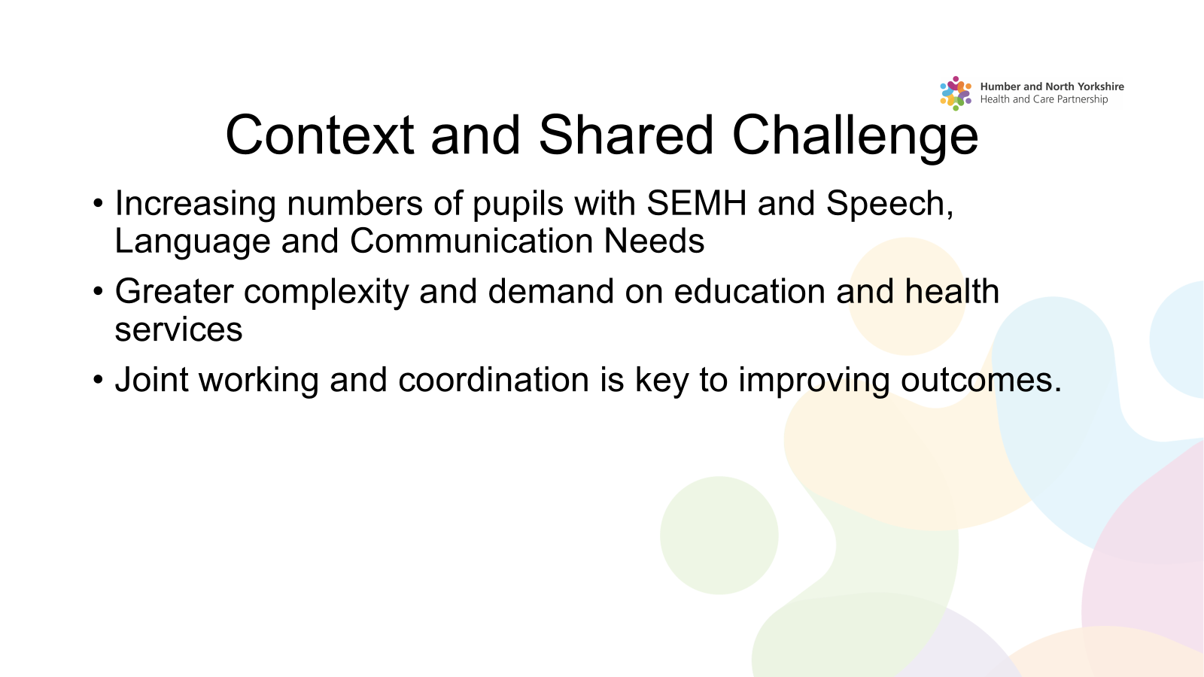

Slide 14
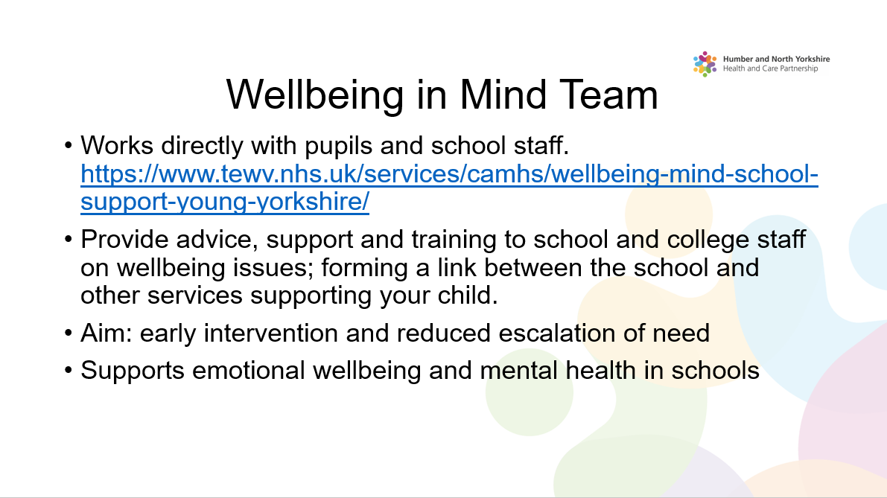

Slide 15
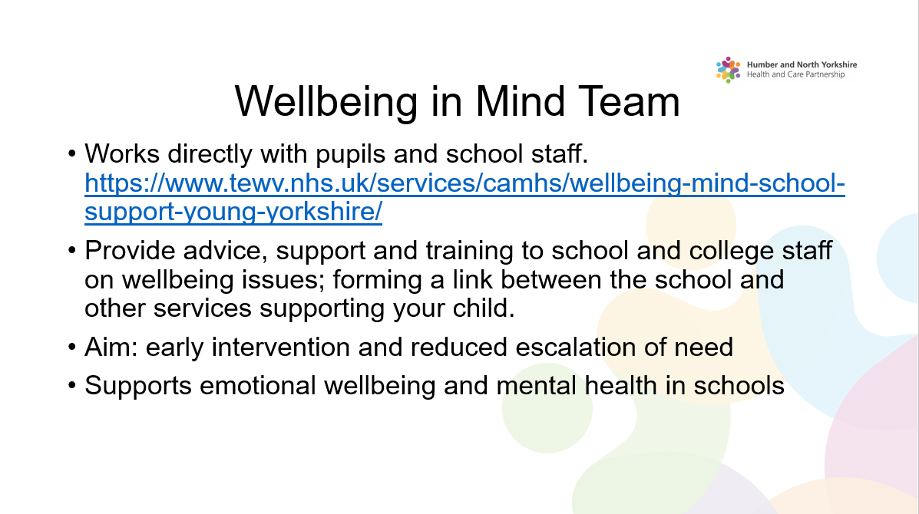

Slide 16


Slide 17
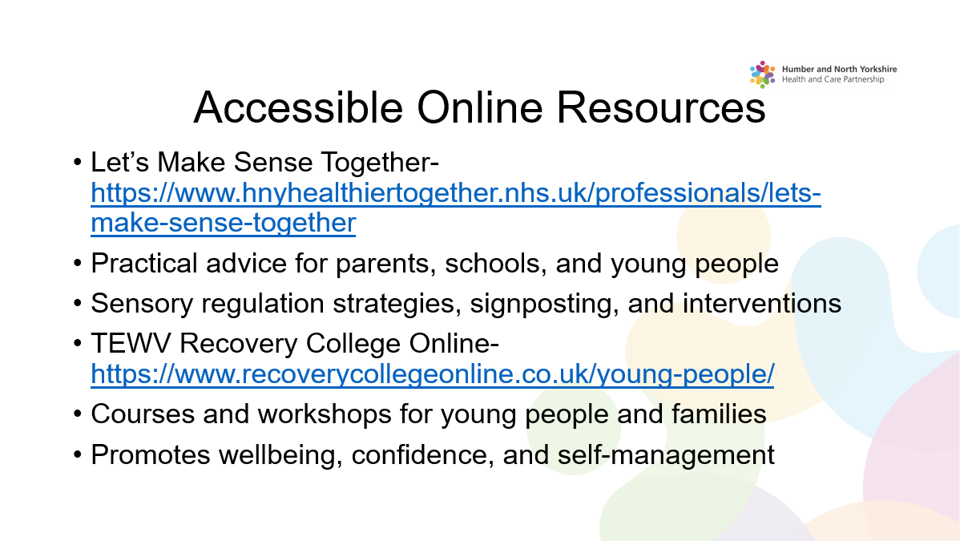

Slide 18
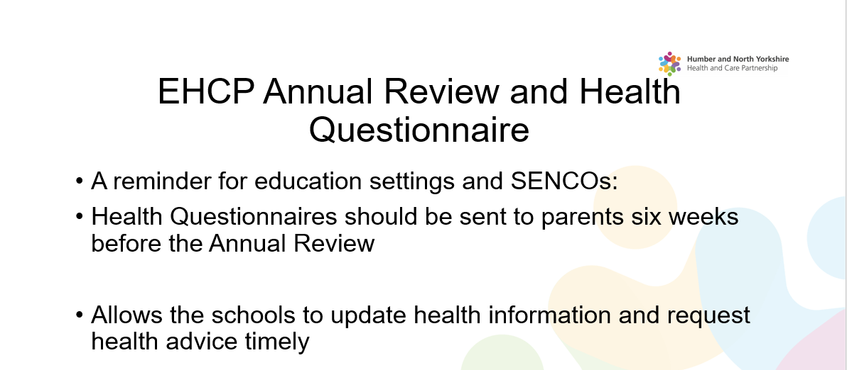



Slide 19
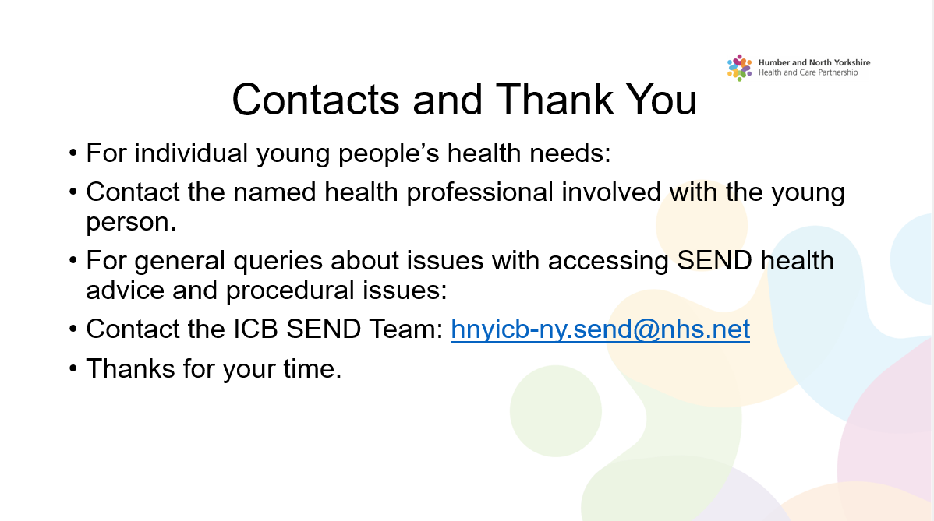

Slide 20

SENCO Network
Spring 2026

Slide 21
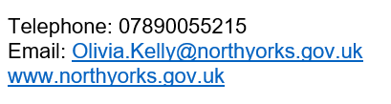
Olivia Kelly
Senior Education Advisor
School Improvement

Slide 22

Every teacher a teacher of SEND
Every leader a leader of SEND
Every governor a governor of SEND

Slide 23


Ofsted – Renewed Ofsted Framework
Education inspection framework: for use from November 2025 - GOV.UK
School inspection: toolkit, operating guide and information - GOV.UK

Slide 24

Ofsted – Renewed Ofsted Framework
Throughout inspections, inspectors will give particular attention to the experiences and outcomes of disadvantaged pupils, pupils with special educational needs and/or disabilities (SEND), pupils known or previously known to children’s social care and those who face other barriers to their learning and/or well-being. These groups are central to planning, inspection activity and evaluation.

Slide 25
Ofsted – Renewed Ofsted Framework
Inclusion
Inspectors will evaluate the effectiveness of the systems and procedures in place for identifying pupils with special educational needs (SEN).
Inspectors will review the support pupils receive and how leaders review provision and impact. They will do this through:
Reviewing the ISDR
Case sampling
Speaking to leaders how needs are identified and met
Learning walks

Slide 26
Ofsted – Renewed Ofsted Framework
Toolkits
These are the standards that are used to inform grading.
They support a shared understanding of what is required within each evaluation area and are used as prompts for discussions and to tailor activities.

Slide 27
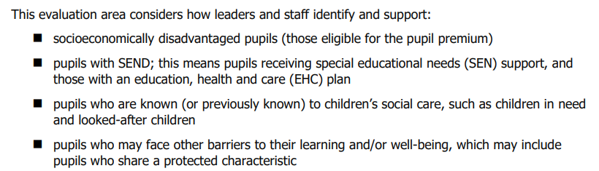
Ofsted – Renewed Ofsted Framework
Inclusion Evaluation Area
Toolkit – page 10

Slide 28
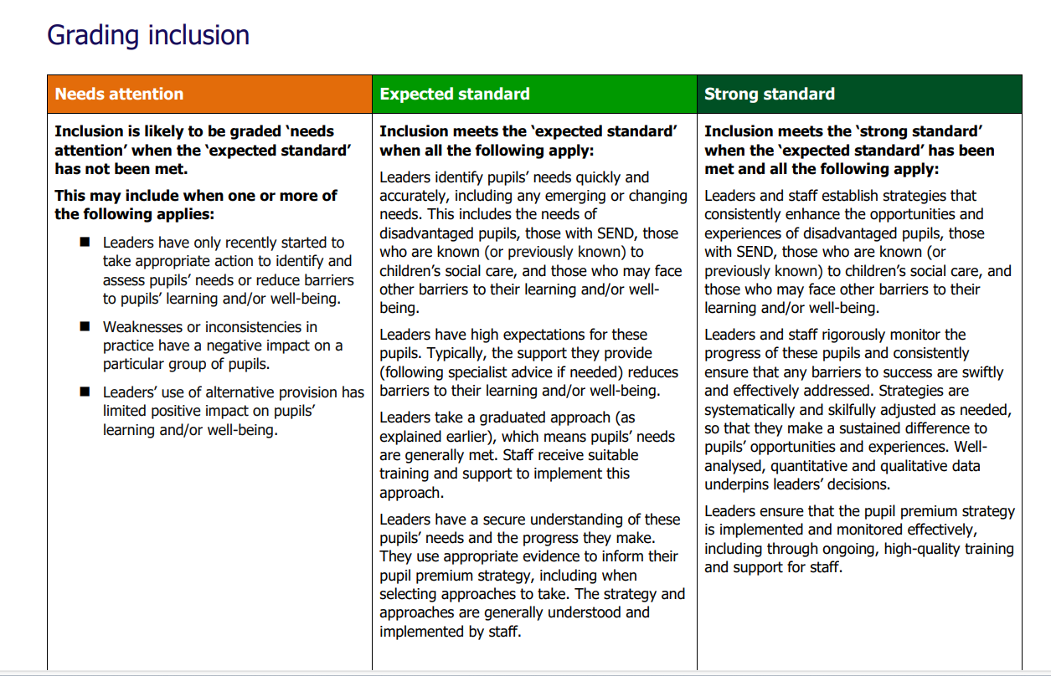
Ofsted – Renewed Ofsted Framework

Slide 29
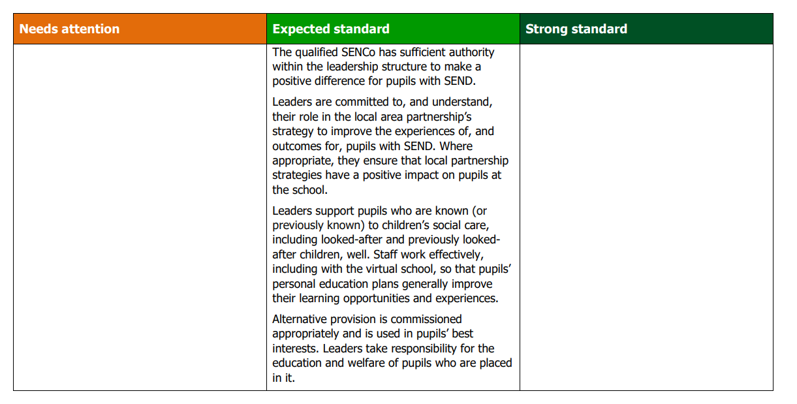
Ofsted – Renewed Ofsted Framework

Slide 30
Gathering Evidence Prompts
Each toolkit has the ‘Gathering Evidence Prompts’ these are prompts the inspectors follow during the inspection.
They will use these to collect evidence to inform the grade.
As SENCO’s you will need to be familiar with these.

Slide 31
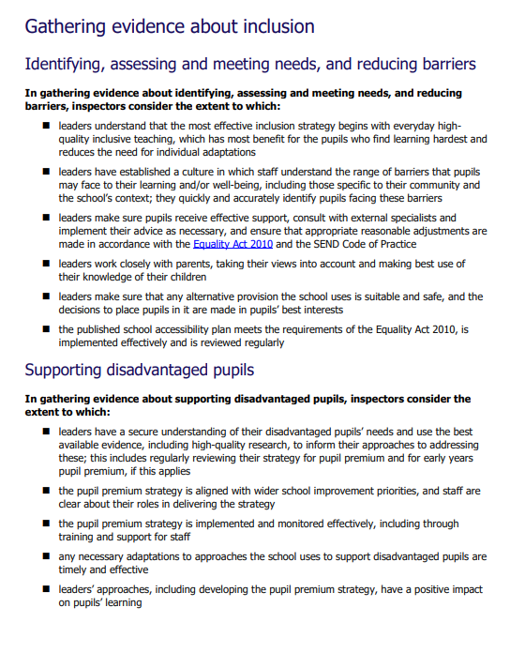
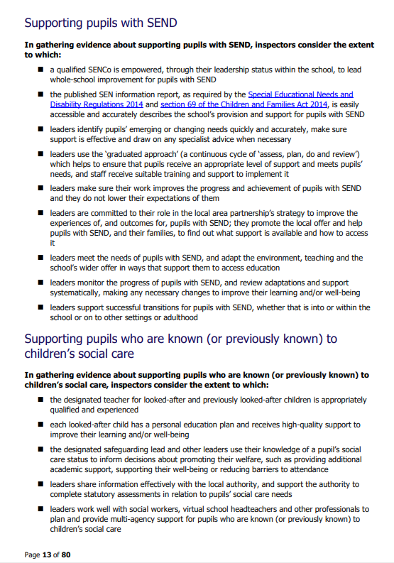

Slide 32
Ofsted Inspection experience as a SENCO
The SENCO was involved for one and a half days of the two-day inspection.
Inspectors were keen to know about the strategic planning/direction for inclusion – why have you chosen to do it this way? What is your vision for inclusion?

Slide 33
Ofsted Inspection experience as a SENCO
Day 1
8.50am – brief meeting with inspector
Numbers on SEN register – this included any students who were PP/LAC/CP/Forces etc.
Number of EHCPs
Main area of need
Requested a list of disadvantaged students
‘SEND on a page’ was a useful document for this meeting

Slide 34
Ofsted Inspection experience as a SENCO
Day 1
8.50am – brief meeting with inspector
Numbers on SEN register – this included any students who were PP/LAC/CP/Forces etc.
Number of EHCPs
Main area of need
Requested a list of disadvantaged students
‘SEND on a page’ was a useful document for this meeting

Slide 35
Ofsted Inspection experience as a SENCO
First Learning Walk
Inspectors chose 1 student from each group. Learning walk focused on the support the students were receiving in the lessons.
Continually observed – looking at how the student engaged in the learning, how both the TA and teacher were interacting with the student
Looked at students' books
Spoke to the students
Spoke to TA and teacher – ‘tell me about the student’ this included the main area of need, the strategies used to support the student.

Slide 36
Ofsted Inspection experience as a SENCO
Discussion with Inspector immediately after learning walk
What did you expect to see? Did you see it?
How did what you see align with whole school policies?
Looked at data and information about individual students – how do TAs use this information?
Looked at support plans and EHCP – how was this used within the lesson?
Staff CPD – How do you train the staff to use individual support plans? How are staff trained on adaptive teaching? Use of TAs?
What support do you receive from the LA?
What is your role as SENCO? How do you work as a whole school team for inclusion?
Personal Development – what training have the staff had to enable them to adapt the PSHE curriculum for students with SEND?
Are students with SEND and disadvantaged students included in extracurricular activities? How do you know?
Looked at SEND register in detail – how many students have been added to the register after Year 7? How many have been taken off the register after Year 7? When do you take off students off the register? Early identification was a thread during this part of the discussion.

Slide 37
Ofsted Inspection experience as a SENCO
Second Learning Walk
Inspectors focused on the provision of SEND in lessons.

Slide 38
Ofsted Inspection experience as a SENCO
Discussion with Inspector
Whole school monitoring – talk through the process of how provision for SEND is monitored.
Data – what is the process for monitoring and tracking progress and attainment for students with SEND?
How do you assess students who arrive after Year 7? Is their progress any different?
Use of AP – case studies prepared were useful to enable the SENCO to talk about all individuals including specific dates and times.
What is whole school policy for using AP? Why has AP been chosen for these students? What has been the impact of the AP? How do you know? Inspectors phoned both AP and Virtual School to verify information
How many EHCPs have been acquired since students have joined the school? How and when?
Part time timetables – How many? Why is it best for this student? What is the process for part time timetables?
Alternative Timetables – what is the rationale for these? How do students benefit from them? Inspectors requested evidence to prove this.
Careers Education – how do you provide careers advice for students with SEND? Students with EHCPs?
How do you prepare students for Post 16? What support do you provide for destinations? Do you invite colleges to EHCP reviews?
How do you know destinations are sustained?
Attendance data – one page document for attendance of SEND and disadvantage groups was useful for this discussion.

Slide 39
Ofsted Inspection experience as a SENCO
Day 2
Third Learning Walk
This focused-on use of TAs within a lesson – particularly focused on students with an EHCP – 2 lessons
Focused in on how TAs were interacting and supporting students
Fourth Learning Walk
General learning walk looking at how TAs are used in classrooms
Asked the TAs –Tell me about this student's needs? How are you supporting the students with SEND? How is information about students with SEND communicated to you?
How are TAs allocated?

Slide 40
Ofsted Inspection experience as a SENCO
Discussion with SENCO
PFA – How do you adapt PSHE and PFA for students with SEND?
If a student with SEND is absent from PSHE how do ensure they catch up?
How do you review progress for students with SEND with parents?

Slide 41
Ofsted Inspection experience as a SENCO
At the end of each meeting, the inspector would tell the SENCO what evidence they will need to bring to the next meeting.
The Inspector followed the ‘evidence gathering prompts’ from the toolkits for all discussions and evidence gathering activities.

Slide 42

Resources
Home page | Nasen

Slide 43



Resources

Slide 44
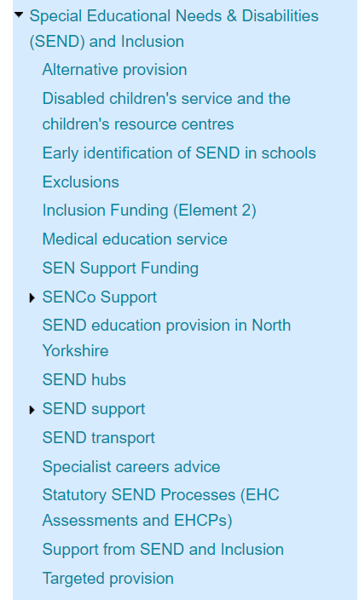
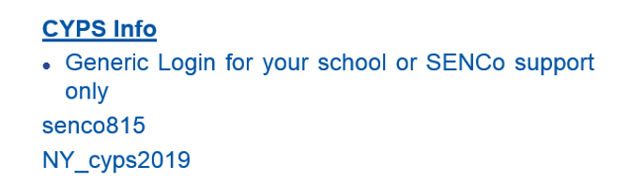
Resources
Welcome to CYPSinfo | CYPSinfo (northyorks.gov.uk)

Slide 45
Julie Bunn
Access and Engagement

Slide 46

Working together to improve school attendance
More children in school, more of the time
Notes:
Chris – acknowledge conflicts in room between national agenda and local agenda, schools and LA, parents and schools/services and even between teams in council

Slide 47
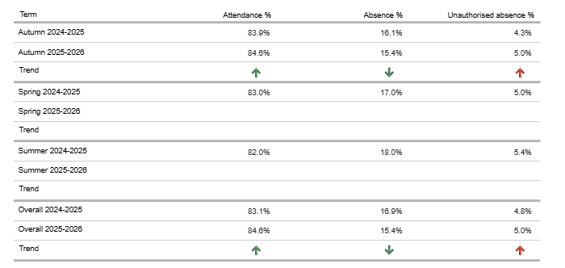

Attendance of pupils with EHCPs – comparison with previous year

Slide 48
Major shift in approach from DfE
Messaging from DfE indicates a major shift in approach regarding suspensions and exclusions, aiming to reduce the number of pupils sent home for non-violent behaviour
Here are the key points from DfE and Ed Secretary Bridget Phillipson:
“Internal Suspensions” Over Sending Home
The government is pushing for supervised in-school isolation to be used for non-violent behaviour, rather than automatically sending pupils home. This is designed to keep children in education and stop them from having “unfettered access to phones and online gaming during school hours.

Slide 49
Recent messaging from DfE
Internal suspensions
Suspensions as last resort
Tracking Internal Exclusions
Guidance on “Off-Rolling”
Re-integration Requirements
SEND Protections
Schools must consider if applying the behaviour policy to a pupil with SEND or a disability without adjustment is discriminatory

Slide 50
Across all areas, the national direction emphasises:
Early intervention, safeguarding, and multi‑agency solutions.
Strong oversight and quality assurance for AP and EHE.
Stricter expectations for documentation, proportionality, and SEND‑specific adjustments in behaviour management and exclusion processes.
For pupils with EHCPs, every decision — attendance, AP, EHE, restraint, suspension — must be tied back to whether need is understood, provision is delivered, and legal duties are met.

Slide 51

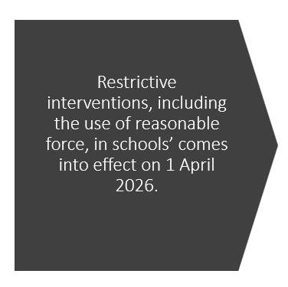
Restrictive interventions, including the use of reasonable force, in schools’ comes into effect on 1 April 2026.

Slide 52
Digital EHCP Project
SENCO Networks
11 February 2025
Lucy Wade – Senior Project Manager
Zoe Rouse – SEND Improvement Lead

Slide 53
Project Summary
What?
The purpose of the project is to implement a new system to manage the end-to-end statutory processes for Education, Health & Care Plans (EHCPs).
Why?
We want children and young people to get the right support as soon as they need it, helping to improve their outcomes.
When?
June 2026 – go live with assessment requests
The existing processes are complex, relying on several systems and methods that reduce efficiency and make multi-agency collaboration challenging.
September 2026 – go live with annual reviews
Demand for EHCPs continues to increase.
We want to improve transparency for families and partners.
Statutory timescales are becoming increasingly challenging to meet.
Notes:
Lucy

Slide 54
What has happened so far?
JAN & FEB 2025
Completed options appraisal
MAR & APR 2025
Received approvals to procure a new system
MAY & JUN 2025
JUL & AUG 2025
Agree route to market and agree tender specification
Market engagement and discovery with supplier of potential systems
SEPT – DEC 2024
Reviewed processes, lessons learned and identified requirements
Notes:
Lucy

Slide 55
The procurement process
September 2025
Tender Specification published on a Crown Commercial framework.
Suppliers review tender and submit their service offering.
October 2025
November 2025
Review the service offerings and evaluation against the specification.
December 2025
Approvals and finalising contract.
January 2026
Contract Award
Plan system implementation
Complete due diligence activity.
Identified CACI as the preferred supplier.
The system is called Impulse and the supplier is CACI.
CACI, is a trusted supplier to many UK councils, working closely with us to deliver a secure, user‑centred and future‑proof digital platform that fully meets statutory requirements and will streamline the EHCP processes.
Notes:
Lucy

Slide 56
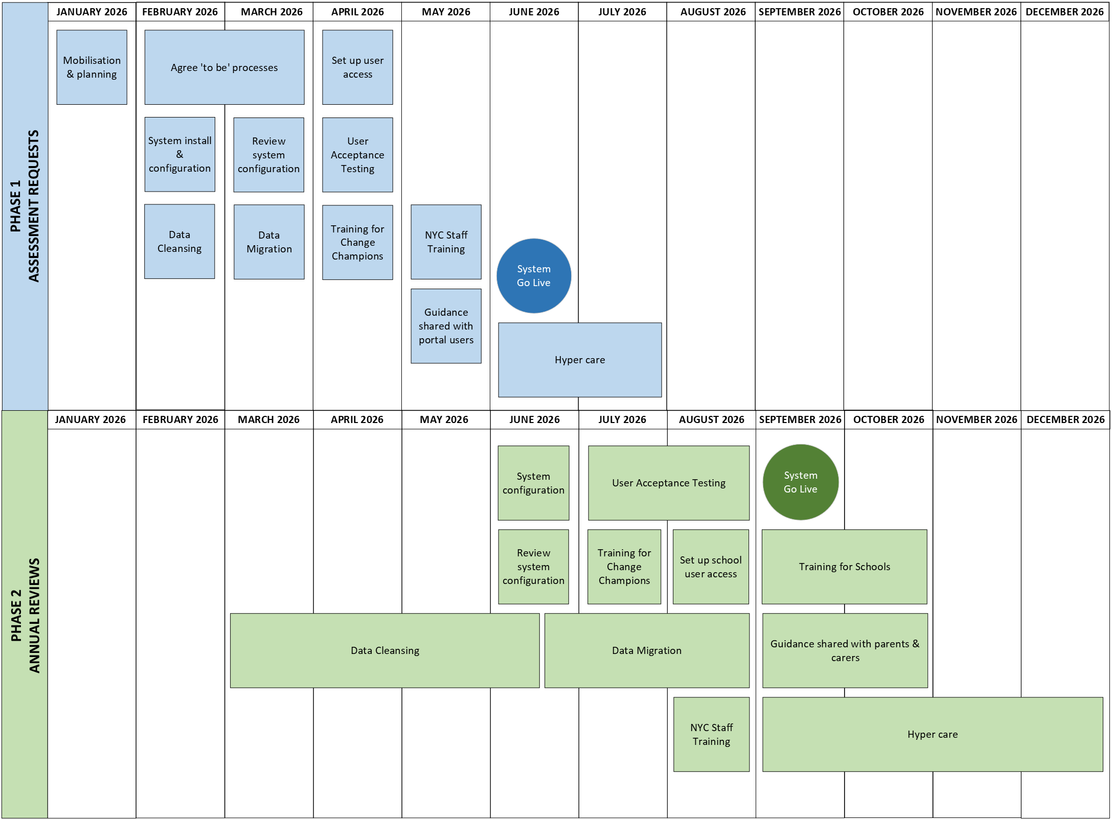
When will the new system be available?
PHASE | WHEN
1. Assessment Requests | 1 June 2026
2. Annual Reviews | 1 September 2026
Please note:
High level plan based on current information and understanding.
We have just started planning the system configuration with the supplier.
We will keep you informed as more information becomes available.
Notes:
Lucy

Slide 57
When will the new system be available?
 | WHAT | WHEN
PHASE 1 – ASSESSMENT REQUESTS | Mobilisation & planning | January 2026
 | Agree ‘to be’ process mapping | Feb – March 2026
 | System Configuration | February 2026
 | Review system configuration | March 2026
 | Data Cleansing | February 2026
 | Data Migration | March 2026
 | Set up user accounts | April 2026
 | User acceptance testing | April 2026
 | Training for Change Champions | April 2026
 | Training for NYC staff users | May 2026
 | Share guidance with portal users | May 2026
 | Go Live | 1 June 2026
 | Hyper care | June – July 2026
 | WHAT | WHEN
PHASE 2 – ANNUAL REVIEWS | System Configuration | June 2026
 | Review system configuration | June 2026
 | Data Cleansing | Mar – Jun 2026
 | Data Migration | Jun - Aug 2026
 | User acceptance testing | Jul - Aug 2026
 | Training for Change Champions | July 2026
 | Training for NYC staff users | August 2026
 | Set up school user access | August 2026
 | Training for Schools | Sept – Oct 2026
 | Share guidance with parents & carers | Sept – Oct 2026
 | Go Live | 1 September 2026
 | Hyper care | Sept – Dec 2026
Please note we are aiming to:
Transfer all ‘in progress’ assessment requests to the new system for 1 June 2026
Transfer all existing plans by 1 September 2026
Notes:
Lucy

Slide 58
What are the key changes?
Improved transparency and tracking
Submit assessments requests online
Enhanced multi-agency collaboration
Easy access to draft plans
Automated reminders and notifications
All information in one system
One system used for all information related to a child's or young person's plan, making it easily accessible to families, professionals, and practitioners.
Partners, including education, health, and social care professionals will be able to collaborate, ensuring a holistic approach to the child’s needs.
Parents, carers, schools & setting will be able to see what's happening with the plan, track progress, and know who is doing what, via the online portals.
All partners will be able to review and provide input on draft plans before they are finalised, ensuring that the plan is comprehensive and meets the child's needs.
Automated reminders for important deadlines, such as annual reviews, ensuring that all key people are prepared and can contribute effectively, with a reduced admin burden.
Parents, carers, schools & settings will be able to submit EHCP assessment requests through an online portal, making the process quick and convenient.
Notes:
Zoe

Slide 59





How will you be supported through the change?
Change Champions
Change Champions have been identified, for each user group, to drive, promote and support the change.
Training
A comprehensive training programme will be designed, considering the needs of each user group.
Ongoing support & guidance
Guidance resources will be available, including short videos.
A period of hyper care following go live.
Support during go live
Accessible support will be available during go live.
Continued engagement
We’ll keep you informed and encourage your feedback to help guide us in the right direction.
Notes:
Zoe

Slide 60
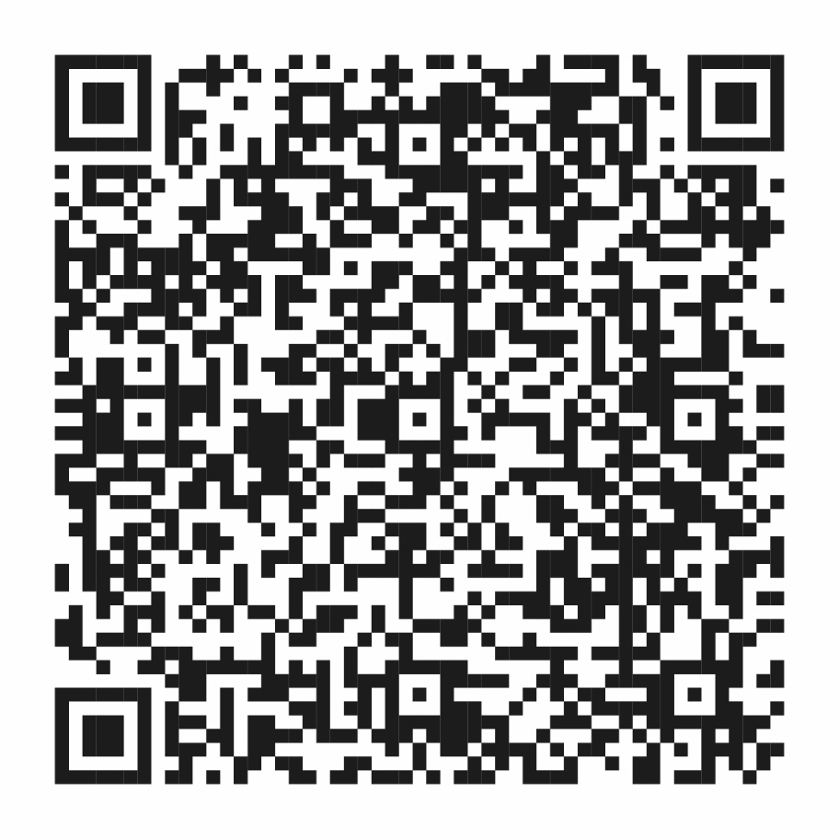
How can I stay up to date with progress?
Webpage:
Transforming EHCPs: a new digital system is coming | North Yorkshire Council
Notes:
Zoe

Slide 61
Next steps – preparation
Consider who the users will be in your schools and settings.
  We will request this information before the end of the summer term 2026
Plan the training into your school events calendar.
  We will contact you with more information about the training programme once we have designed it. Early thoughts are:
    July – share guidance and resources
    September – webinars at the start of September (school training days)
    More targeted support through September & October 2026.
  We will use our identified ‘schools working group’ to consult with, to take guidance on what will work best for schools.
Keep in touch – if you have any concerns or don’t feel you have the appropriate information – please let us know.
Lucy Wade – Project Manager – lucy.wade@northyorks.gov.uk
Zoe Rouse – SEND Improvement Lead – zoe.rouse@northyorks.gov.uk
Notes:
Zoe

Slide 62

Feedback Opportunity
Any Questions?
Digital EHCP Project - SEND Partners Pulse Survey – Fill in form
Notes:
Zoe

Slide 63


Slide 64

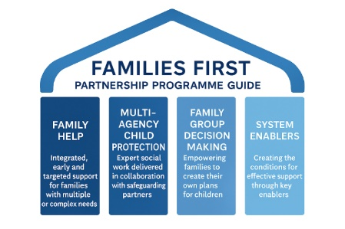



Families First Partnership & Giving Every Child The Best Start in Life

Slide 65

The Families First programme forms a key component of the wider ’Stable Homes, Built on Love’ strategy, which was shaped by insights from numerous reviews and reports on children’s social care.
The Families First programme is part of the broader ’Stable Homes, Built on Love’ strategy, which was informed by recommendations from various reviews and reports on children's social care.
The Families First programme is part of the broader ’Stable Homes, Built on Love’ strategy, which was informed by recommendations from various reviews and reports on children's social care.

Slide 66
Families First Partnership Programme (FFPP) Guide
Purpose
The guide supports safeguarding partners in England to implement reforms in Family Help, Multi-Agency Child Protection Team and Family Network Decision Making (FNDM). It aims to rebalance children’s social care toward early intervention, reducing reliance on crisis services and improving outcomes for children and families.
Key Objectives
  Transform Family Support
    Shift from reactive crisis intervention to proactive, preventative help.
    Embed Family Help as a seamless offer combining early help and Child in Need services.
    Promote multi-disciplinary teams and a Family Help Lead Practitioner role.
Multi-Agency Child Protection Teams (MACPTs)
  Establish statutory teams combining social care, police, health, and education.
  Improve coordination, decision-making, and timely responses to significant harm.
Family Network Decision Making (FNDM)
  Mandate offering FNDM before care proceedings.
  Empower families to create plans to keep children safe and reduce care entries.

Slide 67
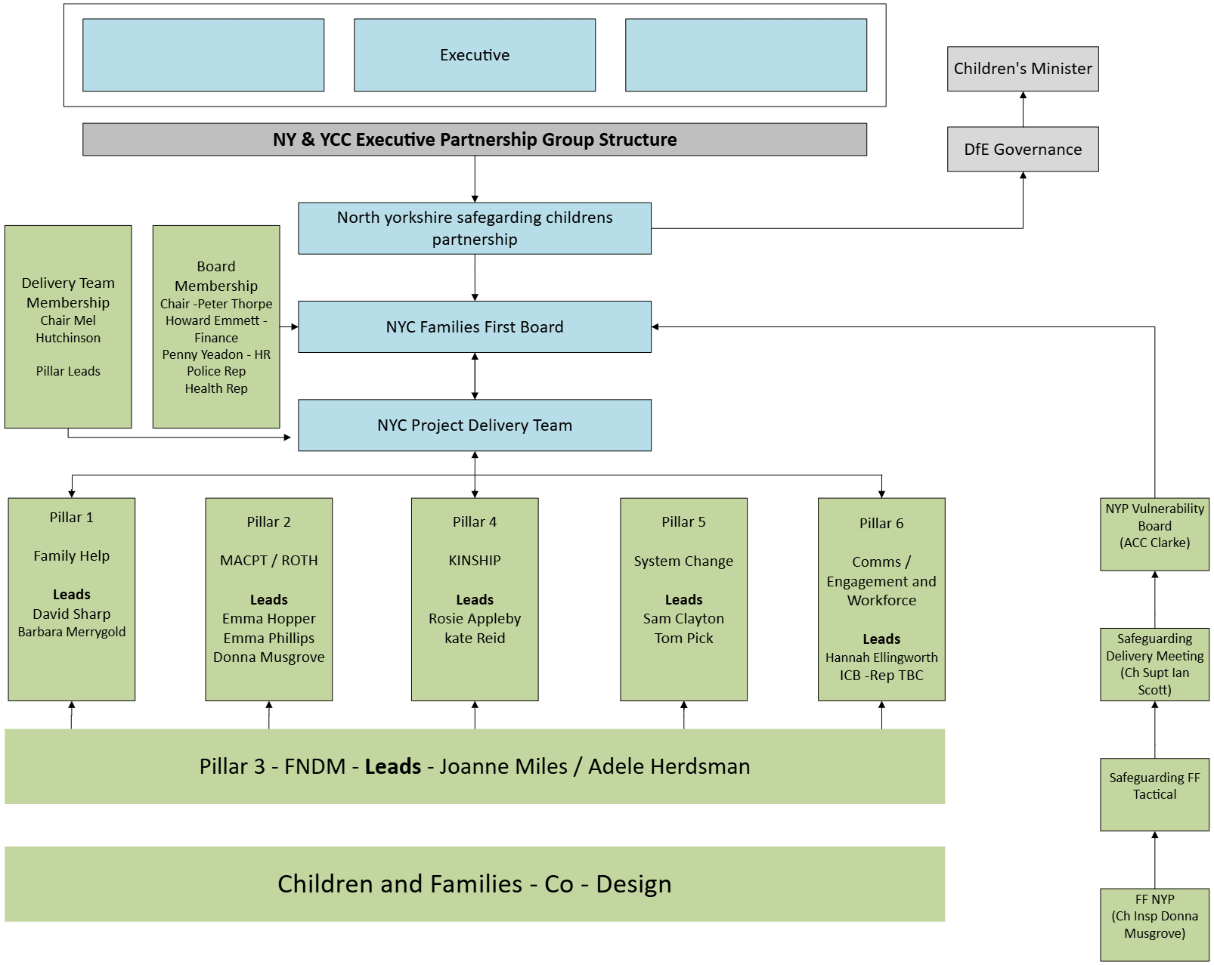

Slide 69
Giving Every Child Best Start in life
‘THE OPPORTUNITY MISSION’ Break Down Barriers to Opportunity
Government Mission
“By 2028, we want a record proportion – 75% - of children to reach a good level of development by the end of reception – That’s up from around 68% meaning 40,000 to 45,000 more children each year will be better prepared for school and life”
February 2026

Slide 70
Development Grant 2025/2026
North Yorkshire awarded £ 205,934
Key Objectives
To identify at least one Best Start Family Hub site from which to deliver your parenting and HLE interventions:
  As referred to in the ‘Giving Every Child the Best Start in Life’ strategy, any Hub(s) identified should be in an area with high levels of deprivation, where support is most needed.
Prepare to Deliver Parenting and Home Learning Environment (HLE) interventions from April 2026:
  Local authorities need to prepare to implement parenting and HLE evidence-based interventions (EBIs) for families with 3–4-year-olds from April 2026, as this cohort is key to achieving the 2028 GLD goals.
Strengthen local plans for Best Start in Life delivery: Building on existing early years work, and leadership role, to drive delivery partners across education, health and community services, to increase the number of 5-year-olds achieving a good level of development by 2028:
  Local authorities should identify local needs and gaps in provision and join up across systems and sectors to develop an integrated plan outlining your strengthened offer

Slide 71
North Yorkshire vision
Focus on Speech Language & Communication – North Yorks Talks - Language and communication is vital for teaching and learning at all ages and across all phases of education. The ability of children to be able to articulate and express themselves is an intuitive and fundamental part of the learning process.
Learning from previous practice – Family Hubs - For North Yorkshire, due to the large geographical area, the concept of one or a small number of physical buildings will not fully achieve the desired outcomes.
Our ambition is to design a model built on established community connections, relationships and community assets complimented by a universal digital offer – for example libraries, parent & toddler group, schools & early years settings.
Strengths in Relationships - Our methodology will bring together the evidence of speech, language and communication with our nationally regarded Strength based Practice model At the heart of this model is bringing the family network together to make plans with families to bring lasting relational change.

Slide 72
Best Start Family Hub sites
The initial site is Scarborough Library – Vernon Road YO11 2NN. Based on the IMD 2025 data:
The postcode YO11 2NN part of Scarborough 010A sits in a Lower-layer Super Output Area (LSOA) that is among the most deprived in England, ranking highly on the Index of Multiple Deprivation (IMD).
The area is ranked 1,015 out of 323,755 LSOAs in England, where a rank of 1 is the most deprived.
This places the area within the most deprived 20% (quintile 1) of neighbourhoods nationally.
Growing hubs in the community – Opportunities emerging to work with a number of Primary Schools to develop Family Hubs within the school site working alongside Communities team - Building on a model of working with schools, libraries, Community anchors and community settings enabling the emergence of further sites to meet the needs of the individual localities and consider repurposing of some children's centre buildings that are being retained for example Bilton CC in Harrogate.
  Barwick Parade, Selby
  Brougham Street, Skipton
  Areté Learning Trust - Kirbymoorside Ryedale, Northallerton - Areté Learning Trust - MAT Leadership
A needs assessment being developed to support this

Slide 73
Evidence-Based Interventions for 3–4-year-olds
From April 2026, DfE funding for Home Learning Environment (HLE) and Parenting within Best Start Family Hubs must be strategically targeted at evidence-based interventions (EBIs) for 3–4-year-olds.
The funding is intended to strengthen and expand universal HLE and Parenting services within Best Start Family Hubs for the long term. It must be used to enhance existing provision—not to replace or offset current funding streams
DFE encourage LA to choose from the two EBI menus we have developed, provided in the annex below. Selecting programmes from these menus aligns with the BSiL strategy’s commitments to provide a consistent, evidence-based offer with clearer funding rules.
https://foundations.org.uk/toolkit/guidebook/
https://www.nesta.org.uk/project-updates/identifying-impactful-parenting-programmes-to-support-parenting-and-the-home-learning-environment-in-the-early-years/

Slide 74
Parenting –
Triple P Family Transitions programme parenting support - Family Transitions Triple P is a targeted, well‑evidenced support programme for separated/divorced parents, focusing on emotional coping, co‑parenting, and child adjustment.
Togetherness – Exemption submitted - North Yorkshire already in the 2nd year of a 5 year license giving all families in North Yorkshire access to this online resource. Purchase of additional parenting group support training
Togetherness is grounded in the Solihull Approach, already well-established across North Yorkshire within Early Help and Healthy Child Service
Home Learning Environment
Easy Peasy - An evidence-based HLE programme standard licence for 3 years, with local signposting support and data integration providing universal access; supports home learning environment
Early Talk Boost – The existing offer will be expanded to additional Early Years Provision providing greater access; supports home learning environment
Parenting Apart Programme – already in place funded through DWP RPC grant
Digital Universal offer – We are working with NYES (North Yorkshire Education Service) to develop a public facing digital platform providing all families within North Yorkshire with access to a suite of HLE and parenting resources.
Parenting & Home Learning Environment

Slide 75
Work with School – EYFS GLD Pedagogy and Practice projects
The project aims to deliver two, 3-year EYFS GLD Pedagogy and Practice projects, aimed at raising standards in all 6 areas of learning outlined in the preceding slide through a whole-school, communication and early language focused approach.
    Project 1: Literacy (writing, word reading, and comprehension underpinned by Listening, Attention and Understanding)
    Project 2: Maths (numerical pattern and number underpinned by Listening, Attention and Understanding)

Slide 76
Focus of Work
Needs Assessment & Data set – Undertake a needs assessment to fully understand the needs of our children within differing localities and Identification of a clear data set that will inform early identification, track progress and measure impact , underpinned by a clear multi agency information sharing agreement.
Integrated working: Work with parents/carers, all partners statutory & community to raise awareness of the importance of a rich home learning environment and early speech, language and communication – building on resource for example the "Grow and Learn project."
Early identification: Very early identification of need - using two-year-old health checks and integrated reviews to identify the groups of children most in need – opportunity to explore & introduce an earlier review for our most vulnerable children.
Targeted support: Evidence based interventions using the Family Network Approach to develop a family plan and trajectory of what needs to happen to ensure the child arrives at school ready to learn. Design the interventions around the child, family and their network

Slide 77
Skilled workforce – Building on the skills of the workforce to ensure they have a strong understanding of the importance of early language and communication ensuring this is threaded through all assessments of children under the age of five years - including Children in care, Children in Need & those open to early help
Consistent Approach – We will develop a toolkit of resources to support delivery of both Universal and targeted interventions; to support partners and practitioners provide consistent messages to family's around early communication and the home learning environment.
Digital Platform – Explore the opportunity to design and develop a digital platform offering personalised support, information and advice to all families and people who work with them, within North Yorkshire
Communication strategy – Produce a communication plan to ensure a common understanding of the work taking place, why & what it is happening and how others can become involved.
School Improvement – Pilot a GLD Pedagogy and Practice Project – The project aims to deliver two, 3-year EYFS GLD Pedagogy and Practice projects, aimed at raising standards in all 6 areas of learning outlined in the preceding slide through a whole-school, communication and early language focused approach.

