Slide 1
SENCo networks
Spring 2025

Slide 2
SENCo networks
Spring 2025

Slide 3

Agenda
9.30 welcome and update from Inclusion- staffing/who’s who, inspection and TMP updates (CaH)
9.45 Hub manager/CWM- locality updates
10.30 Current EP service
10.45 coffee
11.15 DBV update and discussion around transitions
12:15 -lunch
1 Parent Carer Voice- current workstreams (Sarah)
1.30 Digital EHCP- project update and consultation (Lucy)
2 transport update (Gail)
2.20 OFSTED/attendance update- (Olivia)
2.50 Virtual school extended duties and updates (Julie)
330 ish finish

Slide 4
Inclusion leadership team Jan 25
Amanda Newbold
Elaine Weatherley and Karen Russell
Carol-Ann Howe (Locality Hubs)
Julie Bunn
(AP and Virtual School Head)
Karen Jessup (Educational Psychology)
Charlie Lowe (SEND) role being covered by Chris Reynolds
Chris Reynolds
(SEND Strategic Planning and Resources)
Exclusions, children with health needs, EHE, Children Missing Education, EOTAS, Virtual School, HI/VI, OT service
Hub managers, DBV projects, Specialist teachers and therapists, FAP, Early Years SEN,
EP team
Statutory Assessment and Review including banding
SEN sufficiency and provision, SEN capital programme, SEN transport, support for locality boards
Jon Holden (Strategic planning)
School organisation, place planning, schools' capital, admissions and appeals, transport, FAP, PFI schools

Slide 5
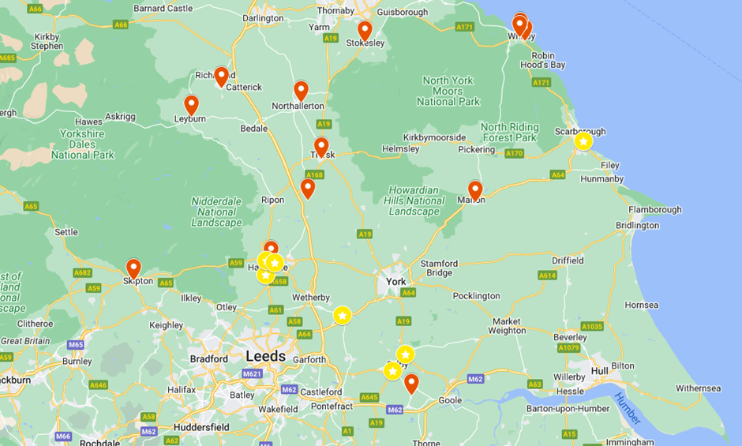
TMP update
TMPs are progressing- 112 places across the county (13 schools) and 12 schools at various stages of activity in the programme
Places are funded in line with High Needs funding guidance since 2021
Set up costs have been approx. £14k per place
The average funding for an 8-place provision is £136,000 per annum
Flexible places are funded at Band 6
All other places in line with EHCP Band
Additional support from ILMs, S&LT, EP and OT

Slide 6
Where do we need provision?
 | Primary |  | Secondary |  | C&I |  | SEMH
 | Current | Total required | Current | Total required | Current | Total required | Current | Total required
Ham/Rich | 3 | 3 | 2 | 2 | 3 | 3 | 2 | 2
Whitby | 2 | 3 | 1 | 2 | 2 | 2 | 1 | 3
Scarborough | 0 | 2 | 0 | 2 | 0 | 2 | 0 | 2
Ryedale | 1 | 2 | 0 | 1 | 1 | 1 | 0 | 2
HKR | 2 | 4 | 0 | 2 | 1 | 3 | 1 | 3
Selby | 0 | 2 | 1 | 3 | 1 | 3 | 0 | 2
Craven | 0 | 2 | 1 | 2 | 1 | 2 | 0 | 2

Slide 7
Recap - Local area partnership inspection
Plans, clear targets, Quality assurance of a ‘good plan’ | Leaders across the partnership should ensure that EHC plans consistently and accurately reflect the needs of children and young people. This includes updating information regularly and setting clear and measurable targets. The partnership should expedite their quality assurance systems, ensuring there is clarity from all partners on what a good quality EHC plan looks like in order to ensure that all plans are accurate and support children and young people’s needs and next steps effectively. | QA process being developed Work taking place alongside Digital EHCP project Increased support for SEND caseworkers
Exclusions and attendance | Leaders across the partnership should improve their planning and oversight of exclusions and attendance data for children and young people with SEND. The recently formed attendance alliance group, consisting of partners across education, health and social care, should use this data to intervene swiftly to help bring about improvements | Data shared with schools in November. An updated data set is being planned and will be followed by targeted conversation with relevant schools/trusts
Monitoring, strategy and plans | The local area partnership should develop systems to use data effectively so that they can identify gaps in service, monitor the impact of their strategies and put plans in place to meet the needs of all children and young people with SEND. | NYC data workshop has been held. SEND partnership are looking at data sharing approaches in order to streamline information and support monitoring capabilities
Transitions: education, health and care settings, PFA | Leaders across the partnership should work together to improve children and young people’s transitions across education, health and social care settings so that they are prepared for adulthood well. | Adult and Children’s social care are refreshing the transition arrangements DBV pilot has considered N-R and Y6-Y7 education transitions but not Y11→ this will need to be reviewed

Slide 8
SWR
? Increase in ask to complete autism referrals
?how are these to complete?
?where is the ask coming from?

Slide 9
SEND Assessment Team Updates

Slide 10
Team Staffing Arrangements
Interim arrangements continue to be in place:
AD Inclusion- Amanda Newbold
Head of SEND- Chris Reynolds covering Charlie Lowe
Current Team Vacancies:
South Team Manager
Assistant Caseworkers x3 (North, South and West)
Recent Recruitment
Caitlin Atkinson recently joined Selby team as Assistant Casework Officer
Assistant Casework Officers for Scarborough, Whitby, Ryedale and Ham Rich (Not yet in post)

Slide 11
Phased Transfers Update
Yr. Group | Number of Students | Preference received | EHCP named for Sept 25 | Current Position
Yr6 | 337 | 313 | 326 | 97%
Nursery2 | 67 | 59 | 63 | 94%
Yr2 | 4 | 3 | 4 | 100%
Yr 11 | 397 | 355 | 176 | 44%
Yr 14 | 272 | 59 | 80 | 29%

Slide 12
Headlines
Higher number of EHC plans issued (800+) in 2024 than in 2023 (675)
Highest proportion (34%) issued for Autism
Increasing trend in EHC plans issued for SLCN and SEMH
Approx. 1100 requests for assessment in 2024 with 75% resulting in a plan
Currently 5500 North Yorkshire funded EHC plans
  +12% on the 4900 at the same point last year
Highest proportion currently for Autism (39%)

Slide 13
Service Priorities
Previous feedback from SENCO’s and stakeholders have been considered. Following are the services immediate priorities:
Digital EHCP (Full review of processes, documentation and formal communications)
Recruitment and retention to aid caseload stability
Induction and ongoing CPD programme for all SEND Assessment posts
Improving Communication
Statutory Performance measures

Slide 14
Hambleton/Richmondshire hub

Slide 15
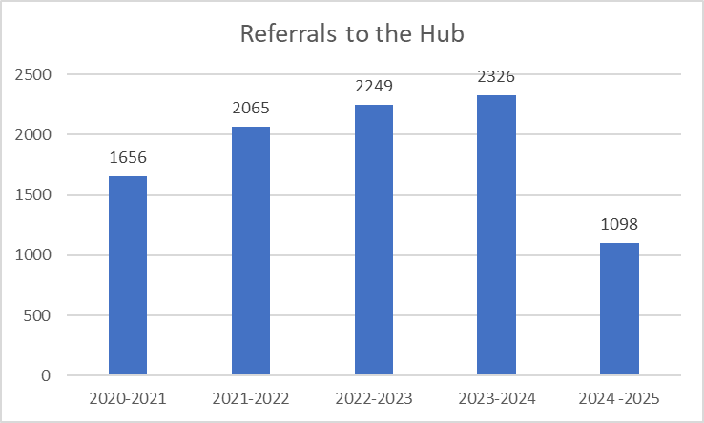
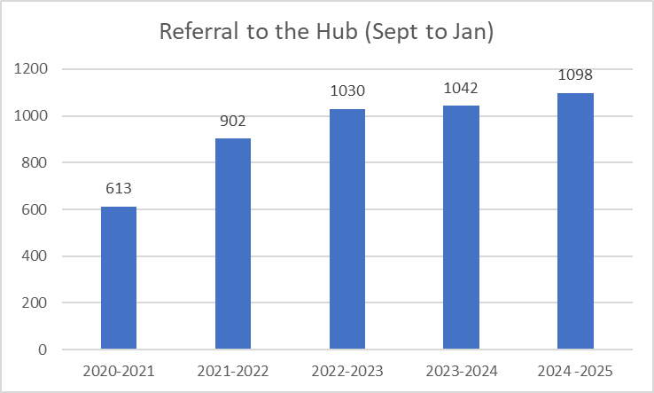
Caseload numbers
The total caseload of SEND hubs has continued to increase over the last 4 years, going from 1656 a year to 2326 in 2023-24, a 40% increase.
There has also been an increase in the number of referrals in the same period each year (from Sep to Jan), from 613 in 2020/21 to 1098 in 2024/25, which is a 79% increase in referrals since 2020.

Slide 16
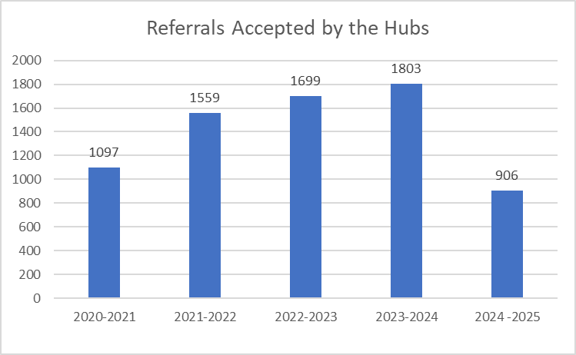
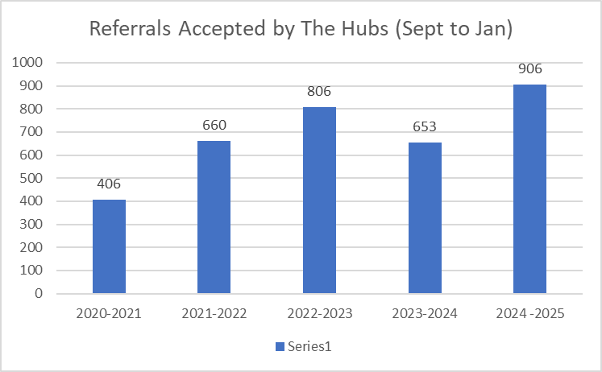
Referrals accepted
The total caseload accepted by SEND hubs has continued to increase over the last 4 years, going from 1097 a year to 1803 in 2023-24, a 64% increase.
There has also been an increase in the number of referrals in the same period each year (from Sep to Jan), from 406 in 2020/21 to 906 in 2024/25, which is a 123% increase in referrals since 2020.
The Hub's have accepted 75% of all referrals. The 25% of referrals declined are still predominantly because of insufficient information provided.

Slide 17
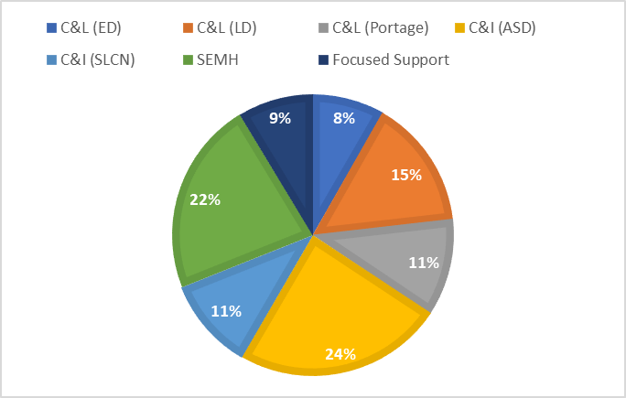
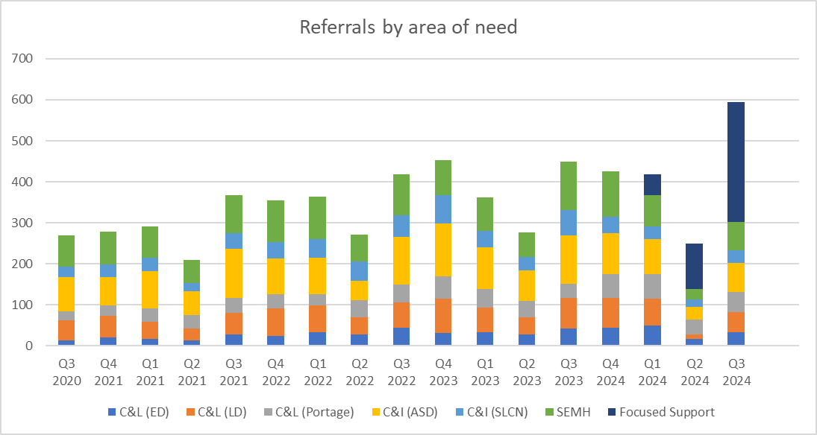
Referrals accepted by areas of need
The biggest demand for support since the Hub opened has been for Communication and Interaction (ASC) and for Social, Emotional and Mental Health Support.

Slide 18
Focused Support Model
Focused Support pilot- Initial launch April 2024, with full take up Sept 2024.
The concept behind Focused Support is the use of a relational approach by which all schools are allocated a FS Partner to jointly plan a schedule of support (and challenge!) through a number of allocated sessions across the school year.

Slide 19
Focused Support
•Since April 2024 The Hubs have been trialling a new way of working which provided an additional element of support to schools called School Focused Support.
•Each school will have a named School Focused Inclusion Partner who will have made regular visits to your school.
•The number of visits your school were offered depended on the size of school, SEN needs within your school and numbers of children who have been permanently excluded.
• The aim was to Jointly set priorities for your school around SEN and look at ways that these priorities could be addressed.
• This may have included:
direct support for individual children
Support on setting up SEN systems and processes, running reviews,EHCP processes and paperwork
Provision mapping
CPD Planning
Bespoke training opportunties – learning walks, solution focused support, targeted observations

Slide 20
Additional options offered to supplement the core offer.
Learning Walk in partnership with HT and SENCO with a jointly agreed focus (1.5 hours) | Solution Circle to support action planning in response to an identified area of focus (1.5 hours) | Coaching Conversation to support school staff to develop greater confidence in addressing an identified need (1.5 hours) | Joint Classroom observation with a key focus re provision and resources ( 1.5 hours) | Right place, Right support, Right Time Individual pupil review Screening Tools (1.5 hours)
Provision Mapping Review to explore how resources are allocated and mapped and impact measured Intervention impact Interventions available (1.5 hours) | What is ordinarily available in our school? QFT Curriculum and teaching adaptations Reasonable adjustments (1.5 hours) | Go –To Guidance and support in understanding of available external support across LAP ( Local Area Partnership) and referral criterial. Using the I Thrive model (1.5 hours) | Meeting the range of needs seen in the classrooms of today. Reasonable adjustments Assistive technology Curriculum adaptations (1.5 hours) | Money Matters What we get How we get How we use effectively (1.5 hours)
EHCAR and SEN response work Next steps following decision not to assess or not to issue an EHCP | Our no 1 resource How we feel Audit staff skill set Mapping CPD Matching skills to challenges / next steps / planning ahead (3 hours) | Culture, Ethos and Values Behaviour Attendance Engagement Policy Training Implementation (3 hour) | Needs response discussion “famous five” What we see and what we have done so far SO what can we do next. (3 hours) | Environmental Audit Sensory Social Physical

Slide 21
Feedback from SENCO's at the last SENCO Network Session
I have loved having mine and I want more of her and more access AND for it not to end in April!
Feedback- great in theory - please stop adding unnecessary paperwork to these visits, asking schools for data that they already have and make no difference...
Hub contact is amazing! Very helpful, seen her several times and she has been great. Thank you –had my first meeting and it's been very helpful, thanks
It has been amazing to get support so quickly and having a named point of contact. There has been high impact with the support in school supporting staff and children. This is a high impact service!
My focused SEND Hub support worker has been fantastic - she
has kept me going when I could have easily given up.

Slide 22
Having a named point of contact is fantastic. She is so responsive and a goldmine of advice!
Really useful - lovely to have a link between school and the SEN Hub - advice has been great! Really useful - lovely to have a link between school and the SEN Hub - advice has been great!
Focused support has been absolutely fantastic and very useful, especially as a new Senco. Invaluable support and advice, and having a named person that I can contact is brilliant.
Good to have a named contact for the school. Very useful documentation to support EHCARs
Having someone to speak to face to face that can spend time getting to know our school context and the needs of not only our school but also me as a new SENCo. They have been fantastic so far, really knowledgeable and supportive.

Slide 23
And some concerns.....
We've found that our focused support contact has limited availability due to statutory work and involvement in exclusion panels. This has made it really difficult to find time to meet.
Due to sickness, we have not had any visits since October half term.
We were told who our IP /FSP was in summer and then it was changed in September, meeting her in October so we will only get her until Easter - only 6 months. She has been helpful so far in what she has suggested/offered but it's taking time and am a bit concerned about how much help we'll get in that short time.
Intial visits idnetified focuses and planning - Autumn term- I expected direct work with children. Due to absence this was not done, discussion around what we had done since her last visit, discussed new high needs intake in reception and promised focused support referral l for three children. We toured the classrooms. Due to sickness this was our last visit. Sadly, I feel we gained nothing from the project. We have now had a follow up meeting with the hub Manager which was very productive and we now feel we are moving forwards.

Slide 24

Locality Board
VERBO – Early Years Project - Verbo is an online speech and language therapy (SaLT) toolkit to support education staff working with children fromage 2 to post-16. Verbo upskills and empowers education professionals enabling them to provide SaLT support for all children in their setting. It supports high quality practice with the hope that every child in your setting has the opportunity to maximise their communication potential at the right time without the barriers of staff resourcing or lack of expertise.
SEMH – Relational Approaches – now being led by Alison Keane. Funding for training has now been allocated by for information about the support networt meetings please contact Alison on Alison.Keane@dalesmat.org
GREAT TEACHING TOOLKIT – sign up is now closed but there may be some opportunity as schools who haven’t used their licences will be transferred to other schools.
For more information please contact localityboards@northyorks.gov.uk

Slide 25
Staffing in Ham / Rich Hub
Cognition & Learning:
Specialist Teacher (LD) - Sharon Leonard & Abigail Savage (from April 2025)
Specialist Practitioner (LD) - Victoria Julian
Specialist Teacher (ED) - Elizabeth Fawcett
Portage Practitioner - Sue Hutchinson, Jill Hetherington & Leanne Wainwright
Communication & Interaction:
Specialist Teacher (ASC) - Alison Smith
Specialist Practitioner (ASC) - Mandy Ewers & Claire Forth
SLCN Specialist - Charley Thickett (currently on maternity leave)
Speech and Language Therapist - vacancy
Speech and Language Therapy Assistant - Liz Wilson & Rachael Hussein
Social, Emotional and Mental Health:
SEMH Specialist - Gill Pritchard-Jenkins & Janina Guthrie
SEMH Specialist Practitioner - Gabriella Camerota, Clare Burrows, Stephanie Siddaway & Abigail Sanderson
School Focused Support: (until end of Spring Term 2025)
Mary White & Abigail Savage

Slide 26
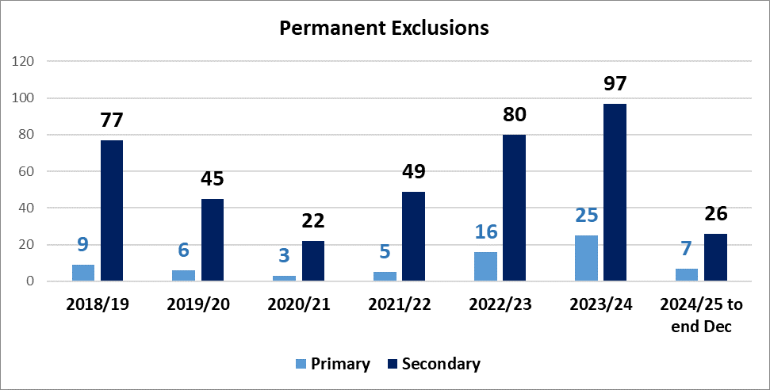
Exclusions from schools – Permanent Exclusions
School Population Permanently Excluded
39 permanent exclusions from North Yorkshire mainstream schools in 2024/25 academic year to the end of December. This compares with 52 in the same point of 2023/24.
Overall, children permanently excluded from secondary schools increased from 79 in 2022/23 to 97 in 2023/24 (+23%)
  The increase in primary schools was 56% (16 in 2022/23 to 25 in 2023/24)
The North Yorkshire average for children permanently excluded as a % of the secondary school population is 0.26% in 2023/24. Up from 0.21% in 2022/23.
  Hambleton & Richmondshire (0.37%), Selby (0.36%) and Scarborough & Ryedale (0.32%) locality board areas have been above the North Yorkshire average for secondary schools
The North Yorkshire average for children permanently excluded as a % of the primary school population was 0.06% in 2023/24. Up from 0.04% in 2022/23
  The rate for Scarborough & Ryedale locality board area in 2023/24 was 0.12% and Hambleton & Richmondshire locality board area was 0.09%.
Actions/Future Outcomes
Rates of exclusion appear to be slowing down marginally this year
Children Permanently Excluded – 2023/24
 | Primary Schools |  | Secondary Schools
Locality Board Areas | Total | %NoR | Total | %NoR
Craven | 2 | 0.05% | 3 | 0.06%
Hambleton and Richmondshire | 9 | 0.09% | 27 | 0.37%
Harrogate | 1 | 0.01% | 21 | 0.19%
Scarborough and Ryedale | 13 | 0.12% | 27 | 0.32%
Selby | 0 | 0.00% | 19 | 0.36%
NYC | 25 | 0.06% | 97 | 0.26%
Notes:
Rising tide of school absences and 'lost learning' addressed | North Yorkshire Council

Slide 27
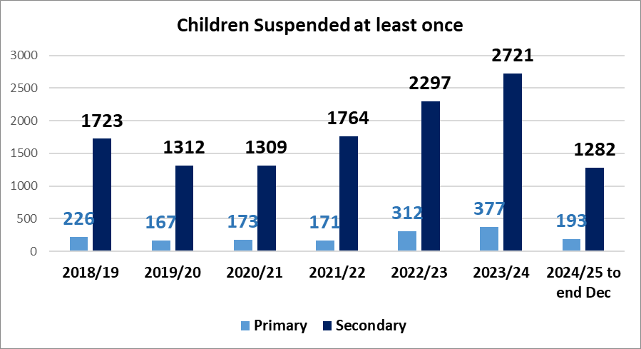
Exclusions from schools – Suspensions
School Population suspended at least once
A total of 1475 children have been suspended at least once from North Yorkshire mainstream schools in 2024/25, there were 1599 in the same period of 2023/24
Overall children suspended at least once from secondary schools increased from 2336 in 2022/23 to 2721 in 2023/24 (+16%)
  The increase in primary schools was 18% (377 in 2023/24)
% of School Population
The North Yorkshire average for children suspended at least once as a % of the secondary school population is 7.3% in 2023/24. Up from 6.3% in 2022/23.
  Both Scarborough & Ryedale (9.6%) and Hambleton & Richmondshire (9.6%) locality board area have consistently been above the North Yorkshire average for secondary schools
The North Yorkshire average for children suspended at least once as a % of the primary school population was 0.86% in 2023/24. Up from 0.71%.
  The rate for Scarborough & Ryedale locality board area in 2023/24 was 1.17%
Children Suspended at least once – 2023/24
 | Primary Schools |  | Secondary Schools
Locality Board Areas | Total | %NoR | Total | %NoR
Craven | 27 | 0.66% | 193 | 3.75%
Hambleton and Richmondshire | 78 | 0.78% | 701 | 9.63%
Harrogate | 77 | 0.69% | 591 | 5.27%
Scarborough and Ryedale | 129 | 1.17% | 809 | 9.64%
Selby | 66 | 0.86% | 427 | 8.10%
NYC | 377 | 0.86% | 2721 | 7.27%

Slide 28
Scarborough, Whitby & Ryedale hub

Slide 29
Scarborough, Whitby & Ryedale Hub
The SWR hub team is a well established part of your schools now. Since 2020 we have had referrals from every school in the locality for children with a wide variety of needs.
Our work enables the children to access their full entitlement to learning and helps schools move away from part time timetables.
Referrals often quote previous advice that has been received and clearly benefited school practice which helps us identify next steps for a starting point.
Portage and EDST support is often requested showing that, as an area, we are hopefully getting in at the earliest opportunity. It’s great when a referral comes in a couple of years later when a child is at a new stage of schooling but you can really see that embedded long term provision has threaded through.
Due to statutory demand we have constant pressure on the SEMH team but as a hub, all staff are involved in all aspects.

Slide 30
SWR Inclusion Hub Staff
Hub Manager – Helen Hodgson
Focused Support Specialist Teacher – Jess Maiden
SLCN Specialist – Helen Hunter
Speech and Language Therapist – Amancay Topping
SLT Assistants – Zoe Green and Charlotte McIntyre
C&I Specialist Teacher – Callum Foster and Katy Andrews
C&I Specialist Practitioners – Suzy Coon and Debbie Myers
SEMH Specialist – Emma Allison
Exclusions Officer – Julie Barber
SEMH Specialist Practitioner – Heidi Milson, Vicky Ellis Whitaker, Olivia Richards, Claire Malton, Hannah Bateman
Early Development Specialist Teacher– Tracy Johnson-Hughes, Stacey Gould
Portage – Patricia Shaw, Joanne Wharton, Laura Bolton
Specialist Teacher Learning Difficulties – Margaret Bostock & Pandora Watkins
C & L Specialist Practitioner – Sarah Cheetham

Slide 31
Caseload numbers
The total caseload of SEND hubs has continued to increase over the last 4 years, going from 1656 a year to 2326 in 2023-24, a 40% increase.
There has also been an increase in the number of referrals in the same period each year (from Sep to Jan), from 613 in 2020/21 to 1098 in 2024/25, which is a 79% increase in referrals since 2020.

Slide 32
Referrals accepted
The total caseload accepted by SEND hubs has continued to increase over the last 4 years, going from 1097 a year to 1803 in 2023-24, a 64% increase.
There has also been an increase in the number of referrals in the same period each year (from Sep to Jan), from 406 in 2020/21 to 906 in 2024/25, which is a 123% increase in referrals since 2020.
The Hub's have accepted 75% of all referrals. The 25% of referrals declined are still predominantly because of insufficient information provided.

Slide 33
Referrals accepted by areas of need
Across the LA the biggest demand for support since the Hub opened has been for Communication and Interaction (ASC) and for Social, Emotional and Mental Health Support. In SWR there is also a high number of referrals for EDST and Portage.
Schools often tick multiple needs but the allocation panel will decide the main area as a starting point

Slide 34
Referrals accepted by areas of need

Slide 35
School Focused Support
Focused Support pilot- Initial launch April 2024, with full take up Sept 2024.
The concept behind Focused Support is the use of a relational approach by which all schools are allocated a FS Partner to jointly plan a schedule of support (and challenge!) through a number of allocated sessions across the school year.

Slide 36
School Focused Support
Since April 2024, the Hubs have been trialling a new way of working which provided an additional element of support to schools called School Focused Support. This was given short term funding so will cease shortly but there has been a lot of learning and thank you for the feedback we’ve received.
Each school has a named School Focused Inclusion Partner who will have made regular visits to your school.
The number of visits your school were offered depended on the size of school, SEN needs within your school and numbers of children who have been permanently excluded.
The aim was to jointly set priorities for your school around SEN and look at ways that these priorities could be addressed. This may have included:
    Direct support for individual children
    Support on setting up SEN systems and processes, running reviews, EHCP processes and paperwork
    Provision mapping
    CPD Planning
    Bespoke training opportunities – learning walks, solution focused support, targeted observations

Slide 37
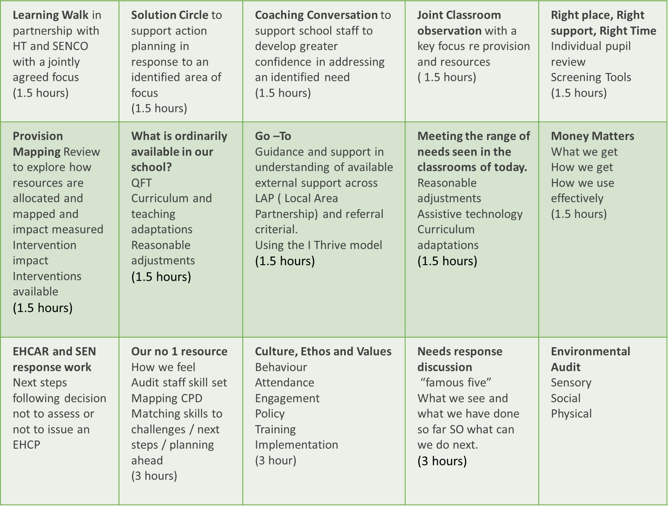
Additional options alongside core offer

Slide 38
Feedback from SENCO's at the last SENCO Network Session
I have loved having mine and I want more of her and more access AND for it not to end in April!
Feedback- great in theory - please stop adding unnecessary paperwork to these visits, asking schools for data that they already have and make no difference...
Hub contact is amazing! Very helpful, seen her several times and she has been great. Thank you –had my first meeting and it's been very helpful, thanks
It has been amazing to get support so quickly and having a named point of contact. There has been high impact with the support in school supporting staff and children. This is a high impact service!
My focused SEND Hub support worker has been fantastic - she has kept me going when I could have easily given up.

Slide 39
Having a named point of contact is fantastic. She is so responsive and a goldmine of advice!
Really useful - lovely to have a link between school and the SEN Hub - advice has been great! Really useful - lovely to have a link between school and the SEN Hub - advice has been great!
Focused support has been absolutely fantastic and very useful, especially as a new Senco. Invaluable support and advice, and having a named person that I can contact is brilliant.
Good to have a named contact for the school. Very useful documentation to support EHCARs
Having someone to speak to face to face that can spend time getting to know our school context and the needs of not only our school but also me as a new SENCo. They have been fantastic so far, really knowledgeable and supportive.

Slide 40
And some concerns.....
We've found that our focused support contact has limited availability due to statutory work and involvement in exclusion panels. This has made it really difficult to find time to meet.
Due to sickness, we have not had any visits since October half term.
We were told who our IP /FSP was in summer and then it was changed in September, meeting her in October so we will only get her until Easter - only 6 months. She has been helpful so far in what she has suggested/offered but it's taking time and am a bit concerned about how much help we'll get in that short time.
Intial visits identified focuses and planning - Autumn term- I expected direct work with children. Due to absence this was not done, discussion around what we had done since her last visit, discussed new high needs intake in reception and promised focused support referral l for three children. We toured the classrooms. Due to sickness this was our last visit. Sadly, I feel we gained nothing from the project. We have now had a follow up meeting with the hub Manager which was very productive and we now feel we are moving forwards.

Slide 41


Locality boards are a dynamic collaboration between education leaders and North Yorkshire Council. The five boards share the aim of maximising outcomes and promoting inclusivity for children and young people aged from 0-25 years old.
North Yorkshire Council allocates budgets to each board, enabling them to initiate projects tailored to the evolving needs of their communities.
To find out more about how your setting can benefit from the projects on offer, visit your locality board pages at https://localityboardsnorthyorks.co.uk and click on your area link

Slide 42

Locality representative
Christina Zanelli- Chairperson. CEO of the Yorkshire Endeavour Academy Trust and Headteacher Lealholm
Lesley Walsh - Vice Chair. Principal, George Pindar Academy
Rachel Wells - Headteacher, West Heslerton Primary School
Marianne Best - Headteacher, Welburn Hall Special School
Jo Fox - Headteacher, Scarborough PRS
Shaun Hopper - Headteacher, Northstead Primary School
Suzzanne Thompson – Childminder
Asheigh Raw - Head of Learning Services, Scarborough TEC
Sian Mitchell - Leavening Primary School
Helen Thompson - Headteacher, Heritage Coast Federation
Claire Barber – Headteacher, St Martins CofE Primary School

Slide 43


Locality Board Support Offer

Slide 44


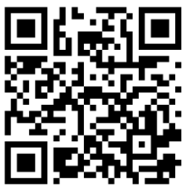
All schools in North Yorkshire have access to Verbo
Every Wednesday 12 -12.30pm
Verbo Live Q & A
Join a live workshop with one of our speech and language therapists where we will answer any questions you may have about the Verbo platform or supporting your pupils with their communication skills.
Verbo Workshops
There are a number of free workshops bookable via the Verbo Website. These include exploring the content, workshops for supporting parents and guest speakers. Follow the QR code to book a slot on wither the Verbo Live or a workshop!

Slide 45
School Exclusions – Permanent Exclusion
There are already 39 permanent exclusions from North Yorkshire mainstream schools in 2024/25 academic year to the end of December.
Overall, children permanently excluded from secondary schools increased from 79 in 2022/23 to 97 in 2023/24 (+23%)
The increase in primary schools was 56% (16 in 2022/23 to 25 in 2023/24)
The North Yorkshire average for children permanently excluded as a % of the secondary school population is 0.26% in 2023/24. Up from 0.21% in 2022/23.
Hambleton & Richmondshire (0.37%), Selby (0.36%) and Scarborough & Ryedale (0.32%) locality board areas have been above the North Yorkshire average for secondary schools
The North Yorkshire average for children permanently excluded as a % of the primary school population was 0.06% in 2023/24. Up from 0.04% in 2022/23
The rate for Scarborough & Ryedale locality in 2023/24 was 0.12% and Hambleton & Richmondshire locality was 0.09%.

Slide 46
Exclusion data sets
 | Primary Schools |  | Secondary Schools
Locality | Total | %NoR | Total | %NoR
Craven | 2 | 0.05% | 3 | 0.06%
Hambleton and Richmondshire | 9 | 0.09% | 27 | 0.37%
Harrogate | 1 | 0.01% | 21 | 0.19%
Scarborough and Ryedale | 13 | 0.12% | 27 | 0.32%
Selby | 0 | 0.00% | 19 | 0.36%
NYC | 25 | 0.06% | 97 | 0.26%

Slide 47
Fixed term Exclusions - suspensions
Throughout 2023 to 2024:
There were 10,169 incidences of suspension which totalled 19,600 days of lost learning in our schools last academic year
3,163 pupils were suspended from NY schools
378 from primary school,
2,721 from secondary school,
49 from special school
46 from PRUs
309 had an EHCP
945 had identified SEND
38 were Looked After Children

Slide 48
School population suspended at least once
A total of 1475 children have been suspended at least once from North Yorkshire mainstream schools in 2024/25, there were 1599 in the same period of 2023/24
Overall children suspended at least once from secondary schools increased from 2336 in 2022/23 to 2721 in 2023/24 (+16%)
The increase in primary schools was 18% (377 in 2023/24)

Slide 49
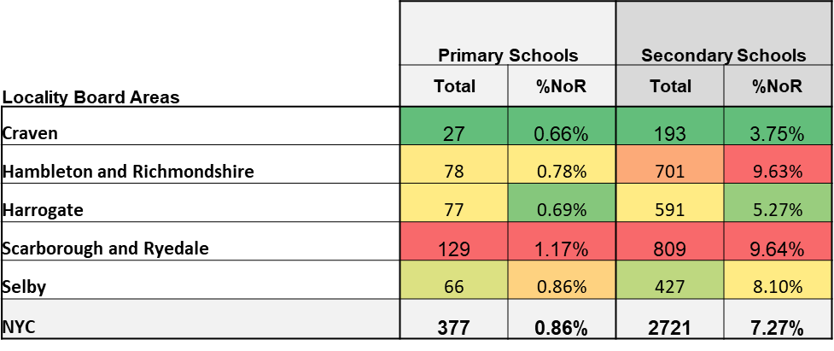
% of school population
The North Yorkshire average for children suspended at least once as a % of the secondary school population is 7.3% in 2023/24. Up from 6.3% in 2022/23.
Both Scarborough, Whitby & Ryedale (9.6%) and Hambleton & Richmondshire (9.6%) locality have consistently been above the North Yorkshire average for secondary schools
The North Yorkshire average for children suspended at least once as a % of the primary school population was 0.86% in 2023/24. Up from 0.71%.
The rate for Scarborough & Ryedale locality in 2023/24 was 1.17%

Slide 50
Contacts and further info
Hub Manager Helen Hodgson
Helen.Hodgson@northyorks.gov.uk
01609 798577
Admin
NYSENDHubs@northyorks.gov.uk
Hub Handbook is on NYES website under SEN as are the ones for all other areas and we update termly.

Slide 51

Harrogate, Ripon, Knaresborough and Craven Hub

Slide 52
Harrogate, Ripon, Knaresborough and Craven Hub
Since the hubs were established in 2020, we've seen many changes, but our current Hub Team includes the following wonderful people:
Cognition & Learning:
Specialist Teacher (LD) - Elisabeth Graham Bell
Specialist Practitioner (LD) - Mary White
Specialist Teacher (ED) - Lorayne Farrington
Portage Practitioner - Michelle Smith, Anna Grant & Bethan Benfield
Communication & Interaction:
Specialist Teacher (C&I) - Alison Stewart, Helen Sturt, Julia Stega.
Specialist Practitioner (C&I) - Jo Deaton, Tracy Ashton and Judith Farrar.
SLCN Specialist - Jo Collett
Speech and Language Therapist - Kirsty Voice
Speech and Language Therapy Assistant – Carol Moxon & Catherine Baranyai
Social, Emotional and Mental Health:
SEMH Specialist - Laura Henry
SEMH Specialist Practitioner - Jodie Elliot, Stephanie Allport, Jo Barnard & Amie Whitfield.
School Focused Support: (until end of Spring Term 2025)
Frances Andrews, Laura Bye & Rebecca Rocks

Slide 53
Caseload numbers
The total caseload of SEND hubs has continued to increase over the last 4 years, going from 1656 a year to 2326 in 2023-24, a 40% increase.
There has also been an increase in the number of referrals in the same period each year (from Sep to Jan), from 613 in 2020/21 to 1098 in 2024/25, which is a 79% increase in referrals since 2020.

Slide 54
Referrals accepted
The total caseload accepted by SEND hubs has continued to increase over the last 4 years, going from 1097 a year to 1803 in 2023-24, a 64% increase.
There has also been an increase in the number of referrals in the same period each year (from Sep to Jan), from 406 in 2020/21 to 906 in 2024/25, which is a 123% increase in referrals since 2020.
The Hubs have accepted 75% of all referrals. The 25% of referrals declined are still predominantly because of insufficient information provided.

Slide 55
Referrals accepted by areas of need
The biggest demand for support since the Hub opened has been for Communication and Interaction (ASC) and for Social, Emotional and Mental Health Support.

Slide 56

Focused Support Modell
Focused Support pilot- Initial launch April 2024, with full take up Sept 2024.
The concept behind Focused Support is the use of a relational approach by which all schools are allocated a FS Partner to jointly plan a schedule of support (and challenge!) through a number of allocated sessions across the school year.

Slide 57
Focused Support
•Since April 2024, The Hubs have been trialling the new way of working which provided an additional element of support to schools called School Focused Support.
•Each school will have had a named School Focused Inclusion Partner who will have made regular visits to your school.
•The number of visits your school were offered depended on the size of school, SEN needs within your school and numbers of children who have been permanently excluded.
• The aim was to Jointly set priorities for your school around SEN and look at ways that these priorities could be addressed.
• This may have included:
Direct support for individual children
Support on setting up SEN systems and processes, running reviews, EHCP processes and paperwork
Provision mapping
CPD Planning
Bespoke training opportunities – learning walks, solution focused support, targeted observations.

Slide 58
Additional options offered to supplement the core offer.
Learning Walk in partnership with HT and SENCO with a jointly agreed focus (1.5 hours) | Solution Circle to support action planning in response to an identified area of focus (1.5 hours) | Coaching Conversation to support school staff to develop greater confidence in addressing an identified need (1.5 hours) | Joint Classroom observation with a key focus re provision and resources ( 1.5 hours) | Right place, Right support, Right Time Individual pupil review Screening Tools (1.5 hours)
Provision Mapping Review to explore how resources are allocated and mapped and impact measured Intervention impact Interventions available (1.5 hours) | What is ordinarily available in our school? QFT Curriculum and teaching adaptations Reasonable adjustments (1.5 hours) | Go –To Guidance and support in understanding of available external support across LAP ( Local Area Partnership) and referral criteria. Using the I Thrive model (1.5 hours) | Meeting the range of needs seen in the classrooms of today. Reasonable adjustments Assistive technology Curriculum adaptations (1.5 hours) | Money Matters What we get How we get How we use effectively (1.5 hours)
EHCAR and SEN response work Next steps following decision not to assess or not to issue an EHCP | Our no 1 resource How we feel Audit staff skill set Mapping CPD Matching skills to challenges / next steps / planning ahead (3 hours) | Culture, Ethos and Values Behaviour Attendance Engagement Policy Training Implementation (3 hour) | Needs response discussion “famous five” What we see and what we have done so far SO what can we do next. (3 hours) | Environmental Audit Sensory Social Physical

Slide 59

Feedback from SENCOs at the last SENCO Network Session
I have loved having mine and I want more of her and more access AND for it not to end in April!
Feedback- great in theory - please stop adding unnecessary paperwork to these visits, asking schools for data that they already have and make no difference...
Hub contact is amazing! Very helpful, seen her several times and she has been great. Thank you –had my first meeting and it's been very helpful, thanks
It has been amazing to get support so quickly and having a named point of contact. There has been high impact with the support in school supporting staff and children. This is a high impact service!
My focused SEND Hub support worker has been fantastic - she has kept me going when I could have easily given up.

Slide 60
Feedback from SENCOs at the last SENCO Network Session
Having a named point of contact is fantastic. She is so responsive and a goldmine of advice!
Really useful - lovely to have a link between school and the SEN Hub - advice has been great! Really useful - lovely to have a link between school and the SEN Hub - advice has been great!
Focused support has been absolutely fantastic and very useful, especially as a new Senco. Invaluable support and advice and having a named person that I can contact is brilliant.
Good to have a named contact for the school. Very useful documentation to support EHCARs
Having someone to speak to face to face that can spend time getting to know our school context and the needs of not only our school but also me as a new SENCo. They have been fantastic so far, really knowledgeable and supportive.

Slide 61
Feedback from SENCOs at the last SENCO Network Session
And some concerns.....
We've found that our focused support contact has limited availability due to statutory work and involvement in exclusion panels. This has made it really difficult to find time to meet.
Due to sickness, we have not had any visits since October half term.
We were told who our IP /FSP was in summer and then it was changed in September, meeting her in October so we will only get her until Easter - only 6 months. She has been helpful so far in what she has suggested/offered but it's taking time and am a bit concerned about how much help we'll get in that short time.
Initial visits identified focuses and planning - Autumn term- I expected direct work with children. Due to absence this was not done, discussion around what we had done since her last visit, discussed new high needs intake in reception and promised focused support referral for three children. We toured the classrooms. Due to sickness this was our last visit. Sadly, I feel we gained nothing from the project. We have now had a follow up meeting with the hub Manager which was very productive, and we now feel we are moving forwards.

Slide 62

Moving forward............
The Focused Support offer was a pilot project made possible by having access to some short-term funding which has now ended.
There is currently ongoing work to establish what the overall Hub model will look like in the future and the learning from this pilot has been helpful in informing next steps.
Decisions will be made as to what support will look like as soon as possible, so watch this space......................

Slide 63
Exclusions from schools – Suspensions
School Population suspended at least once
A total of 1475 children have been suspended at least once from North Yorkshire mainstream schools in 2024/25, there were 1599 in the same period of 2023/24
Overall children suspended at least once from secondary schools increased from 2336 in 2022/23 to 2721 in 2023/24 (+16%)
  The increase in primary schools was 18% (377 in 2023/24)
% of School Population
The North Yorkshire average for children suspended at least once as a % of the secondary school population is 7.3% in 2023/24. Up from 6.3% in 2022/23.
  Both Scarborough & Ryedale (9.6%) and Hambleton & Richmondshire (9.6%) locality board area have consistently been above the North Yorkshire average for secondary schools
The North Yorkshire average for children suspended at least once as a % of the primary school population was 0.86% in 2023/24. Up from 0.71%.
  The rate for Scarborough & Ryedale locality board area in 2023/24 was 1.17%
Children Suspended at least once – 2023/24
 | Primary Schools |  | Secondary Schools
Locality Board Areas | Total | %NoR | Total | %NoR
Craven | 27 | 0.66% | 193 | 3.75%
Hambleton and Richmondshire | 78 | 0.78% | 701 | 9.63%
Harrogate | 77 | 0.69% | 591 | 5.27%
Scarborough and Ryedale | 129 | 1.17% | 809 | 9.64%
Selby | 66 | 0.86% | 427 | 8.10%
NYC | 377 | 0.86% | 2721 | 7.27%

Slide 64
Exclusions from schools – Permanent Exclusions
School Population Permanently Excluded
39 permanent exclusions from North Yorkshire mainstream schools in 2024/25 academic year to the end of December. This compares with 52 in the same point of 2023/24.
Overall, children permanently excluded from secondary schools increased from 79 in 2022/23 to 97 in 2023/24 (+23%)
  The increase in primary schools was 56% (16 in 2022/23 to 25 in 2023/24)
The North Yorkshire average for children permanently excluded as a % of the secondary school population is 0.26% in 2023/24. Up from 0.21% in 2022/23.
  Hambleton & Richmondshire (0.37%), Selby (0.36%) and Scarborough & Ryedale (0.32%) locality board areas have been above the North Yorkshire average for secondary schools
The North Yorkshire average for children permanently excluded as a % of the primary school population was 0.06% in 2023/24. Up from 0.04% in 2022/23
  The rate for Scarborough & Ryedale locality board area in 2023/24 was 0.12% and Hambleton & Richmondshire locality board area was 0.09%.
Actions/Future Outcomes
Rates of exclusion appear to be slowing down marginally this year
Children Permanently Excluded – 2023/24
 | Primary Schools |  | Secondary Schools
Locality Board Areas | Total | %NoR | Total | %NoR
Craven | 2 | 0.05% | 3 | 0.06%
Hambleton and Richmondshire | 9 | 0.09% | 27 | 0.37%
Harrogate | 1 | 0.01% | 21 | 0.19%
Scarborough and Ryedale | 13 | 0.12% | 27 | 0.32%
Selby | 0 | 0.00% | 19 | 0.36%
NYC | 25 | 0.06% | 97 | 0.26%
Notes:
Rising tide of school absences and 'lost learning' addressed | North Yorkshire Council

Slide 65


Locality
Boards
Home - Locality Boards
•Locality boards are a dynamic collaboration between education leaders and North Yorkshire Council. The five boards share the aim of maximising outcomes and promoting inclusivity for children and young people aged from 0-25 years old.
•North Yorkshire Council allocates budgets to each board, enabling them to initiate projects tailored to the evolving needs of their communities. To find out more about how your setting can benefit from the projects on offer, visit your locality board pages by clicking on their logo above.

Slide 66
All schools in North Yorkshire have access to Verbo
Every Wednesday 12 -12.30pm
Verbo Live Q & A
Join a live workshop with one of our speech and language therapists where we will answer any questions you may have about the Verbo platform or supporting your pupils with their communication skills.
Verbo Workshops
There are a number of free workshops bookable via the Verbo Website. These include exploring the content, workshops for supporting parents and guest speakers. Follow the QR code to book a slot on wither the Verbo Live or a workshop!

Slide 67
Locality Board - Harrogate
Knaresborough Ripon
Post-16 Pathways
Film about different post 16 pathways in HKR for students with an EHCP.
SEMH Project Inclusion Projects
Unlock a Brighter Future for Your School with Positive Regard Training and Consultancy.
Clicker
All primary schools in your area have access to Clicker – at the heart of Clicker sits a child-friendly word processor that offers extensive support to emergent, developing and struggling readers.
DocsPlus
All secondary schools in your area have access to DocsPlus – an award-winning literacy software that provides the support struggling students need to tackle writing tasks.

Slide 68

Interoception Network Meeting
Next meeting:
Tuesday 17th June 2025 4pm – 5pm
Venue: TBC
If you do not have the pdf files of resources that support the delivery of the curriculum, please email:
Katie.Middleton@northyorks.gov.uk

Slide 69
Locality Board - Craven
Tracy Hansen Outreach SENCO
Schools can contact me directly via email or telephone for an initial discussion and to set a date for me to visit. t.hansen@skipton.mlt.co.uk 01756 702537
VERBO – Early Years Project
Verbo is an online speech and language therapy (SaLT) toolkit to support education staff working with children fromage 2 to post-16.
Clicker
All primary schools in your area have access to Clicker – at the heart of Clicker sits a child-friendly word processor that offers extensive support to emergent, developing and struggling readers.
DocsPlus
All secondary schools in your area have access to DocsPlus – an award-winning literacy software that provides the support struggling students need to tackle writing tasks.

Slide 70


Primary Schools
Save the date… SixIntoSeven Drop-in Q&A session will take place at 3-4pm on Tuesday 11th March. The Customer services team will be on hand to answer any questions.
Secondary Schools
Save the date… SixIntoSeven Drop-in Q&A session will take place at 3-4pm on Thursday 3rd April. The Customer services team will be on hand to answer any questions.
Additional information:
SixIntoSeven Support: support@pupilpathways.com

Slide 71

Locality
Boards
FEEDBACK
We want to hear from you about whether you feel the projects you’ve been involved with were worthwhile. The information we gather helps us to improve the projects that we offer and to justify the work of the boards.
Every year we ask settings to complete a survey, the results will help to guide your Locality Board in their future priorities. We will let you know on our website and via email when the next survey is ready to complete.

Slide 72

Contacts and further info
Hub Manager – Amanda Millgate
Amanda.Millgate@northyorks.gov.uk
01609 533215
Business Support
NYSENDHubs@northyorks.gov.uk
Hub Handbook is on CYPS.info website under SEN as are the ones for all other areas and we update termly.

Slide 73
Selby Hub

Slide 74
Caseload numbers
The total caseload of SEND hubs has continued to increase over the last 4 years, going from 1656 a year to 2326 in 2023-24, a 40% increase.
There has also been an increase in the number of referrals in the same period each year (from Sep to Jan), from 613 in 2020/21 to 1098 in 2024/25, which is a 79% increase in referrals since 2020.

Slide 75
Referrals accepted
The total caseload accepted by SEND hubs has continued to increase over the last 4 years, going from 1097 a year to 1803 in 2023-24, a 64% increase.
There has also been an increase in the number of referrals in the same period each year (from Sep to Jan), from 406 in 2020/21 to 906 in 2024/25, which is a 123% increase in referrals since 2020.
The Hub's have accepted 75% of all referrals. The 25% of referrals declined are still predominantly because of insufficient information provided.

Slide 76
Referrals accepted by areas of need
The biggest demand for support since the Hub opened has been for Communication and Interaction (ASC) and for
Social, Emotional and Mental Health Support.

Slide 77
Focused Support
•Since April 2024 The Hubs have been trialling a new way of working which provided an additional element of support to schools called School Focused Support.
•Each school will have a named School Focused Inclusion Partner who will have made regular visits to your school. In the Selby Locality some schools have sadly not had the number of visits or level of support of other schools due to the absence of one of the Focused Support Partners, who has recently left this post following a long period of absence. This has not been ideal.
•The number of visits your school were offered depended on the size of school, SEN needs within your school and numbers of children who have been permanently excluded.
• The aim was to Jointly set priorities for your school around SEN and look at ways that these priorities could be addressed. This may have included:
direct support for individual children
Support on setting up SEN systems and processes, running reviews, EHCP processes and paperwork
Provision mapping
CPD Planning
Bespoke training opportunities – learning walks, solution focused support, targeted observations

Slide 78
Additional options offered to supplement the core offer.
Learning Walk in partnership with HT and SENCO with a jointly agreed focus (1.5 hours) | Solution Circle to support action planning in response to an identified area of focus (1.5 hours) | Coaching Conversation to support school staff to develop greater confidence in addressing an identified need (1.5 hours) | Joint Classroom observation with a key focus re provision and resources ( 1.5 hours) | Right place, Right support, Right Time Individual pupil review Screening Tools (1.5 hours)
Provision Mapping Review to explore how resources are allocated and mapped and impact measured Intervention impact Interventions available (1.5 hours) | What is ordinarily available in our school? QFT Curriculum and teaching adaptations Reasonable adjustments (1.5 hours) | Go –To Guidance and support in understanding of available external support across LAP ( Local Area Partnership) and referral criterial. Using the I Thrive model (1.5 hours) | Meeting the range of needs seen in the classrooms of today. Reasonable adjustments Assistive technology Curriculum adaptations (1.5 hours) | Money Matters What we get How we get How we use effectively (1.5 hours)
EHCAR and SEN response work Next steps following decision not to assess or not to issue an EHCP | Our no 1 resource How we feel Audit staff skill set Mapping CPD Matching skills to challenges / next steps / planning ahead (3 hours) | Culture, Ethos and Values Behaviour Attendance Engagement Policy Training Implementation (3 hour) | Needs response discussion “famous five” What we see and what we have done so far SO what can we do next. (3 hours) | Environmental Audit Sensory Social Physical

Slide 79
Feedback from SENCO's at the last SENCO Network Session
I have loved having mine and I want more of her and more access AND for it not to end in April!
Feedback- great in theory - please stop adding unnecessary paperwork to these visits, asking schools for data that they already have and make no difference...
Hub contact is amazing! Very helpful, seen her several times and she has been great. Thank you –had my first meeting and it's been very helpful, thanks
It has been amazing to get support so quickly and having a named point of contact. There has been high impact with the support in school supporting staff and children. This is a high impact service!
My focused SEND Hub support worker has been fantastic - she
has kept me going when I could have easily given up.

Slide 80
Having a named point of contact is fantastic. She is so responsive and a goldmine of advice!
Really useful - lovely to have a link between school and the SEN Hub - advice has been great! Really useful - lovely to have a link between school and the SEN Hub - advice has been great!
Focused support has been absolutely fantastic and very useful, especially as a new Senco. Invaluable support and advice and having a named person that I can contact is brilliant.
Good to have a named contact for the school. Very useful documentation to support EHCARs
Having someone to speak to face to face that can spend time getting to know our school context and the needs of not only our school but also me as a new SENCo. They have been fantastic so far, really knowledgeable and supportive.
Feedback from SENCO's at the last SENCO Network Session

Slide 81
Feedback from SENCO's at the last SENCO Network Session
And some concerns.....
We've found that our focused support contact has limited availability due to statutory work and involvement in exclusion panels. This has made it difficult to find time to meet.
Due to sickness, we have not had any visits since October half term.
We were told who our IP /FSP was in summer and then it was changed in September, meeting her in October so we will only get her until Easter - only 6 months. She has been helpful so far in what she has suggested/offered but it's taking time and am a bit concerned about how much help we'll get in that short time.
Initial visits identified focuses and planning - Autumn term- I expected direct work with children. Due to absence this was not done, discussion around what we had done since her last visit, discussed new high needs intake in reception and promised focused support referral l for three children. We toured the classrooms. Due to sickness this was our last visit. Sadly, I feel we gained nothing from the project. We have now had a follow up meeting with the hub Manager which was very productive, and we now feel we are moving forwards.

Slide 82
Moving forward............
The Focused Support offer was a pilot project made possible by having access to some short-term funding which has now ended. ​
There is currently ongoing work to establish what the overall Hub model will look like in the future and the learning from this pilot has been helpful in informing next steps.​
Decisions will be made as to what support will look like as soon as possible, so watch this space......................
The Focused Support offer was a pilot project made possible by having access to some short-term funding which has now ended.
There is currently ongoing work to establish what the overall Hub model will look like in the future and the learning from this pilot has been helpful in informing next steps.
Decisions will be made as to what support will look like as soon as possible, so watch this space......................

Slide 83

Home - Locality Boards
Locality boards are a dynamic collaboration between education leaders and North Yorkshire Council. The five boards share the aim of maximising outcomes and promoting inclusivity for children and young people aged from 0-25 years old.
North Yorkshire Council allocates budgets to each board, enabling them to initiate projects tailored to the evolving needs of their communities. To find out more about how your setting can benefit from the projects on offer, visit your locality board pages by clicking on the link above.

Slide 84
Selby Locality Board - Offer
Locality Board Inclusion Lead – Sam Johnson – Has a role of supporting smoother transitions, helping to reduce exclusions and improving attendance. My work complements the other services provided by North Yorkshire Council. This p[ost runs from Sept 2024 until July 2026.
Below are the things Sam has worked on so far;
Relational Approach Network for Selby locality: where schools can meet regularly to support one another in developing their whole school relational approach.
‘A day in the life of a Year 7’: primary school students can attend a secondary school for a day and follow a Year 7.
Transition Networking meeting: bringing together Transition Leads, SENCos and teachers to develop communication.
Ambition Hub: This program, held one day a month for six months, is for Year 6 to Year 8 students. It promotes achievement, resilience, and teamwork through Outdoor Adventurous Activities, helping students develop new skills and positive mindsets.
Attendance project working in partnership with NHS’s ‘Integrated Neighbourhood Team’ with specific schools

Slide 85
SEMH Relational Approaches Project 2024/25 - The board would fund training costs in your chosen relational approach. Please note there is certain criteria for this training e.g. at least one member of SLT is to already be trained or can be trained in this offer.​ The board also require a commitment from your school to complete short impact surveys so that the effectiveness of the training can be reviewed.
Verbo Early Years, and Verbo - Verbo is an online speech and language therapy (SaLT) toolkit to support education staff working with children from
age 2 to post-16. Verbo upskills and empowers education professionals enabling them to provide SaLT support for all
children in their setting. It supports high quality practice with the hope that every child in your setting has the
opportunity to maximise their communication potential at the right time without the barriers of staff resourcing or
lack of expertise.

Slide 86

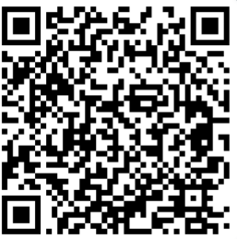
Selby Inclusion Lead
Sam Johnson is working on various inclusive initiatives in the Selby area including;
creating Relational Approach Network meetings
Ambition Hub
'A day in the life of a Year 7' transition events
See her webpage for more details and contact her
to get support or get involved.
Contact: sj@selbyhigh.co.uk

Slide 87
Selby Hub
The Selby Hub team currently has a number of pressures in relation to staffing.
Due to the DBV projects and the current review of the Hub model we are unable to recruit to a number of vacancies. This will soon be concluded.
There are vacancies and long-term absences within the C&I team, specifically the SLCN service. Apologies if you are waiting for support from members of this team. We will try and resolve this as soon as we can.
Please get in touch if you have any queries about the Hub, or need help to address any of the issues raised.
Hub Manager – kerry.chapman@northyorks.gov.uk

Slide 88
Selby Hub – staffing updates
Hub Manager – Kerry Chapman
Cognition & Learning:
•Specialist Teacher (LD) - Katie Heaven-Terry (part-time)
•Specialist Practitioner (LD) – Emma Gilmer
•Specialist Teacher (ED) - From April 2025 –Katie Heaven-Terry (part time)
•Portage Practitioners - Sally Carse, Sue Issatt
Communication & Interaction:
•Specialist Teacher (C&I) – Ellie Richards
•Specialist Practitioner (C&I) – Katie Collins, Helen Wright
•SLCN Specialist - Vacancy
•Speech and Language Therapist - Linda Dalgliesh
•Speech and Language Therapy Assistant – Vacancy
Social, Emotional and Mental Health:
•SEMH Specialist - Cameron Beattie
•SEMH Specialist Practitioner - Amelia Formstone, Charlotte Rowbotham, Jen Taylor
School Focused Support: (until end of Spring Term 2025)
•Rachel Spence. Kirsty Wilkinson has recently left her post.

Slide 89
Exclusions from schools – Permanent Exclusions
School Population Permanently Excluded
39 permanent exclusions from North Yorkshire mainstream schools in 2024/25 academic year to the end of December. This compares with 52 in the same point of 2023/24.
Overall, children permanently excluded from secondary schools increased from 79 in 2022/23 to 97 in 2023/24 (+23%)
The increase in primary schools was 56% (16 in 2022/23 to 25 in 2023/24)
The North Yorkshire average for children permanently excluded as a % of the secondary school population is 0.26% in 2023/24. Up from 0.21% in 2022/23.
Hambleton & Richmondshire (0.37%), Selby (0.36%) and Scarborough & Ryedale (0.32%) locality board areas have been above the North Yorkshire average for secondary schools
The North Yorkshire average for children permanently excluded as a % of the primary school population was 0.06% in 2023/24. Up from 0.04% in 2022/23
The rate for Scarborough & Ryedale locality board area in 2023/24 was 0.12% and Hambleton & Richmondshire locality board area was 0.09%.
Actions/Future Outcomes
Rates of exclusion appear to be slowing down marginally this year
Children Permanently Excluded – 2023/24
 | Primary Schools |  | Secondary Schools
Locality Board Areas | Total | %NoR | Total | %NoR
Craven | 2 | 0.05% | 3 | 0.06%
Hambleton and Richmondshire | 9 | 0.09% | 27 | 0.37%
Harrogate | 1 | 0.01% | 21 | 0.19%
Scarborough and Ryedale | 13 | 0.12% | 27 | 0.32%
Selby | 0 | 0.00% | 19 | 0.36%
NYC | 25 | 0.06% | 97 | 0.26%
Notes:
Rising tide of school absences and 'lost learning' addressed | North Yorkshire Council

Slide 90
Exclusions from schools – Suspensions
School Population suspended at least once
A total of 1475 children have been suspended at least once from North Yorkshire mainstream schools in 2024/25, there were 1599 in the same period of 2023/24
Overall children suspended at least once from secondary schools increased from 2336 in 2022/23 to 2721 in 2023/24 (+16%)
The increase in primary schools was 18% (377 in 2023/24)
% of School Population
The North Yorkshire average for children suspended at least once as a % of the secondary school population is 7.3% in 2023/24. Up from 6.3% in 2022/23.
Both Scarborough & Ryedale (9.6%) and Hambleton & Richmondshire (9.6%) locality board area have consistently been above the North Yorkshire average for secondary schools
The North Yorkshire average for children suspended at least once as a % of the primary school population was 0.86% in 2023/24. Up from 0.71%.
The rate for Scarborough & Ryedale locality board area in 2023/24 was 1.17%
Children Suspended at least once – 2023/24
 | Primary Schools |  | Secondary Schools
Locality Board Areas | Total | %NoR | Total | %NoR
Craven | 27 | 0.66% | 193 | 3.75%
Hambleton and Richmondshire | 78 | 0.78% | 701 | 9.63%
Harrogate | 77 | 0.69% | 591 | 5.27%
Scarborough and Ryedale | 129 | 1.17% | 809 | 9.64%
Selby | 66 | 0.86% | 427 | 8.10%
NYC | 377 | 0.86% | 2721 | 7.27%

Slide 91
All schools in North Yorkshire have access to Verbo
Every Wednesday 12 -12.30pm
Verbo Live Q & A
Join a live workshop with one of our speech and language therapists where we will answer any questions you may have about the Verbo platform or supporting your pupils with their communication skills.
Verbo Workshops
There are a number of free workshops bookable via the Verbo Website. These include exploring the content, workshops for supporting parents and guest speakers. Follow the QR code to book a slot on wither the Verbo Live or a workshop!

Slide 92

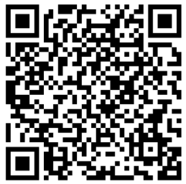
Relational Approach Support
Do you have concerns about behaviour in your school? Do you want support in choosing or embedding a relational approach?​
If so contact H&R LB's Relational Approach Co-ordinator who can offer bespoke support for your setting.
Contact: Alison.Keane@dalesmat.org
Watch out for further
projects on our project's
webpage

Slide 93
Selby Inclusion Lead
Sam Johnson is working on various inclusive initiatives in the Selby area including;
creating Relational Approach Network meetings
Ambition Hub
'A day in the life of a Year 7' transition events
See her webpage for more details and contact her
to get support or get involved.
Contact: sj@selbyhigh.co.uk

Slide 94


Topic: North Yorkshire Nurture Network
Time: Feb 12, 2025, 03:30 PM London
Join Zoom Meeting
https://eu01web.zoom.us/j/62552109689?pwd=Bt6TDUZAcspEJ9ch7wWuvpuEs6Wa2i.1
Meeting ID: 625 5210 9689
Passcode: 242860
Tonight!!!

Slide 95
Interoception Network Meeting
Next meeting:
Tuesday 17th June 2025 4pm – 5pm
Venue: TBC
If you do not have the pdf files of resources that support the delivery of the curriculum, please email:
Katie.Middleton@northyorks.gov.uk

Slide 96
Primary Schools
Save the date… SixIntoSeven Drop-in Q&A session will take place at 3-4pm on Tuesday 11th March. The Customer services team will be on hand to answer any questions.
Secondary Schools
Save the date… SixIntoSeven Drop-in Q&A session will take place at 3-4pm on Thursday 3rd April. The Customer services team will be on hand to answer any questions.
Additional information:
SixIntoSeven Support: support@pupilpathways.com

Slide 98
Educational Psychology Service
SENCo Networks
Dr Nicola O'Driscoll
Senior Educational Psychologist
25th February 2025

Slide 99

Educational Psychology Service Updates
Recruitment
  Internationally recruited EPs
  Assistant EPs
  Future Plans
Statutory Work
  Investment in locums - backlog EHC needs assessments cleared. Now working within the statutory 6-week deadline latest over 80% in time.
  Developing a process where NYEPs are involved in EHC advice for specific year groups.
  Some requests from the SEND team for NY EPs.

Slide 100


Building EP Service Delivery
Current offer
Build a more proactive offer
  Needs-led models – consultation/ joint problem solving
  Build skill and capacity within the workforce to meet the significant challenges in schools e.g. Attendance and engagement, engaging purposefully with trauma informed approaches.
  Specific cohorts
  Increasing connection in the area e.g. SEPs
  TMPs and DBV work
  Building proactive offer e.g. ELSA, consultations.
  Increased offer to EHC needs assessments.
Notes:
Thoughts on EP input at next SENCO network?

Slide 101


Senior Educational Psychologists –
By Area
Ed Sugden Ed.Sugden@northyorks.gov.uk; (Harr/Knares/Rip/Craven)
Nicola O’Driscoll Nicola.ODriscoll@northyorks.gov.uk; (Selby)
Pamela Melville Pamela.Melville@northyorks.gov.uk; (Scar/Whit/Ryedale)
Sharon Merle Lourd-Moyo Sharon.Lourd-Moyo@northyorks.gov.uk (Hamb/Rich)

Slide 102
DfE Funded DBV Project Updates
Inclusive Practice Framework
Transitions
Notes:
The project lifespan ends 31st March but the teams are very much still currently working.

Slide 103

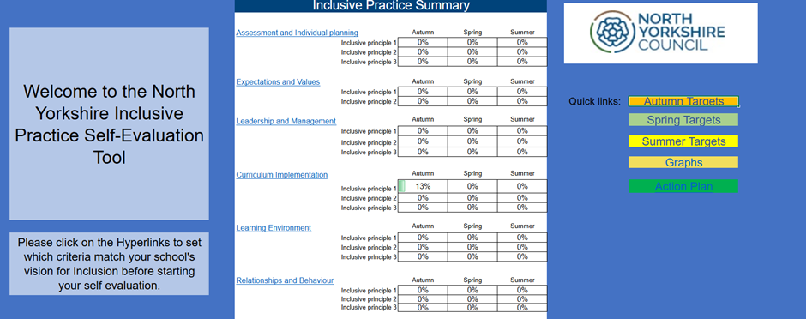
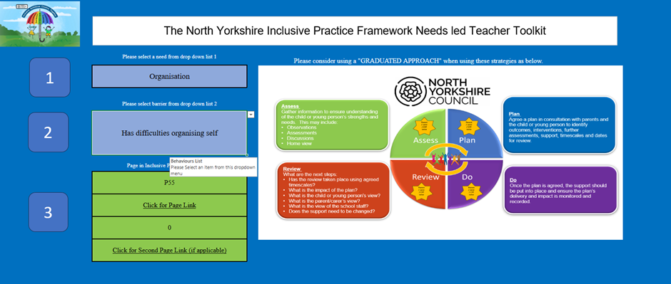
Inclusive Practice Framework
Thank You!
•
Notes:
I cannot thank you all enough. I know many of you in this room have either been involved at the very start helping to co construct the content or have volunteered to be a critical friend and have been sending us feedback about the framework and tools that we have developed.
Every piece of feedback is helping us to really ensure that it is the best it can be.
We have responded to feedback and made a number of improvements to the SE tool, The Inclusive Practice Framework. We have produced a Teacher toolkit, a how to guide and training webinars to support users.
We are working towards publication and also have the impending publication of the Ofsted Framework at the forefront of our minds and the fact that it will need editing once again.
The tools will be reviewed and refreshed to ensure they remain fit for purpose.
SE Tool- feedback has been very positive from all schools of all size and type.

Slide 104
Transitions Pilot Project
•Brief was to target phase transfers:
•30 N-R and 30 Y6-Y7
•48 schools are involved
•57 of the cohort continue to remain in mainstream.
•All have made progress
•All have had an offer of advice and targeted support from the team as a whole: Specialist teacher, Children and Families Worker and EP.
•A holistic approach around the child, which has included the family and school
•Feedback has been resoundingly positive.

Slide 105
Feedback from CYP
It will be a bummer when you leave
You have helped me to speak to the school about what I need
You have helped me to think about how to make friends
I know who can help me in school, I don't need you now
I am no longer worried.

Slide 106
Feedback from Parents
I feel you have lifted a burden I was putting on myself about making sure child was attending school in September and following a traditional route. You are right that it will be baby steps and it will all come together in the end.
I am not even thinking about specialist as I am so pleased with the provision that the school have put in place.
You have encouraged me to take a breath, and to work with here and now, and have helped me to see that it is ok to not have all the answers
The transition project has been invaluable helping us and school. It has really helped A and us transition easier

Slide 107
Feedback from Schools
I have enjoyed the process- the opportunity to reflect- it has been cathartic and thought provoking.
This has been well co-ordinated and joined up between professionals involved. I have felt well supported.
I think the key one for us was the relationship that they built with families. And to be that bridge between home and us.
The professional dialogue that has been really good for us.
The anxiety levels of staff have reduced and confidence has been boosted- staff know that they are making the right choice

Slide 108
Questions We Asked
•How well do your SEND transition arrangements support pupils to:
•Develop relationships with new peers and support social development
•Develop relationships with new adults
•Become familiar with new places eg new school building, bus routes
•Become familiar with new routines eg timetables, use of planners, tying a tie, organisational skills
•Have a positive end at their current school/ setting
•Develop understanding of skills and emotions related to “moving on” and support emotional wellbeing
Notes:
These questions led schools and settings that were involved start to think about their transitions arrangements and have already made alterations for their forthcoming transitions, particularly due to the social aspects as they recognised they were probably not doing enough to focus on that element and they wanted to really improve the way in which they built relationships between staff and children and the children themselves.

Slide 109
Transitions Guidance Document
•What do you think would be useful to have in a transitions guidance document?
•What elements do you find the most difficult to ensure a good transition
•What will support you as SENCOs and support your school?
•What resources would you like to see included?
•Would checklists be beneficial?
•Timelines?
Notes:
The guidance document will be an all age support tool.
We want this to support schools and settings with a focus on the needs of vulnerable pupils.
It will support us to build on all of the existing good transition practice across NYC.
To provide clarity around responsibilities, processes and strategies
To recognise transition as an intervention for children.
To establish a cycle of transition actions across a school year
Transitions is a process not an event and parents and CYP are listened to and valued as part of the process.
We know that enhanced transition arrangements will be needed for some children.

Slide 110
Reception- Year 1 Transition
•What do you do or could you do in your school to support the transition of children from Reception- Year 1?
•What have you tried that has been successful?
•What adaptations do you make to the “formal curriculum”?
•What do you think of the checklist that has been provided as an example?
Is it a useful tool? What else could be included?
Notes:
I apologise as this is a very specific question to Primary colleagues but secondary colleagues here today I want you to think about what you could recommend could be done.
Moving from reception (YR) into KS1 is a time of change and can be a source of both excitement and anxiety for children and for their parents/carers.
We do see a spike in terms of requests for EHCPs and specialist placements for those transitioning from reception to Year 1 and often paperwork will reference the formal curriculum.
We categorically as a LA want to ensure that children have access to the right provision at the right time with the right support but often the requests for specialist provision are not appropriate for the child and will limit their outcomes.
We do have parents contacting us at the hubs, particularly my Early Development Specialist teachers saying that they have been told by school that they should start looking at other provisions because their child can be managed in reception but not in Year 1.
I always find this interesting as I am a former teacher, deputy head and SENCO and I recognise the challenges on schools but I want to take this opportunity to look for ideas and solutions so what have you done in your school that has really helped and supported the CYP to continue to attend your setting- has it been consideration of grouping, changes to the environment, tools and resources to support, I know I never started Year 1 with any tables or chairs in the room bar 2 and then it would extend when they CYP was ready to sit at a table and for some that was all year, what have your transitions processes been?
We really want to build on the Education Endowment Foundation’s Putting Evidence to Work: A School’s Guide to Implementation, which supports schools in thinking about implementation processes

Slide 111
Introduction to
Parent Carer Voice North Yorkshire
February 2025

Slide 112
We are the recognised Parent Carer Forum for North Yorkshire, supporting families with children and young people (0-25 years old) with Special Educational Needs and/or Disabilities (SEND).
Notes:
The Parent Carer Forum for North Yorkshire is similar to other parent carer forums in other areas of the country. Some are independent and others are hosted by larger organisations as we are. There is also a national structure of parent carer forums and a regional Y&H group that PCV belongs to.
PCV is NOT a lobbying group or a campaign group.
PCV IS a group of people coming together who really want to have a positive influence on the support and services that are available to families with a child or children with SEND. Our core activity is the provision and circulation of information and connecting people to other people who can help.
working in partnership with parents, carers and all agencies, statutory and voluntary, to improve things in the long-run.

Slide 113
Our Mission
To listen and respond to the voice of family parent carers and carers of children with SEND across North Yorkshire by:
Co-ordinating and sharing information
Enabling mutual support
Facilitating parent carer interaction and communication
Developing and facilitating co-operative and influential partnerships; with the aim of working co-productively to improve support and services for families
We passionately believe in helping families to live their lives in the way they want to live them.
Notes:
We are a community, connecting families through shared information, experiences and mutual support. We know how isolating and confusing it can be to navigate services and family life with SEND, so we organise events and training across North Yorkshire and share information with the aim to inform and empower families. Every person who works for or volunteers with Parent Carer Voice is the parent or kinship carer or a child or young person with SEND.
We work together, using our collective voice for positive change. We work closely and co-productively with our strategic partners and service providers such as the Local Authority and ICBs to help improve services and support for families. North Yorkshire

Slide 114
How we work
Ensuring a good flow of information between the local authority/health and parents and carers (in both directions!).
Making sure the collective voices and lived experiences of parents and carers in North Yorkshire are heard and understood by professionals involved in designing or delivering services.
Connecting parents and carers to each other for mutual support and community building.
Signposting parents and carers to events, services and other people and organisations which can help and inform them.
Notes:
Collecting and representing the collective voices and lived experiences of Parents and Carers in consultations, service design processes etc with the LA and Health
Distributing information from the LA/Health about SEND services, activities and changes as widely as possible, and encouraging parents and carers to get involved

Slide 115
Our Current Work
Barriers to school engagement/attendance (BtSEA) project
(formerly Emotional Based School Avoidance)
Launch date - 03rd October 2024 at the ‘Inclusion Conference 2024’
Update - Jan/Feb 2025 North Yorkshire Council evaluating how to implement project outcomes into a new education offering
Parents’ voice videos for schools project
Video 1) Barriers to attending school
Video 2) How school rules, policies and practices affect neurodivergent children
Video 3) Working with parents and children to understand neurodiversity
Partnership for Inclusion of Neurodiversity in Schools (PINS) programme
January 2024 - April 2025
13 mainstream primary schools
Update - separate training sessions are being held in all schools in the programme for school staff and parents and carers
Notes:
BTSEA - North Yorkshire are currently restructuring their education department and offering and the new lead will be integrating the BtSEA project outcomes into the new framework. The name change was a direct result of our extensive consultation with parents who all stated that their children didn’t avoid attending school, it isn’t a choice not to attend, it is that they CAN’T attend.
Parents’ voice videos are being edited and will be available for education settings at the end of February
PINs training offered to all parents and carers, throughout the 13 schools includes as requested by them includes SEMH, Sensory processing differences, EHCPs, Understanding Overwhelm Meltdown and Shutdown, One Page Profiles, the Importance of Play and Makaton

Slide 116
Joint working / Co-production
‘Let’s Talk’ Sessions
North Yorkshire Adult Learning
Inclusive Practice Framework - 2024/25
(responsible for co-producing the Parent guide)
All Age Carers Strategy 2025-2030
Autism Strategy 2024-2027
Notes:
Let’s Talk - We are hosting information sessions throughout 2025 for all our members on EHCPs, SEMH, Sensory Awareness, PDA, Preparing for Adulthood, finance, Direct Payments, Wills and Trusts, SENDIASs, to support their knowledge and understanding
North Yorkshire Adult Learning - a series of 8 Wellness sessions for parents and carers to be offered around the county to be rolled out during the Summer term to provide support and information to build resilience and mental health
Inclusive Practice Framework - the parent guide will enable parents and carers to work in partnership with their child’s school to ensure their child is supported in the most effective way
All Age Carers Strategy - interestingly, parent carers and young carers were not considered in previous NYC offerings - our input and co-production work with NYC has resulted in parent carers and young carers being acknowledged as 2 of the 4 main primary care groups
Autism Strategy - this hugely complex All Age strategy encompassing every possible area of society is in the final stages of development. Our involvement with the steering group has been extensive to ensure the best outcomes and support for Autistic people and those who support them

Slide 117
Other work streams we are involved in
Autism - Needs led pathway
SEND Employment Forum
Dingley’s Promise
NYC Early Years SEND Forum
Preparing for Adulthood (PforA)
North Yorkshire Council’s Local Offer redesign
SEMH (Social Emotional Mental Health) locality meetings
SEND and AP Partnership Board
Sensory Processing/resources
Personal learning college
ICB/PCF joint forum meeting
Humber/Yorkshire - Regional Forum
Communication and engagement group
Parent carer forum support group network meeting
Notes:
In so many of the meetings we attend on behalf of our members, the majority of professionals are not themselves carers and don’t fully appreciate the impact the service they offer has on our children and young people. Our small group of dedicated parents and kinship carers engage with as many work streams as possible to ensure lived experiences are heard, understood and accounted for.

Slide 118
Further Joint working / Co-production
We are a member of the Sendiass Steering Group
We attend regular Yorkshire and Humber Parent Carer Forum Regional meetings for the National Network of Parent Carer Forums
We are invited to partnership meetings with representatives from NYC Education and Social Care, numerous ICB’s and other strategic partners where appropriate
And, we have been involved in the recruitment process for a number of key roles with SEND.

Slide 119
How PCV can support SENDCos:
Many parents feel lost, confused, isolated and misunderstood. Many struggle to communicate effectively and for some this results in frustration, anger and adversarial conflict.
We help parents by providing information, training and wellbeing opportunities in collaborative environments and signpost them to appropriate support groups.
By supporting parents in this way it can help alleviate their concerns navigating the complex SEND system and empower them to work co-operatively with education and health care providers.
Please invite us to any coffee mornings or information sessions you hold for your parent carers to help us support them and you.
Notes:
If any of us have any story to recount about a parent carer, say it here!

Slide 120
Our Trustees
We have 3 Trustees that oversee the running of the Forum:
Chair of Trustees - Sandra Bell (appointed 01 April 2023)
Parent Carer Trustee - Emma Locker (appointed 01 April 2023)
Parent Carer Trustee - James Koppert (appointed 07 July 2023)
(Trustee board minimum 3 - maximum 8)
Priority - Trustee recruitment drive

Slide 121
Our Staff Team
Strategic Lead - Catherine Ostler
Administrator - Sarah Williams
Scarb/Whitby/Filey - Rachel Hurst Ripon - Mel Hordley
Harrogate - (Temp) Catherine Ostler Ryedale - (Temp) Rachel Hurst
Richmondshire - Donna Muffett Selby - Position vacant
Hambleton - (Temp) Donna Muffett Craven - Position vacant
All our staff are employed on a part-time basis during term times.

Slide 122

Thank you for supporting Parent Carer Voice and giving us this opportunity to speak to you today.
We are excited for the future with us all working together for positive change.
Any questions?

Slide 123
2937 Digital EHCP Project
SENCO Networks
February 2025
Lucy Wade - Project Manager

Slide 124
Project background
The purpose of the project is to explore opportunities to improve the end-to-end EHCP statutory processes, using technology.
NYC previously developed a solution to manage EHCPs, which was trialled in Hambleton. The solution was not successful, and the implementation was not continued.
The demand for EHCPs has continued to grow, resulting in an increased need for an improved process – 44% increase since 2020/21.
Technology options have improved - new systems are in place across the Council, suppliers have developed their solutions, and more innovation available.
Connecting with other LAs to share ideas.
DfE initiative to standardise EHCPs.
Notes:
The previously trialled system has been discounted as it does not meet system requirements.

Slide 125
Project Objectives
This project aims to implement a digital EHCP solution, improving the processes within the SEND and Inclusion service to achieve the following objectives:
To improve compliance with all statutory processes and timescales relating to EHCP’s.
To enable the Council to better manage the increasing demand for statutory assessments.
To gain efficiencies and improve quality of statutory assessment process.
To improve the customer experience.
To support co-production of the plan.
To capture the voice of the child at appropriate stages of the process.
To enable transparency and ease of access to an EHCP for families and professionals.
To improve the data quality relating to statutory assessment process and support the SEN2 statutory return.
To improve the quality and accessibility of management information.
Ensure we have the appropriate technologies in place to benefit from emerging technologies.

Slide 126
Project approach
REVIEW PROCESSES
Review/map ‘as is’ processes for all EHCP related processes, in detail (timings, systems, data entry, people involved, etc).
Identify business requirements.
REVIEW OPTIONS
Consider the re-use solutions available.
Consider the customer & partner journey.
Identify functional requirements.
Identify data requirements.
Use existing knowledge & information.
Conduct desktop market testing to identify suppliers.
Consider the technology innovations available.
Cost each option and identify benefits.
Agree objectives.
IDENTIFY REQUIREMENTS
Identified problem areas.
Notes:
YOU are key partners so we want to hear from you to know what the preferred solution is.

Slide 127
MENTIMETER
We would like your feedback!

Slide 128
What are the issues we have identified?
The information, advice and guidance available to parents and carers needs improvement.
The information captured on the assessment requests does not always contain the required information, which can result in assessment requests being denied.
Parents, carers and schools are not kept up to date on the progress of their assessment requests, which results in a high volume of contacts to the SEND team.
Advice requests from partners are not always received within the required timescales, and sometimes essential information is omitted.
Consultation requests are not always returned within statutory timescales.
We don’t always meet the statutory timescales for assessment requests or annual reviews.

Slide 129
What do we want from a digital EHCP solution?
Submit requests online: Parents, carers and schools able to submit EHCP assessment requests through an online portal, making the process quick and convenient.
All information in one place: A central repository for all information related to a child's or young person's plan, making it easily accessible to families, professionals, and practitioners.
Multi-agency collaboration: Stakeholders, including education, health, and social care professionals to be able to collaborate, ensuring a holistic approach to the child’s needs.
Transparency and tracking: Families able to see what's happening with the plan, track progress, and know who is doing what.
Access to draft plans: All stakeholders able to review and provide input on draft plans before they are finalised, ensuring that the plan is comprehensive and meets the child's needs.
Reminders and notifications: Automated reminders for important deadlines, such as annual reviews, ensuring that all key people are prepared and can contribute effectively.
Secure access: Sensitive information is protected and only accessible to authorised users.

Slide 130
Next Steps
Complete the Options Appraisal to identify a preferred solution.
Engage with partners and stakeholders to understand their experiences and requirements.
Would you like to be involved?
Please email Lucy Wade
lucy.wade@northyorks.gov.uk
Any Questions?
Notes:
NOTE- if asked: Approval routes are taking place over the next few weeks. FULL timeline has NOT been identified as working on the solution currently and ensuring that the best platform is identified to meet ALL key users needs and requirements.

Slide 131

Gail Chester
SEND Transport Manager

Slide 132
2024-25 BUDGET
PINK – How much do you think NYC are predicted to spend on Home to school Transport this academic year
Green – what is the average cost of a taxi (up to 8 pupils) per year
Yellow – what is the average cost of transport for a pupil with SEN/EHCP

Slide 133
Policy
The home to school travel policy is the council declaration – it tells us what we will and won't do in line with all the legal legislation
The Policy has recently been updated in line with the DfE updated guidance
Key points:
Transport assistance is only considered to the Nearest school in which a child can secure a place as of September 2024
We still cover all of reception year
We don’t reassess on the 8th birthday – we look at the end of year 3
Post 16 and post 19 are governed by different legislation and as such have a separate policy statement

Slide 134

Key points:
The eligibility criteria is in 2 parts
Part 1 – you MUST meet all these requirements
It only applies from reception to the end of year 11 and the CYP must be attending the nearest school which can meet the age aptitude and ability including any SEN needs of the child and they can secure a place there
Part 2 – you must meet at least 1 of these requirements
Live over the statutory walking distance to your nearest school (2 miles from reception to year 3, increasing to 3 miles from year 4 – end of year 11)
Live on an unsafe route
Have extended rights under free school meals ( distance remains at 2 miles and you have a choice of nearest 3 schools between 2-12 miles)
Would be unable to walk the statutory walking distance due to the nature of your SEN, medical or Mobility

Slide 135
Eligibility and EHCP
For EHCP holders the only school we can consider in applying the policy to is the nearest school named in Section I
For most of the cases this will be the nearest school that, following a consultation, returned a positive response
However, there will be cases in which the parent preference is not the nearest school
Whilst a parent has the right to preference a particular school they may not be eligible for travel assistance.
It is important that when working with families to manage expectation and help them consider how will their child get to a provision which is not the nearest if that is their choice when moving on

Slide 136

Anyone who is requesting transport on the Grounds of SEN or has an EHCP and requesting transport is expected to have an individual assessment which reviews their individual needs and circumstances
The process can take 15 days from the point the SEN Transport team receive a completed application to Transport being commissioned if eligible
This timeline can change throughout the year where demand increases e.g. during the summer term in preparation for the new school year

Slide 137


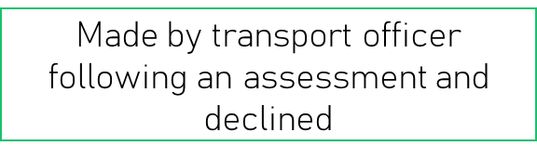


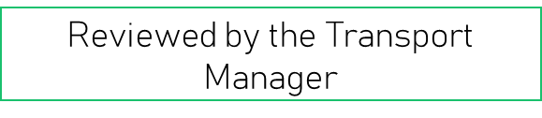



As the local authority is making a formal decision on its statutory duty – in the same way a parent can appeal a decision around an EHCP – parents can appeal our transport decision

Slide 138
Supporting Parents Understanding
DO
Tell them about the policy and where to find it
Offer to take any questions forward you can't answer
Make them aware that transport has restrictions – such as home address only and beginning and end of school day only
Ensure planning of transitions factor in reasonable timelines for travel assistance to be provided
DO NOT
Provide a view on eligibility for transport

Slide 139
September transfers
Nursery 2 – Reception
Travel policy covers the full reception year
We send email out after April 16th – National offer day
Year 6 to year 7
Those that are continuing at the school we need to know by 1st Feb
Those moving school will get an email on or around 1st March
Year 11 – post 16
Parents/Young Person must apply online
Year 15 onwards
The application must come through adult social care

Slide 140
Contacting us
School Transport Eligibility – None EHCP Transport
Email: SchoolTransportEligibility@northyorks.gov.uk
Telephone : 0300 131 2 131
SEND TRANSPORT (STT)
Email : sendtransport@northyorks.gov.uk
Telephone : 0300 131 2 131
School Transport Service – IPT Commissioning,
Email: schooltransport.services@northyorks.gov.uk
Telephone: 0300 131 2 131
IPT Compliance - Contract management and complaints
Email: ipt.compliance@northyorks.gov.uk
Tel: 0300 131 2 131

Slide 141
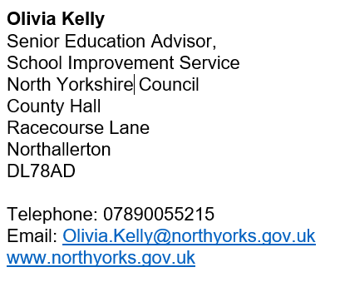


Slide 142

Every teacher a teacher of SEND
Every leader a leader of SEND
Every governor a governor of SEND

Slide 143
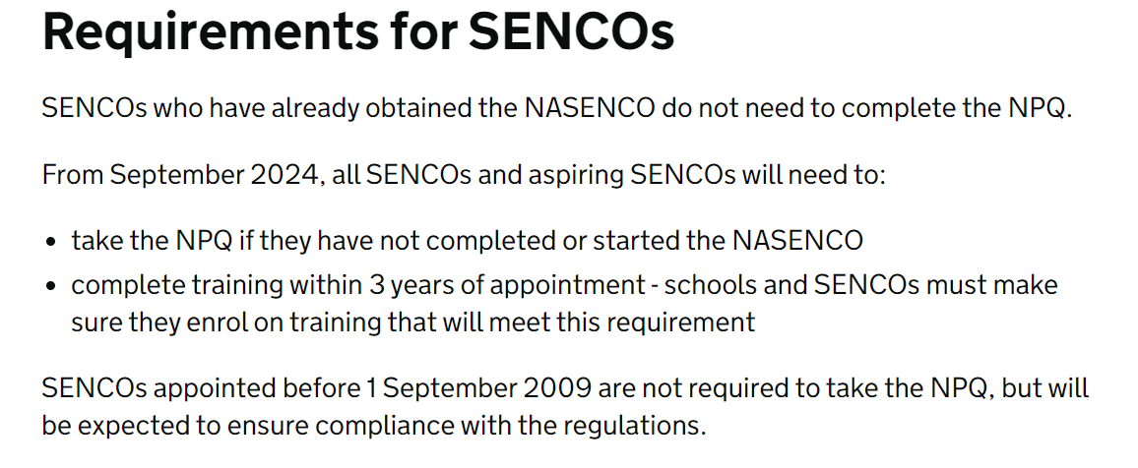
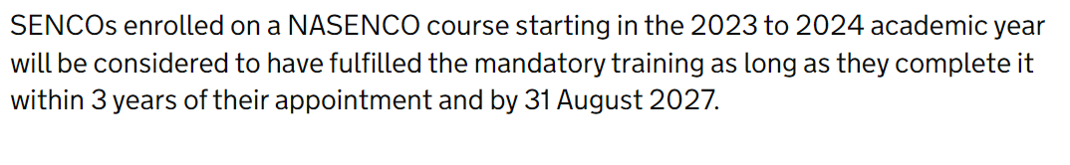
National professional qualification for special educational needs co-ordinators (publishing.service.gov.uk)
Notes:
The qualification has altered in terms of its focus- it takes approximately 12-18 months to complete and it is much more focused on the strategic role of the SENCO.

Slide 144
School Website
What maintained schools must or should publish online - GOV.UK
Updates in October 2024 to DFE Guidance on What maintained Schools must or should publish online
SEND Section:
Additional information about the:
  arrangements for the admission of disabled pupils
  steps the school has taken to prevent disabled pupils from being treated less favourably than other pupils
  facilities it provides to help disabled pupils access the school
  accessibility plan it has prepared under paragraph 3 of Schedule 10 to the Equality Act 2010 to:
    increase the extent to which disabled pupils can participate in the curriculum
    improve the physical environment to increase the extent to which disabled pupils can take advantage of the educational benefits, facilities or services provided or offered
    improve the way disabled pupils can access information that is easily accessible to pupils who are not disabled
Notes:
There is also additional guidance for what academies and further education colleges must or should publish online.
School admissions have now altered their appendices to reflect the changes.
Particularly in terms of access to educational visits and the wider curriculum aspects- that they aren't less included.
You must ensure that your accessibility plan is up to date and reviewed every 3 years.

Slide 145
With the additions to the DFE Guidance on what LA Maintained Schools should have published on the school website, you will need to ensure you have the following up to date and published:
Whole School Accessibility Plan
Equality Statement/ Policy
Admissions Policy
Notes:
NYC's Accessibility Plan template reflects all of the changes to guidance.
Ensure your Equality Statement is updated every 3 years along with your accessibility plan.

Slide 146
NYC SEND Policy Template
It has been reviewed and updated. Two additional paragraphs have been added. These will be highlighted in green when you receive the updated version.
Accessibility Statutory Responsibilities
Admissions
Notes:
If you recall The SEND Policy template was collaboratively co-produced at previous SENCO network meetings. We are aware that it can take time to get something signed off and agreed within NYC so the two new sections have been added to the template but you must ensure that your governors ratify it. If you are an academy or trust please just ensure your policies reflect the additional updates within the academies guidance.

Slide 147
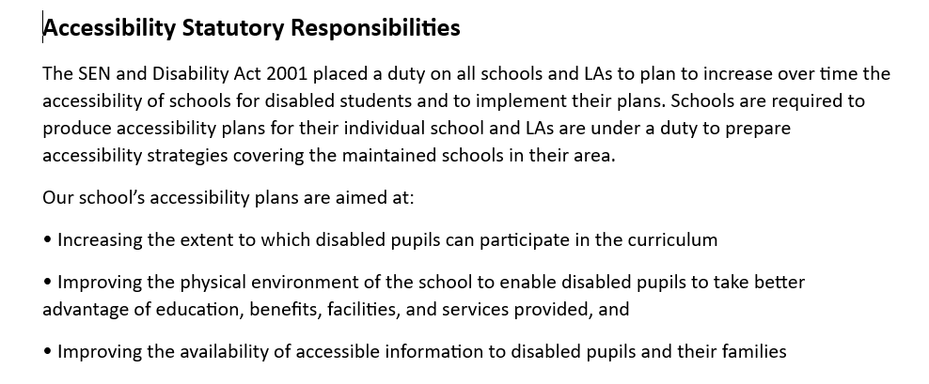
NYC SEND Policy Template – Additional Paragraph
Notes:
It is worth noting as well that on 3rd Feb DfE released new guidance for governors of SEND and there is a really useful checklist in there for governors and is worth sharing with them.

Slide 148
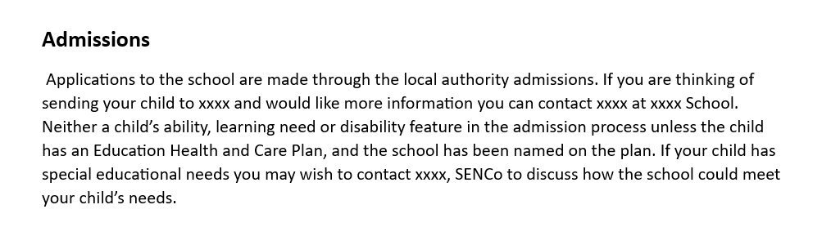
NYC SEND Policy Template – Additional Paragraph

Slide 149

Ofsted Reports – Common Themes
Autumn Term
Notes:
They have been very active. Still waiting for many to be published but Olivia has trawled through the latest reports and picked out the common themes. It is worth mentioning though that there are so many strengths across NY and this really is worth celebrating. As teachers we don't do it for them but it really is a time for a happy dance when your hard work is recognised and celebrated in terms of what has been achieved across NY schools.

Slide 150
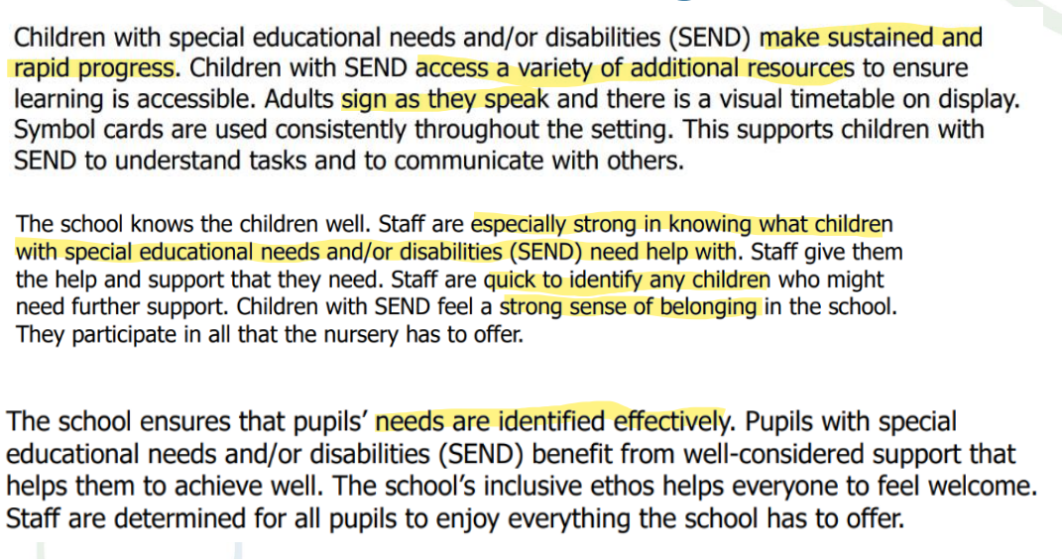
Strengths
Notes:
Common themes in terms of the thematic reviews and linked to the forthcoming report card system it is clear what is being recognised.

Slide 151
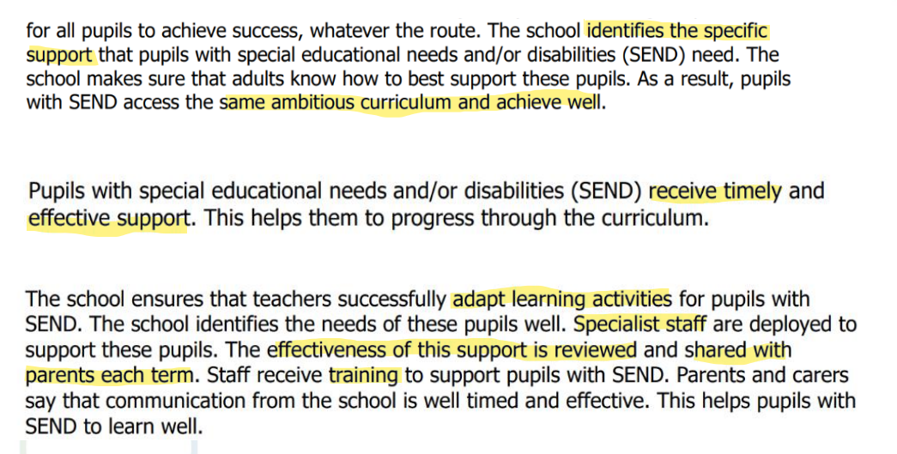
Strengths

Slide 152
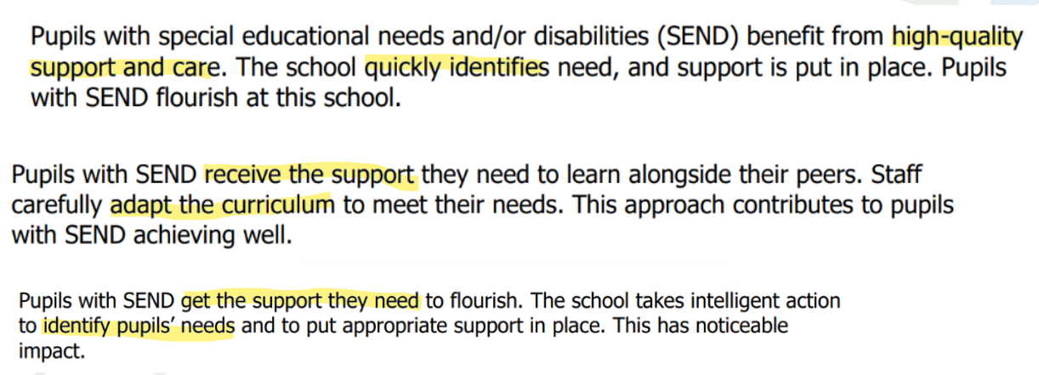
Strengths
Notes:
Early identification of need is a key theme and it is a key priority for the LA. Investment from Locality Boards is very much around the early identification of need- Verbo and we are looking at other ways we can support all schools and settings to identify needs early.

Slide 153
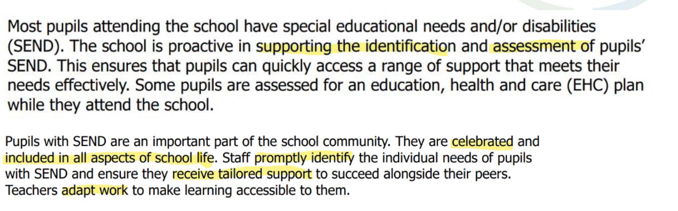
Strengths
Notes:
Inclusion is key in the forthcoming report cards and the sense of belonging for our most vulnerable pupils, not only in terms of curriculum inclusion but across the entire school day.

Slide 154
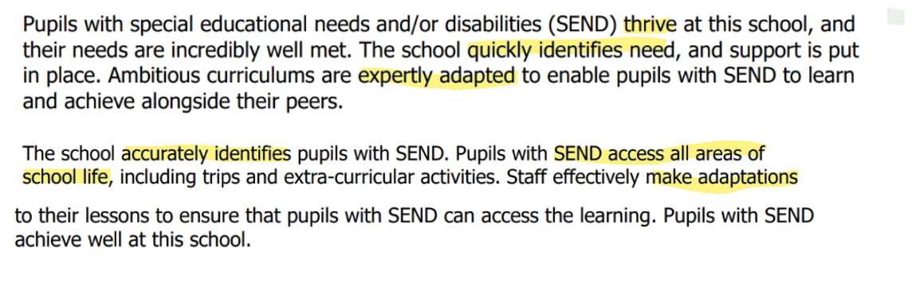
Strengths

Slide 155
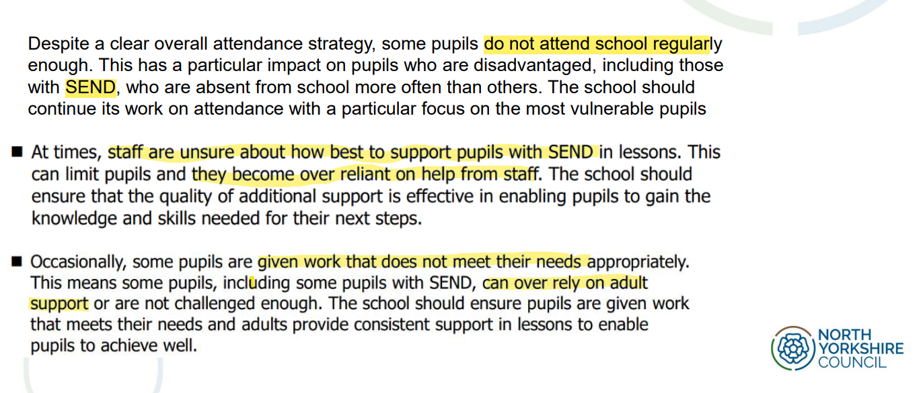
Areas For Improvement
Notes:
So much excellent practice taking place that these are the key areas of development coming through the reports.
If you are in the Ofsted window consider how well do ALL staff and governors understand your school's graduated approach.
They are really looking @ the use of additional adults and support and in particular the velcro TA- is this providing exclusive practice as opposed to inclusive practice?
Remember EEF produced an excellent audit tool looking at maximising the use of TAs.

Slide 156
Ofsted Reports – Common Themes Autumn Term
Provision for SEND has been identified as a strength in the majority of Ofsted Reports
Key themes from inspections, indicate inspectors are focusing on the following for SEND:
Identification
Curriculum adaptations – same curriculum as their peers
Use of additional adults/ support
Staff training
Notes:
We know they are busy reviewing their framework and it should be coing to us for September. The report card system (which still involves a ranking) is particularly focusing on
Inclusion and belonging, particularly SEND
Attendance
Curriculum

Slide 157
Ofsted Reports – Common Themes
Questions to reflect on and take back to school
Have you identified how your curriculum is adapted to meet the needs of the SEND in your SEN Information report?
Do you have a SEND CPD plan for staff?
Is your curriculum consistently adapted to meet the needs of the SEND? How do you know?
Do you monitor how the curriculum is adapted? Do curriculum leaders know how the curriculum is adapted? Do they monitor how the curriculum is adapted?
How are support staff deployed to support children and young people with SEND? How effective is the support they provide?
Notes:
In terms of the clear SEND CPD plan utilise training that is out there
Locality Boards
NYES
Dingley's Promise
Whole School SEND
Some schools mapped out and decided on SEND Pledges in terms of curriculum adaptation as then everyone knows what the minimum standards of adaptation are as they will see the same in every room.

Slide 158

Attendance
Working together to improve school attendance (applies from 19 August 2024)
Notes:
Statutory from August
How are you tracking and monitoring attendance? Part time timetables protocol?
How are you working across departments in secondary?
Attendance in terms of whole school is now the remit of the School Improvement Team and they are regularly tracking attendance and will be having discussions directly with schools regarding attendance tracing and any pinch points.

Slide 159
NYC Templates and Information
School Attendance | CYPSinfo
Notes:
We recognise that often you can spend hours trying to find templates so we have included the direct links in the slide deck for you. All contact details are here on this page.

Slide 160
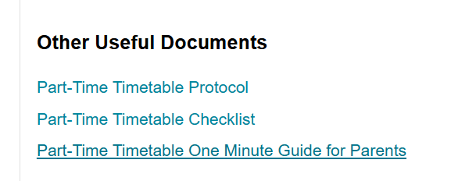
Part Time Timetables – NYC Templates and Information
School Attendance | CYPSinfo
Notes:
19,600 days lost learning......Remember part time timetables are to be used in exceptional circumstances. All pupils of compulsory school age are entitled to full time education. In very exceptional circumstances, there may be a need for a temporary part-time timetable to meet a pupil’s individual needs. For example, where a medical condition prevents a pupil from attending full time education and a part-time timetable is considered as part of the reintegration package.
A part-time timetable must not be treated as a long-term solution. Any pastoral support program or other agreement must have a time limit by which point the pupil is expected to attend full time or be provided with alternative provision.
Any decision about a part-time timetable needs to have due and full consideration of any safeguarding and welfare risks, plus steps to prevent these. Any vulnerabilities and risks must be fully regarded as part of your duties to safeguard and promote the welfare of children. Not being in school full time can put children at significant risk, including risk of harm, neglect, abuse, exploitation and radicalisation, for example, as well as the risks of underachieving, poor outcomes, and becoming NEET.
A reduced timetable is not considered an appropriate method of managing poor behaviour, or pupils at risk of exclusion, in the longer term. This intervention should only be considered after other strategies have been exhausted and they should be for the benefit of the pupil, such arrangements must be made with the agreement of parents/carers.

Slide 161
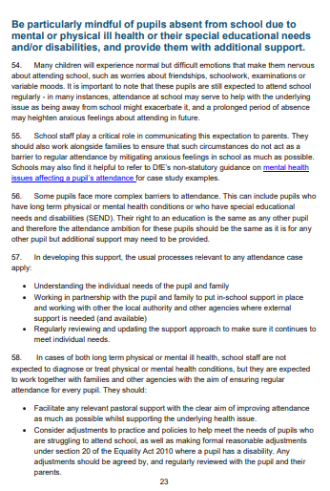
Attendance and SEND
Page 23 -35
Notes:
We also recognise that in your 80 hour working week you don't have the time or energy to trawl through guidance so SEND information are on pages 23-35. Be very mindful of those with SEND who are being persistently or severely absent with SEND- not just those with EHCPs but those that we are monitoring or our most vulnerable and at risk pupils

Slide 162
Attendance of Children and Young People with SEND
Points to Consider:
How do you monitor attendance of children and young people with SEND? Do you monitor attendance by area of need? By SEN support/EHCP?
How do you report attendance of children and young people with SEND to the Governors?
What support do you provide to families where attendance is low? How are external agencies used?
Is attendance discussed with parents during annual reviews/ support plan reviews?
Individual case studies are a useful way to evidence impact of support etc on attendance for individual children or young people

Slide 163
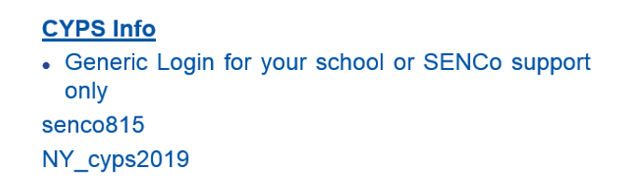
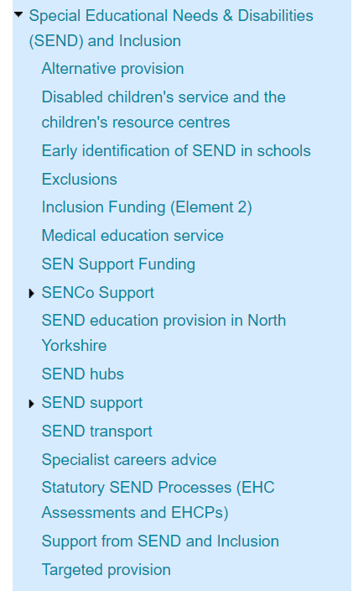
Resources
Welcome to CYPSinfo | CYPSinfo (northyorks.gov.uk)

Slide 164

For those in EY..

Slide 165
Solihull parent programme
Inourplace.com out of area parents please use school postcode.
Courses include:
Understanding the teen brain
Understanding your child with additional needs
Understanding your child's feelings
Understanding your child's mental health
Moving up to secondary for children with additional needs
Understanding your own trauma
For teenagers- understanding your brain and feelings
Also in several community languages

Slide 166
Virtual School 3 duties
Looked After Children
Children Previously in Care
CiN/CP and Kinship
DT responsibility 3 PEPs and liaise with VS on PP+
DT responsibility school receives PP+
DSL responsibility
Looked After Children
Children Previously in Care
CiN/CP and Kinship
VS Strategic responsibility and advice and information to schools and social workers for cohorts of children but not parents/guardians
VS Advice and information to schools, social workers and parents/guardians
VS has Corporate parenting responsibility

Slide 167

Becoming a Statutory Duty for all Children with a Social Worker
As champions for children with a social worker, the Virtual School should create a culture of high aspirations and drive improved outcomes for these pupils.​
Strengthen relationships between education settings and the local authority so agencies can work together in partnership.
Identify the cohort’s needs and intervene to overcome barriers to poor educational outcomes and ensure pupils reach their potential.
Support and advise key professionals to help children make progress, including through increasing their confidence in using evidence-based interventions.

Slide 168
Wider Working Together National Update
The Children’s Wellbeing and Education Bill is making it’s way through Parliament. Read the policy note on the content here: Children’s Wellbeing and Schools Bill
NB: Thematic reviews of children not in school in local areas - GOV.UK
Thematic reviews of children not in school in local areas
Focus on children with SEND who are not attending well

Slide 169

PLAC / SGO / Kinship Responsibility
We have two ELAs who have responsibility for these areas. They do not casehold but are able to offer help and advice and signpost any teachers, social workers or carers and parents that get in touch. We also have a PLAC PEP. This is not a statutory document, but it provides a useful starting point from which to discuss the support that is in place or that could be implemented.
What works for Children in Care, also works for PLAC, SGO and Kinship too.
Make sure you tick the PLAC box on the school census.
Kinship
https://kinship.org.uk
What is kinship care?
Kinship carers are family or friends who step up, often during an unexpected crisis, to care for a child when their parents aren’t able to. Kinship care is a commitment. To bring love and hope to a child who has experienced trauma. No matter what.

Slide 170

Next Designated Teacher Training
13/02/25
Time:
15:30-16:30 New to Role:
16:30-17:30 Updates for All DTs
Keep an eye on NYES or contact your Virtual School Worker

Slide 171
Thematic Reviews of Children Not in School
Alternative Provision
SENCO update Feb 2025

Slide 172
Introduction
The thematic reviews conducted by Ofsted and the Care Quality Commission (CQC) focus on understanding the experiences of children with special educational needs and/or disabilities (SEND) who are not in school.
These reviews aim to:
Identify Reasons: Explore why children with SEND leave full-time education, including factors such as unmet needs, bullying, and mental health issues.
Assess Support: Evaluate the support provided by schools, local authorities, social care, and health providers to these children.
Gather Insights: Collect views from parents, children, practitioners, and leaders on the effectiveness of current support systems and identify areas for improvement.
Recommend Improvements: Provide recommendations to enhance coordination, increase resources, and implement regular monitoring and evaluation to better meet the needs of children with SEND.

Slide 173
Areas of Children Not in School review
Collaboration: How health, education, and social care services work together to meet the needs of these children.
Reasons for Leaving School: Why children with SEND leave full-time education and what schools are doing to help them stay.
Local Authority Role: The impact of local authorities in ensuring children with SEND receive suitable education.
Social Care Role: The role of social care in supporting children with SEND who are not in school and need help and protection.
Health Providers' Role: How health providers meet the health needs of children with SEND who are not in school.
Support for Hard-to-Reach Children: How local authorities support children not in school, especially those who are hard to reach or have safeguarding concerns.
Stakeholder Views: Insights from parents, children, practitioners, and leaders on why children are not in school and how their needs are being met.
They will seek to understand the experiences of:
children with SEND and their families, including:
  children who are missing from education and children who are electively home educated
  children who are on a school roll but are flexi-schooled on a part-time basis, or are severely absent
  children attending unregistered AP
  children who receive special educational provision through EOTAS arrangements
  children who have returned to education in the last 6 months having met our definition of a child not in school
strategic leaders, including:
  those who commission, or support the commissioning of, services that provide support for children not in school
  those who are involved in area-wide strategic planning for children not in school, which includes knowing their destination and providing support
delivery partners, including:
  providers and practitioners that deliver education to school-age children
  health and social care providers that support all children in a local area

Slide 174
Format of the thematic review
3 weeks (2 weeks off site, 1 week on site)
3 inspectors (education, health, social care)
Survey to gather feedback
Track 3 young people
  Speak to young person, parent/carer, setting and practitioners
Sampling visit providers
Meet with parent/carers
Meet with children and young people

Slide 175
Sampling
Sampling meetings
Inspectors will have sampling meetings with education, health and social care professionals.
Sampling visits to providers and services
During sampling visits, inspectors will visit a specific provider or service and ask for information about children’s experiences.
The settings that inspectors choose to visit may include, but are not limited to, a registered independent school or a school maintained by a local authority, a pupil referral unit or an unregistered setting that offers AP.
Inspectors will choose the children to speak to during sampling visits, where this is possible.
They may choose the children before the visit, using the information provided by local area partners.
Inspectors will look at any other relevant documents relating to the children.
Findings will be based on contemporary practice and on practice that has an impact on the child’s current situation. However, inspectors may ask for historical information to help them understand the reasons why a child is not in school.

Slide 176
Alternative Provision

Slide 177
What schools should know…
Schools need to carefully consider what providers are available that can meet the needs of their pupils, including the quality and safety of the provision, costs and value for money.
Schools are required to maintain on-going contact with the provider and pupil, with clear procedures in place to exchange information, monitor progress and provide support.
Schools should maintain a full record of all placements they make, including a pupil’s progress, achievements and destination following the placement. This should also include the pupil’s own assessment of their placement.
Ultimately, the responsibility for the AP used rests with the commissioning body and a Quality Assurance visit must take place before any placement commences regardless of being within the directory
Commissioning schools must satisfy themselves that providers are compliant with the statutory guidance KCSIE – Letter of Assurance in resource pack.
AP providers should provide good quality risk assessments especially when children/young people are at a higher risk i.e. allergies / absconders / complex needs
Insurance must be in place / Health and Safety policies and procedures should be clear and appropriate to the setting
Ensure that all other relevant information is shared with providers, including any information on special educational needs, literacy, behaviours that challenge, strategies that have worked in the past, aptitudes and interests.

Slide 178
Alternative Provision Directory
This was developed to help schools source AP across North Yorkshire.
It is NOT an Approved List of AP Providers
Lists providers who have met NYC minimum standards framework:
  Providers who adhere to DfE statutory guidelines
  Annual Self Evaluation Framework sent to LA:
    Show number of young people attending
    DBS details
    CPD
    Safeguarding policies and procedures
    Health and Safety
    Improvement Plan
    Annual meeting with LA to scrutinise all of the evidence
Allows schools to find providers according to location/courses/cost
The current directory can be found at Alternative Provision Directory
Annual webinar on 3rd April 2025 3.30pm book for free via NYES Alternative Provision Webinar for Schools | NYES Training
Further info wendy.butterfield@northyorks.gov.uk

Slide 179
Alternative Provision Audit
Audit 2024
274 schools returned data
21% were using AP
86% of those using AP were maintained schools
12% Primary
88% Secondary
61% pupils accessing AP had previously PEx
>1% PEx since accessing AP
77% pupils had SEN support/EHCP
Audit 2025 to be shared after half term (returns by Easter)

Slide 180


Slide 181
Thank you
and
any questions

