Slide 1
Early Years SENCO Network
12th February 2025

Slide 2
Agenda
9:30 Welcome and Introductions
9:40: Lucy Wade- Digital EHCPs.
10:10: Wendy Butterfield- Dingley’s Promise Updates
10:25: Rachel Yeadon- Early Help and Available training
10:40: Holly Strickland- VERBO
Close
Further key messages and reminders are in the slides and the full presentation will be uploaded onto CYPS info.

Slide 3
Lucy Wade: Digital EHCPs

Slide 4


Dingley’s Promise
Early Years SENCO update
January 2025
Wendy Butterfield

Slide 5
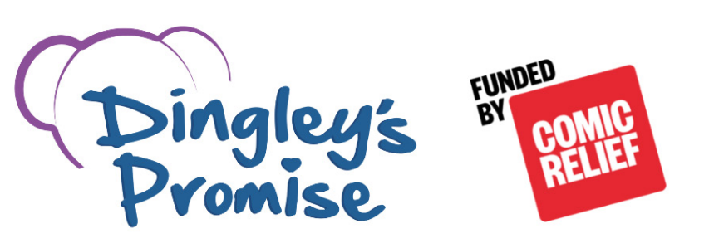

Dingley’s Promise – Early Years Inclusion Project (North Yorkshire)
Do you want access to cutting edge training?
Free online training for those working with young children (0-5 years)
Courses include:
  Introduction To Early Years Inclusive Practice – environment, learning styles and individualised learning
  Early Years SEND Transitions – explore positive transitions for children with SEND
  Managing Behaviours that Challenge – influences on behaviour and getting the right support
  Having Difficult Conversations with Families – plan for difficult conversations
  The Voice of the Child – communication strategies and the impact of relationships
  Intersections within Early Years - the overlapping and interdependent systems of discrimination and disadvantage that many face due to the intersections in their lives.
  Leadership and Management of Inclusion – give you tools to make the changes on your inclusivity journey
All courses are online and are a mix of workbook, clips and activities.
Complete in any order and at your own pace.
Receive a certificate of completion for each course.
Get the Dingley’s Promise Mark of Achievement!
Register at:
https://dingley.org.uk/dingleys-promise-training/early-years-inclusion-programme/

Slide 6
National
Overview
10 FREE training courses (7 currently)
Mark of Achievement - 159
Stakeholder groups
Peer networks
National steering group
Parent Carer Group
In total:
17,155 learners across our 32 local authorities
23,194 completed courses

Slide 7
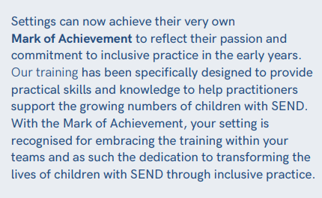

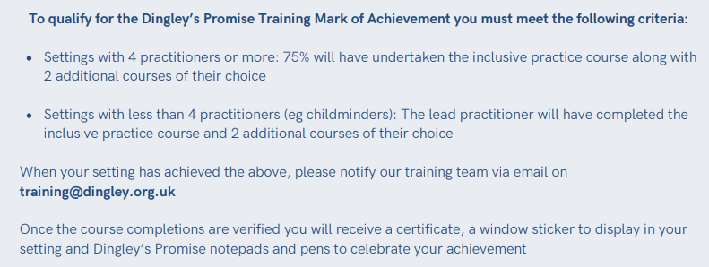
Mark of Achievement

Slide 8
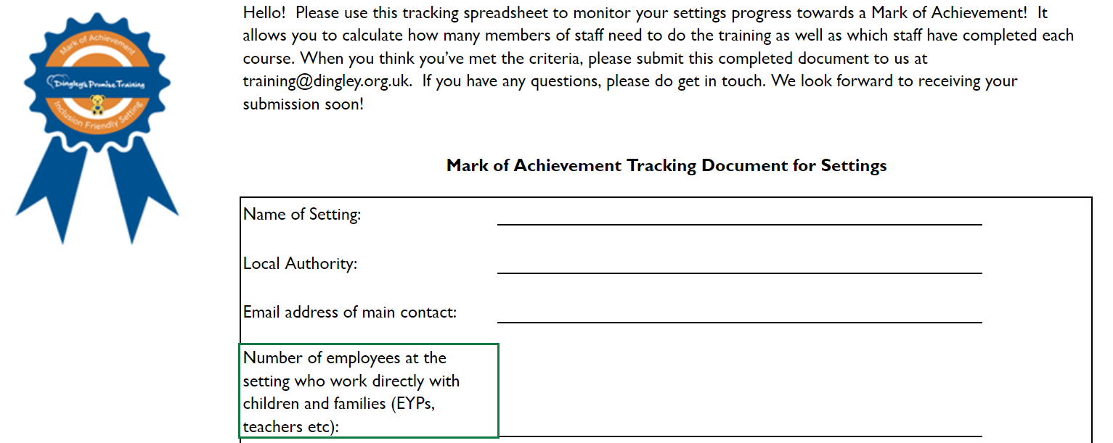
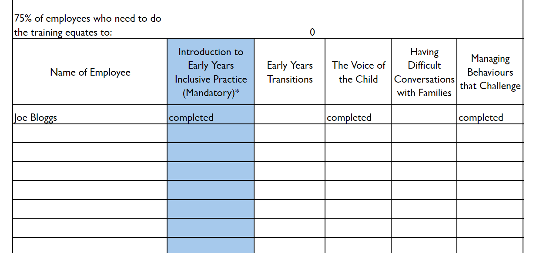
MoA
Tracker

Slide 9
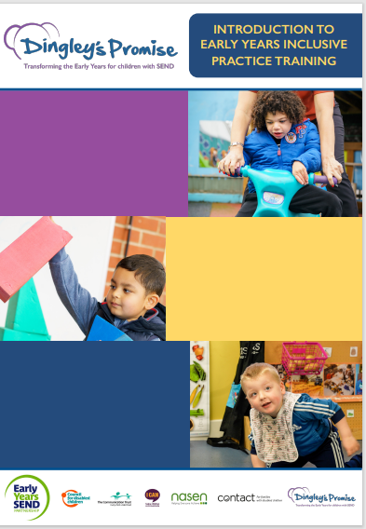
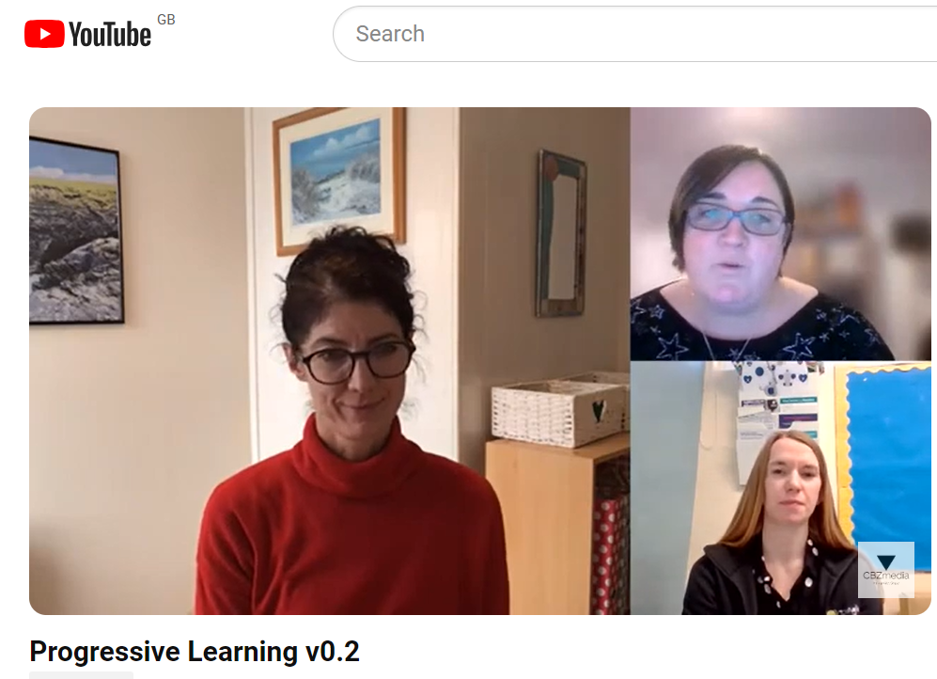
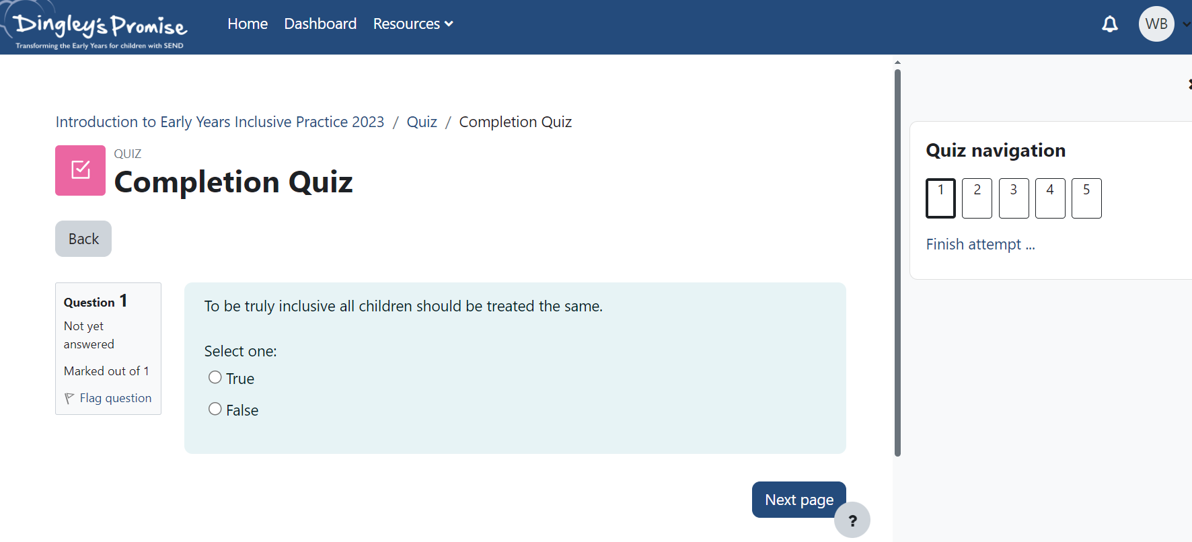
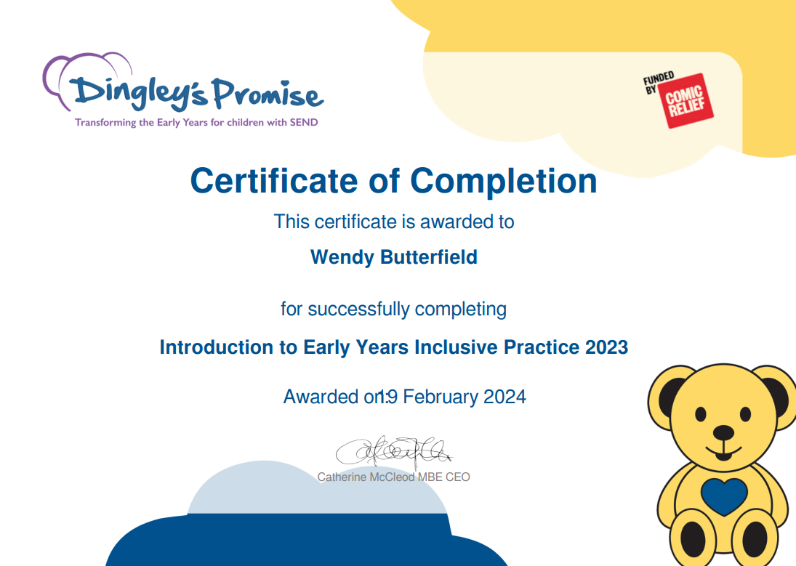
Courses
Courses

Slide 10
Total Learners
(Nov 24)
Notes:
820 learners (Dec 24)
4 MoA’s

Slide 11
Total Completions
(Nov 24)

Slide 12
Learner Satisfaction
Of those who have completed the training so far…
97% Feel more confident as a result of the training
96% Believe they can support more children
99% Would recommend this course
98% are committed to making a change in their setting as a result of the training.

Slide 13

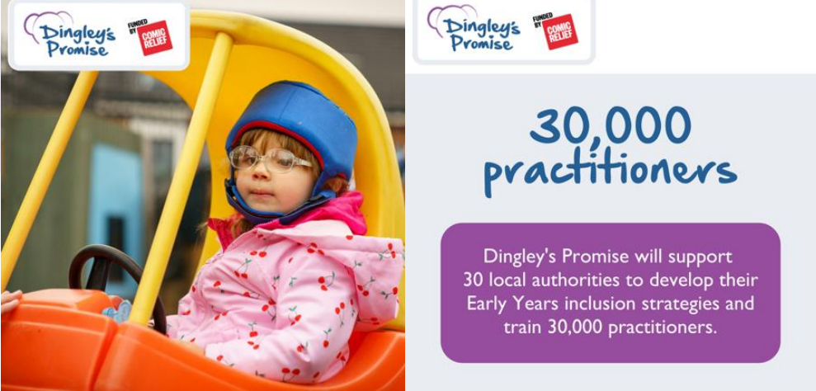
Dingley’s Promise – Early Years Inclusion Project (North Yorkshire)
Do you want help in supporting young children with SEND?
Calling all parents and carers!
Has your child’s setting signed up to Dingley’s Promise Comic Relief Early Years Inclusion Project?
What is Dingley’s Promise?
Dingley’s Promise are working with 30 local authorities over 5 years to improve education and learning development of inclusive practice of those working with children with special educational needs and disabilities.
Who is this FREE training for?
Anyone supporting young children such as Early Years practitioners, health visitors, social workers, therapeutic services, family support worker and parents and carers themselves.
Sign up for the FREE training at:
https://dingley.org.uk/dingleys-promise-training/early-years-inclusion-programme/

Slide 14
North Yorkshire Feedback
Intro to Inclusive Practice Practice
Really helpful to think about adjustments
I found it empowering
For those who work with children of all ages
Very thought provoking
Good ideas for working practice
Easy to access
Videos were really useful

Slide 15
How to sign up
Register for free at:
https://dingley.org.uk/dingleys-promise-training/early-years-inclusion-programme/
Email Wendy for more information
wendy.butterfield@northyorks.gov.uk

Slide 16


Slide 17
Next steps
They are looking to produce an Ordinarily Available Provision document for the Early Years

Slide 18

Childcare Works Wraparound Toolkit

Slide 19

Early Years Toolkit

Slide 20


Toolkits to support
Wraparound Childcare Toolkit | from Childcare Works
SEND and Inclusive Practice | Wraparound Childcare Toolkit

Slide 21
Dingley’s Assessment Toolkit
Dingley’s Assessment Toolkit

Slide 22
Early Years Toolkit
Early Years Toolkit | from Childcare Works
Early Years SEND
Help for early years providers : Meeting the needs of all children
Understanding Autism – PACEY
Providing childcare for children with special educational needs and disabilities | Family and Childcare Trust

Slide 23

Remember it's live- check out your area’s offer on the website
Home - Locality Boards (localityboardsnorthyorks.co.uk)

Slide 24




Strength in Relationships
Early Help Parenting Support
Rachel Yeadon | Senior Early Help Consultant (West)
February 2025

Slide 25


What is Early Help?
Early Help is not a designated team; it is the way that everyone works together to support the needs of families.
The aim of Early Help is to build on people’s strengths and resources to manage their own dilemmas, resolve their own difficulties and prevent further problems in the future

Slide 26
Support available from NYC
In the early stages of emerging need, the most appropriate person to offer support is often the person who knows the child and family the best. This can be a person from any agency. To support this process there are Locality Early Help Consultants based across North Yorkshire. Their role is to offer support, advice and guidance to all Practitioners.
Locality | Contact number
West (Harrogate, Knaresborough, Craven, Ripon) Rachel Yeadon, Sarah Webb, Elaine Shaw, Deborah Clement | 01609 534842
East (Scarborough, Whitby, Ryedale) Amy Magson, Siobhan MacDonald, Jessica Kennedy, James Urquhart | 01609 534852
Central (Selby, Richmondshire, Hambleton) Jon Coates, Liz Power, Liz Hebdon, Tracy Rotherforth | 01609 534829

Slide 27
Support available from NYC
Early Help Assessment
An Early Help Assessment should be completed when a child, young person, parent/carer or professional is worried that the needs of a child are not being met. An Early Help Assessment can be completed when a professional has consent from the young person and/or their family, when a professional has concerns about the progress or wellbeing of a child, when the needs are wider than your service can address on your own.
The assessment includes the following sections for information gathering:
Section A: The child
Section B: People in the family / household
Section C: Services working with the family
Section D: Reason for assessment (including scaling)
Section E: Next steps
Section F: Author’s details
Section G: EHC oversight IF a referral is needed
The EHA can be accessed here: NYSCP

Slide 28
EHA nursery example, 4-year-old:
Why does the family require intervention from Children & Families Service? | Mum has now contacted nursery to say home is stable and targeted support around routines and boundaries is needed. Nursery are still seeing the same issues that were present in October and support provided by nursery remains consistent. EHC has supported nursery to update EHA and update actions to reflect current situation. Nursery have worked alongside mum and health services to explore worries; however the family are now moving home. Although the house move will be positive in the long-term mum is worried about the financial impact on the household and the challenges that will be presented with changes to environment and routine for her son. Nursery have worked alongside mum to explore EHA and have been clear with mum that engagement is needed to ensure changes are sustainable moving forward. Mum and nursery feel a short-term targeted intervention to focus on healthy sleep, improved family network and family budget will help to reduce parental stress and anxiety. Targeted support will help mum and dad to have a firm network plan moving forward. O has additional needs and this will not change, however a sustainable network plan and clear understanding of O’s health needs will help to promote parental resilience when challenges arise.
How has consent been obtained? | x Verbal | ☐ Not obtained Reason: | Date consent obtained: Xx/xx/xx
 | ☐ Written
Have you informed the parent/carer about the reason for the referral? | X Yes ☐ No | If yes, what is the Parent/Carer/Child’s view of the referral:
Who has consent been obtained from? | X Parent | ☐ Person with parental responsibility | ☐ Child themselves
Date of referral agreement with Early Help Consultant. | Xx/xx/xx
Name of Early Help Consultant: | EHC East

Slide 29

Support available from NYC

Slide 30






Slide 31

Support available from NYC

Slide 32

Support available from NYC
‘Your Family Toolkit’
The toolkit consists of modules:
• Suitable for all ages and their parents and carers
• Suitable for younger children and their parents and carers
• Suitable for older children and their parents and carers

Slide 33
Support available from NYC
Modules available:
Your Family Toolkit - Building resilience module
Your Family Toolkit – Behaviour – what’s going on?
Your Family Toolkit - Parents’ emotional wellbeing, anxiety and self esteem
Your Family Toolkit - Understanding healthy relationships
Your Family Toolkit - Understanding your role in parenting
Your Family Toolkit – Understanding how TRAUMA can affect children and young people
Your Family Toolkit - Early years (1-4yrs) Parenting and relationships
Your Family Toolkit - Early years (1-4yrs) Play and development
Your Family Toolkit - Responsive parenting and relationship building 0-1 years
Your Family Toolkit - The importance of play and communication for 0-1yrs
Your Family Toolkit – Thinking about SEND (0-5 yrs)
Your Family Toolkit - Understanding the transition to adulthood
Your Family Toolkit - Trying to understand what it’s like to be a teenager

Slide 34

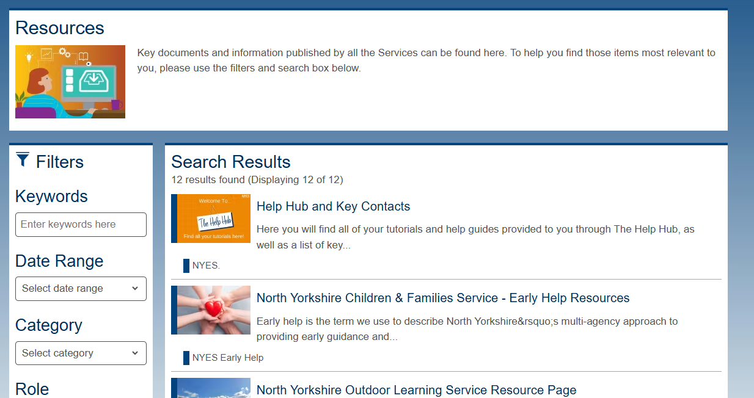
Support available from NYC
Parenting Support | NYES Info

Slide 35
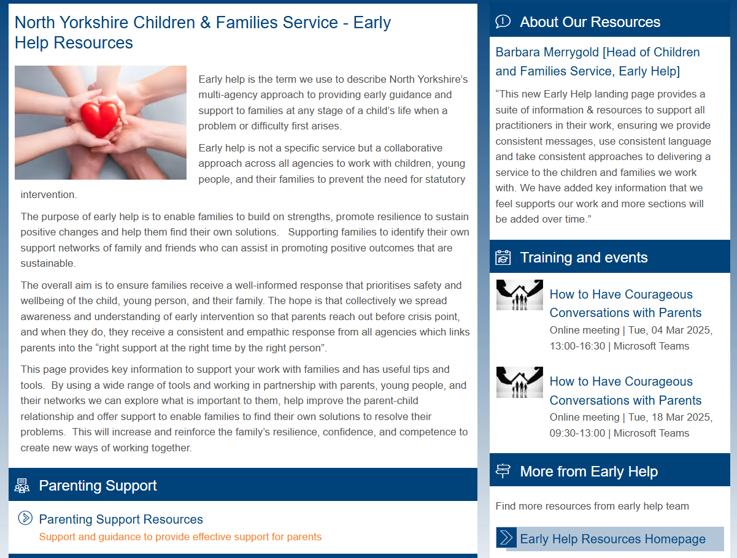
Support available from NYC
Parenting Support | NYES Info

Slide 36
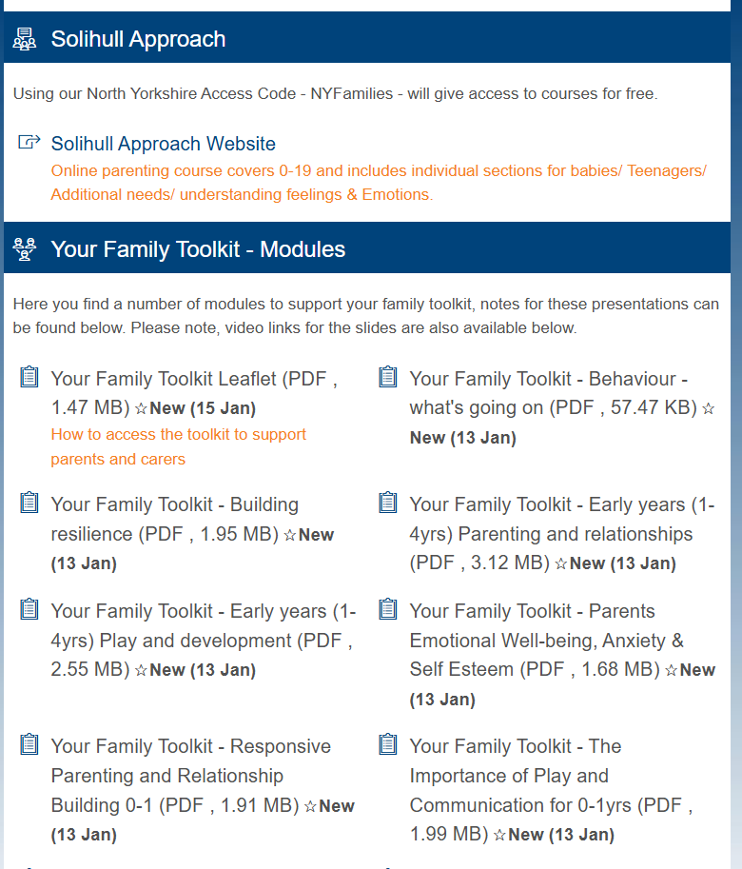
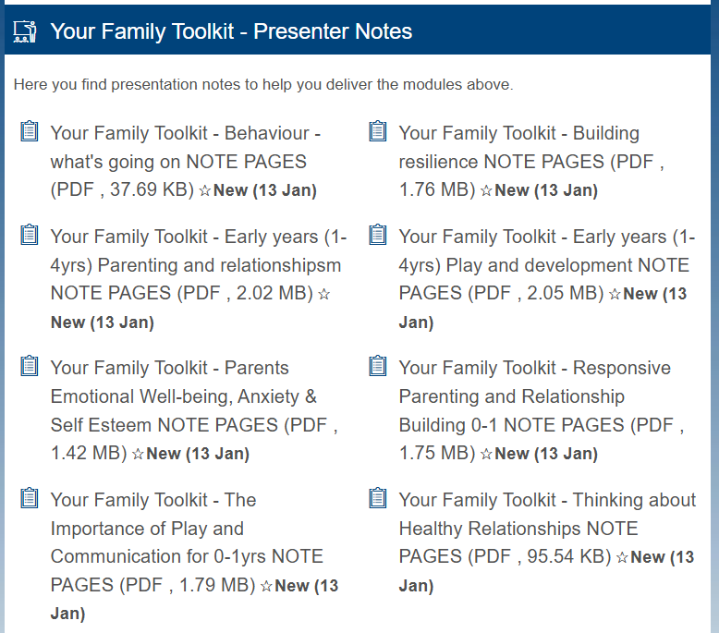
Support available from NYC
Parenting Support | NYES Info

Slide 37

Please don’t hesitate to contact me with any questions………
rachel.yeadon@northyorks.gov.uk
Thank you for your contributions

Slide 38
Holly Strickland
VERBO

Slide 39
Remember hub teams are there to help
Hub referral and hub handbook:
SEND hubs | CYPSinfo (northyorks.gov.uk)
SEND - Hub Referral Form.docx (live.com)

Slide 40

Early Years Drop ins.
You said we heard... There will be specific Early Years drop ins.
You may wish to use this time to talk about; Individual Learning Provision Plans (ILPPs), smart targets, Hub referral forms, Education Health and Care Assessment Requests (EHCARs), Element 2 funding, provision, transition etc.

Slide 41
Your named Early Development Specialist Teachers (EDSTs) are...
Scarborough, Whitby and Ryedale – Stacey.gould@northyorks.gov.uk
Tracy.johnson-hughes@northyorks.gov.uk
Hambleton and Richmond – Elizabeth.fawcett@northyorks.gov.uk
Selby – lynne.kilford@northyorks.gov.uk. Katie Heaven-Terry will be starting her role in April.
Harrogate, Knaresborough, Ripon and Craven – lorayne.farrington@northyorks.gov.uk

Slide 42
Things to remember…
Sleep Charity
Dingley's promise
Solihull approach – free training
Stronger Practice hub
Early Years in Mind
Early Years Store Themes

Slide 43
Including PfA from an Early Age
PfA outcomes Tool.pdf

Slide 44
Slides are available after the meeting on the following:
SENCo Network | CYPSinfo
SENCo Early Years | CYPSinfo

Slide 45
Education Endowment Foundation-EEF
The EEF Guide to the Pupil Premium | EEF
Early Years | EEF- The Early years Toolkit
Primary | EEF
Secondary | EEF
Take part in an EEF project | EEF

Slide 46
Whole School SEND
Early years SEND review guide: Early Years SEND Review Guide | Nasen
17667_leadership_and_senco_toolkit_2.pdf
SEND Forums | Whole School SEND
Events listing | Whole School SEND- all upcoming events

Slide 47

Access on NYES

Slide 48
What would you like on the next agenda?
The next SENCO Network is 14th May
What would you like on the agenda?
We are planning face to face network meetings for next round of SENCO Networks.

Slide 49

Next SENCO Network: 14th May 2025
Please let us know what you would like us to cover in the next meeting.. Add your thoughts to the chat box or email lynne.kilford@northyorks.gov.uk

