Slide 1
Early Years SENCO Network
May 2025

Slide 2
House Keeping
This will NOT be recorded so there is a safe space for discussion and all chat will also be captured.
The slide deck will be available on CYPS info by the end of the week.
There will be a number of discussion points throughout the session
Interaction would be greatly appreciated

Slide 3
Agenda
Updates
Transitions and Starting Reception
North Yorkshire Trends and Data
Dingley’s Promise Training
Delayed and Deferred Entry: Important Information

Slide 4
Please share the following updated poster

Slide 5


Slide 6
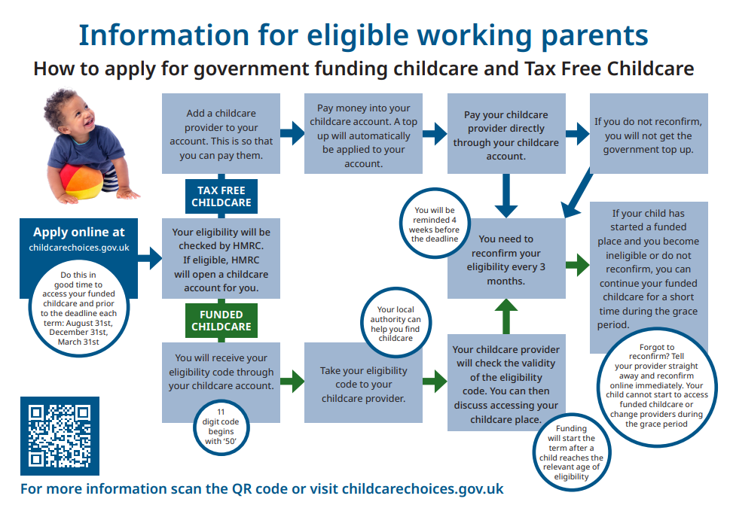

Slide 7
Free Early Years Courses and Resources: Open University
Early Childhood Resources | OpenLearn - Open University

Slide 8
Transitions
Support Guidance has been collated

Slide 9
Learning from the Pilot Project
Holistic support and partnership working was beneficial
Key skills and activities for families to work on during holiday periods decreased anxiety
Allowing time for parents anxieties to be heard
Starting Early in terms of transition preparation
Sharing information
Ensuring transition processes and visits supported child’s needs

Slide 10
Tiny Happy People Resources
Starting School: School readiness: How to prepare your child for school - BBC Tiny Happy People
Copy of School Checklist – Colour

Slide 11

Startingreception.co.uk
KINDRED

Slide 12
Why Starting Reception?
Kindred Survey results
School readiness survey: 25% starting reception not toilet trained; 33% can’t feed or dress independently
Impact huge: 2.5hours of teaching time lost every day and it affects every child
Lack of shared understanding: 9 out of 10 parents say their child is ‘ready’; teachers say it’s closer to half
Nearly half of parents think children aren’t ready because parents don’t think it’s their job
National squeamishness about talking about parenting and there’s no single definition, leaving parents in the dark

Slide 13
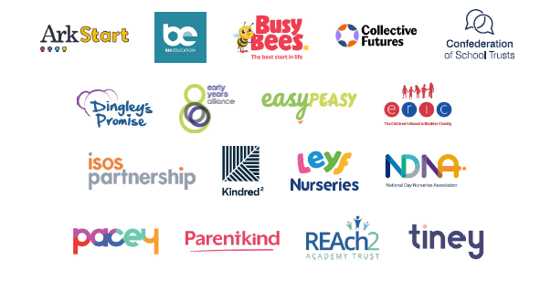
This definition was created collaboratively by:

Slide 14
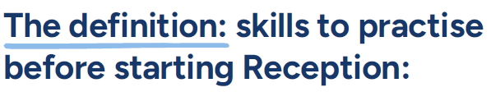




We understand that all children develop at their own pace, and that we’re all learning from birth. When it’s time to start school, some children will need more help than others.
Ther’s lots you can do at home to build your child’s confidence and independence, helping them feel emotionally and practically prepared to start school.
New skills take time to learn. Practising at home will help your child move into school more easily and with confidence.

Slide 15
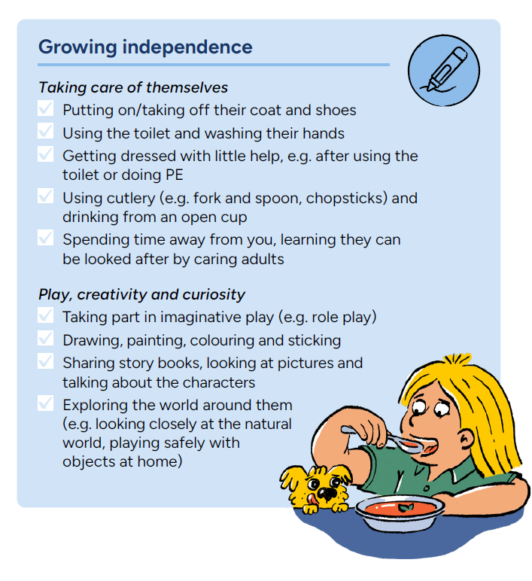
Useful links:
Growing independence
Check out Parentkind’s online advice hub and magazine for parents ‘Be School Ready’
Enjoy Family Corner’s 5 tips to help your child get ready for Reception
Guidance for parents and practitioners - PACEY
Download the free EasyPeasy mobile app for tips and activities to support everyday parenting moments
Taking care of themselves
How can you make separating easier? - Family Corner
Getting dressed and ready for the day - backward chaining information sheet - NHS
Getting ready for the Day – BBC
Toilet training
The Institute of Health Visiting has advice and tips on toilet training
Simple and supportive toilet training advice - ERIC
Potty training and bedwetting - NHS
Pants4School - Down Syndrome UK
Playing, creativity and curiosity
5 steps for brain building through serve and return - Center on the Developing Child at Harvard University
How to follow a child’s interest in play - National Literacy Trust
How to role play with your child - Pretend role play - BBC
How to role play with your child - Playing pretend animals - BBC
Fire up their imagination with drawing - BBC
What is mark-making and why is it important for learning? - PACEY
Sharing story books on World Book Day - BBC
Nature activities for children - BBC
Learning and having fun on the bus - BBC
Play a game of 'What's that sound?' - BBC

Slide 16
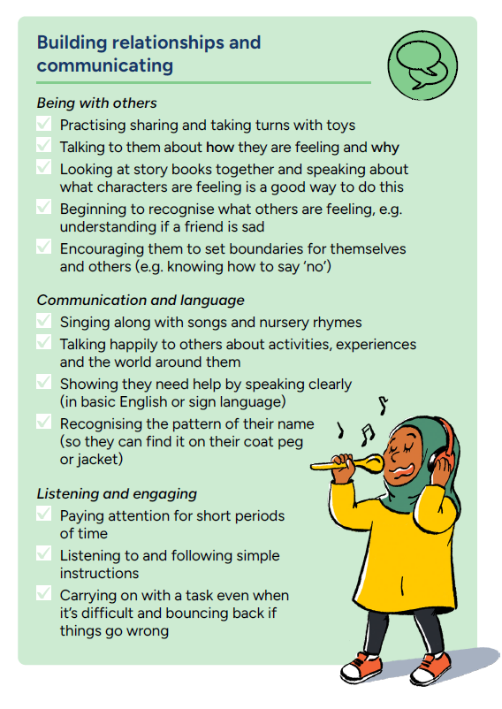
Useful links:
Building relationships and communicating
The Royal Foundation Centre for Early Childhood’s Shaping Us Framework outlines how these skills develop in early childhood
Top tips for enjoying stories together and book recommendations for starting school - Book Trust
Being with others
Learn how to support your child to make friends - Family Corner
Understand your child's social development - Words for Life
Practice sharing with toys – BBC
Communication and language
You are your child’s first teacher – help them learn how to write their name - Words for Life
Explore a range of approaches to language learning and development from NHS Start for Life
Build your child’s imagination and language by making up stories together - BBC
Child's Progress checker - Speech & Language UK
Listening and engaging
Follow the walk and talk trail with the National Literacy Trust
Practice language and listening skills at home with these games - Playing with a cardboard telescope - BBC
Practice language and listening skills at home with these games - Red Light, Green Light - BBC

Slide 17
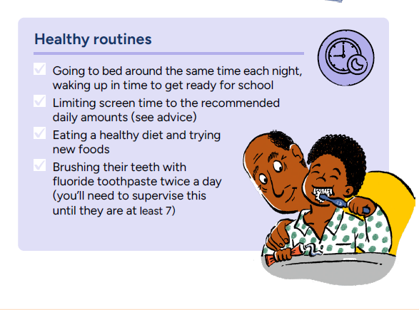
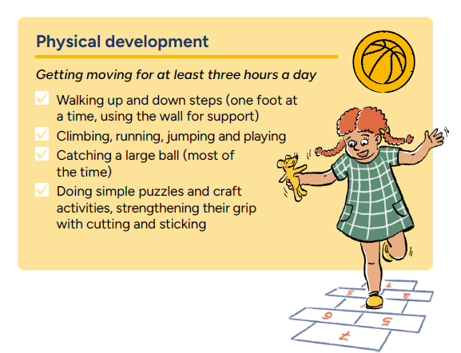
Useful links:
Physical development
Getting moving for 3 hours a day - NHS
Support your child to be a Healthy Mover - Youth Sport Trust
What is core strength and why is it important for children? - Department for Education
Fun games to get them moving - BBC
Useful links:
Understand what 'healthy' levels of screen time are, by age
World Health Organization guidance
Health Professionals for Safer Screens poster
Get insights on internet safety, how screen use impacts young children and recommended screen time: Help for early years providers: Internet safety
And for those with younger children, the NCT covers advice for babies and toddlers too: Screen time for babies and toddlers – NCT
Brushing teeth
Toothbrushing SOS with the singing dentist
Help children build a strong relationship with food and make the right choices from the start
Nutrition guidance - Department for Education
Healthier families - NHS
Five tips for helping your kids to eat healthily all year round - BBC
Eating Well - First Steps Nutrition Trust
Factsheet for healthy children's diets - Association of UK Dieticians
Sleep guidance
Sleep and young children - NHS
Struggling to get children to sleep: How to establish a bedtime routine - BBC

Slide 18

If you’re worried about your child’s progress, talk to your childminder/nursery/pre-school team, health visitor, local children’s centre or Hub.
If your child has developmental delays or SEND (suspected or confirmed), speak to their nursery, childminder, or health visitor/nursery/pre-school team well before they start Reception and discuss their needs when you are selecting schools.
You can work with your child’s early years setting to help your child with self-care, managing emotions, social skills, and communication in a way that suits their stage of development.
You might want to share details about their development, needs, what motivates them, what might trigger difficulties, how they learn best, and what strategies work well.
Make sure you share important information with everyone supporting your child, including their new Reception teacher.

Slide 19
Starting Reception: your child’s journey to school starts at home…but we have to start somewhere!
Childminders, nursery professionals, primary schools and parent bodies coming together to agree a single definition of the skills parents can be practising with their children
But Starting reception is a destination not a route map
Every child is different, but every school needs to start somewhere
The website sets out simple steps for making the resource your own
A printable PDF version is available to print and distribute….
…and there are instructions for adding your own logo. We WANT people to make it their own!
Please let us know if you are using this resource – and how! contact@startingreception.co.uk

Slide 20
North Yorkshire Early Years SEND Trends
Out of 453 early years providers (PVI) 99.6% are judged either good or outstanding.
This indicates high levels of quality first adaptive teaching within North Yorkshire settings and early years providers. This is evidenced through children's outcomes at the end of reception.
None the less we recognise the gap with national for children under the age of 5 years for the identification of SEND.
Outcomes for all children in North Yorkshire in Early Years is strong.

Slide 21
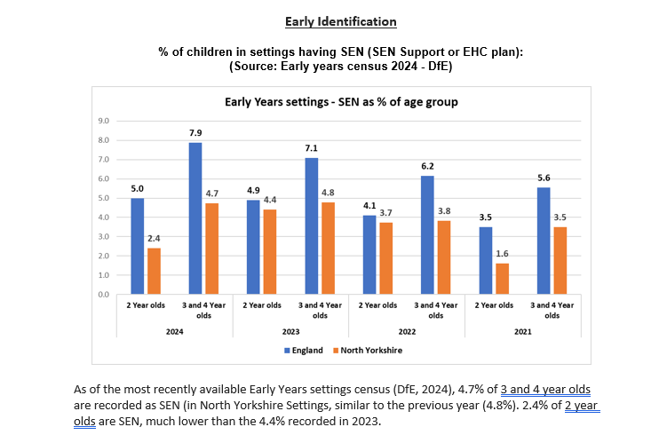

Slide 22
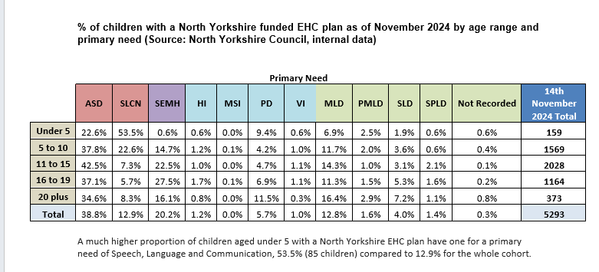

Slide 23
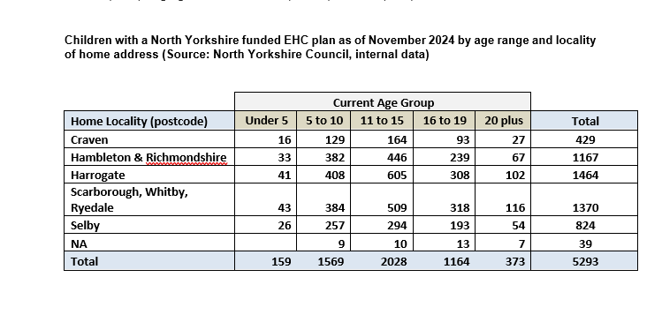

Slide 24
How can we support you in terms of Early Identification?

Slide 25
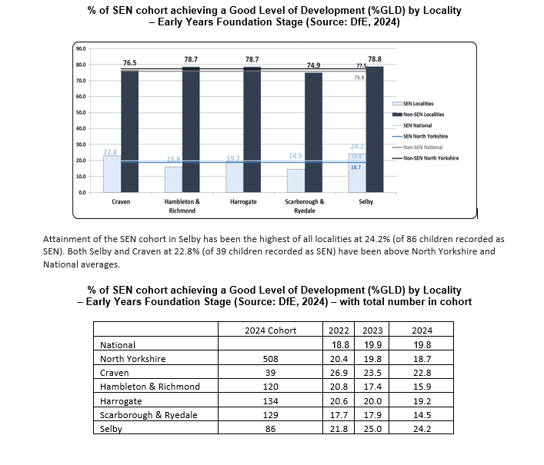

Slide 26
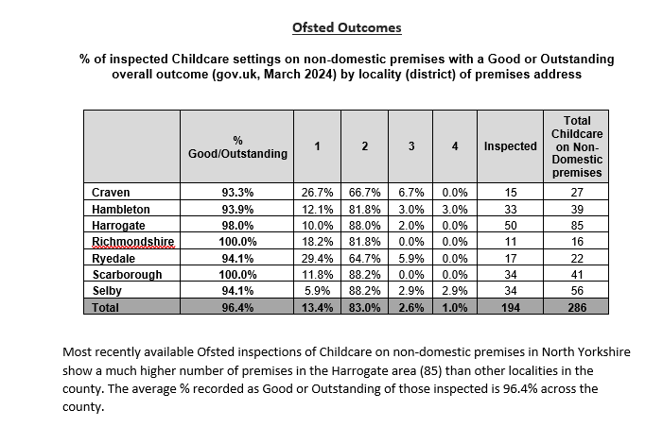

Slide 27
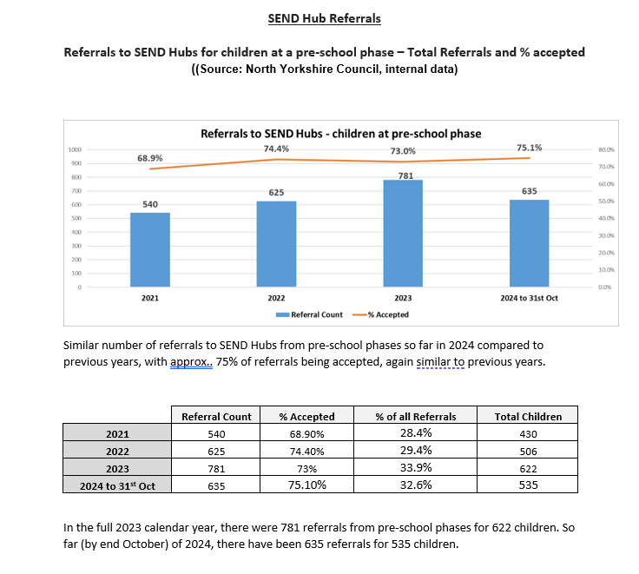

Slide 28
What will help you to support children with additional needs?
CPD, training and development
Graduated Approach
Inclusive Practice
Ofsted preparation

Slide 29
Who has accessed Dingley’s training?
Use any icon to let me know if you have accessed any training.
Who has accessed at least 1 unit?
Who has accessed at least 3 of the units?
Who has accessed more than 3 of the units?
Who has accessed all of the units?

Slide 30
What have you thought of the training?

Slide 31
What have you implemented or altered following the training?
What is the impact of the training?

Slide 32
What have been the barriers to accessing the training?
What would support you to access and implement the training?
Would Dingley’s on tour support you?

Slide 33
Latest Headline data from Dingley’s
Thank you to ALL of you who have signed up to Dingley’s
Please remember that it is not just about the sign up but the completion of the modules
We now have 5 settings with the Mark of Achievement Award

Slide 34


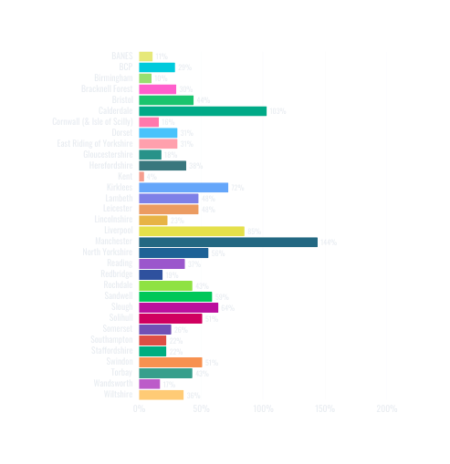
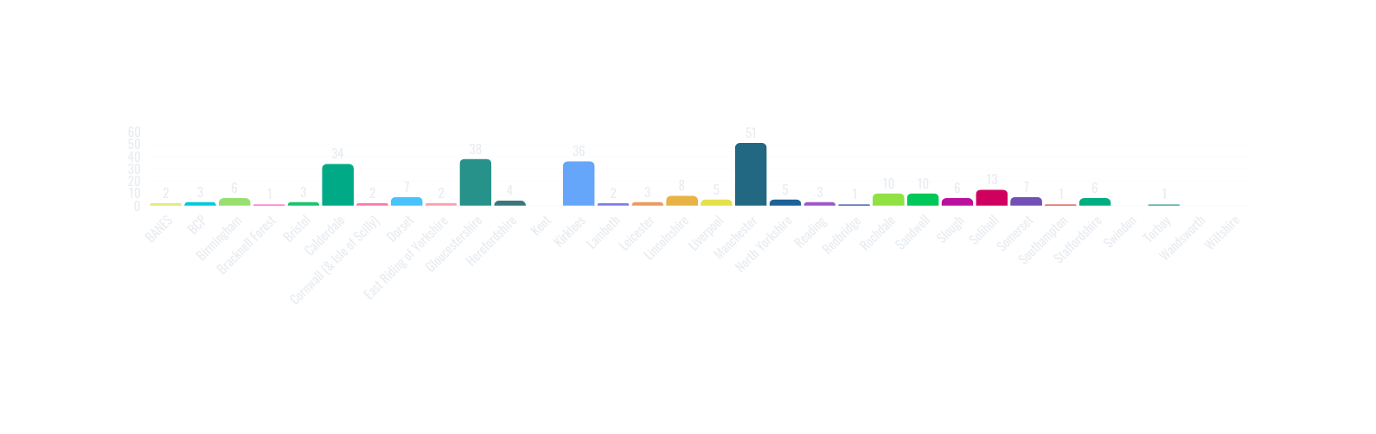


Highlights
21680
Learners across 32 local authorities
464
New learners
2467
New course completions
21
New Mark of Achievements
Learners
Capacity
Mark of Achievement

Slide 35
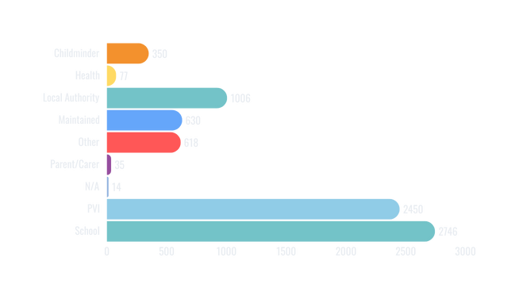
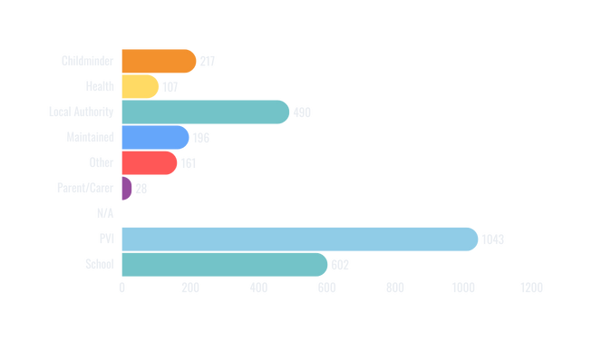
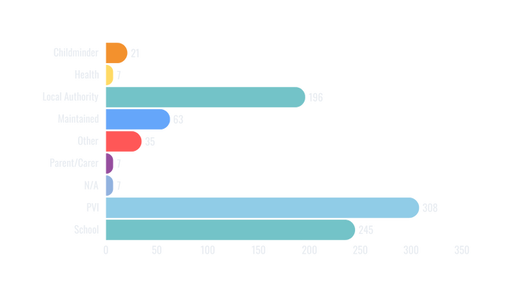
Year 2 Sector Summary
Manchester
North Yorkshire
Redbridge

Slide 36
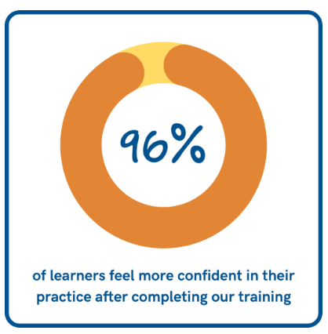
Why Dingley’s Promise?
They have used their experience of working with children with SEND over the last 40 years to create resources to enhance skills, improve confidence and inspire early years educators to cultivate an inclusive environment for all children.
Professionals across the country are improving their skills and gaining confidence through our range of training courses. Centred around inclusive practice and designed for anyone working in the early years, our training has helped thousands to enhance their ability to include and support children with SEND in their settings.

Slide 37
Dingley’s Promise Improving Inclusion
I attended an in-person session for the introduction to Dingley's, I found it very helpful to share ideas with other professionals and ask the course leader questions on how I could support certain children in my class.
webinars are very useful to gain tips on how to change the environments e.g. making the room minimalistic and not much on the walls as a distraction.
We were at a point of feeling very overwhelmed by the increased number of children with SEND. Dingley’s Promise Training is giving our staff team an opportunity to reflect on our practice together and make positive changes.
This was a very knowledgeable course and I have taken many ideas and different strategies away from the course which will be beneficial.

Slide 38
Dingley’s Promise Improving Inclusion
Very insightful and practical. I learnt a lot about how to help the children regulate.
brilliant! full of information and makes you reflect on your practice and where improvements can be made.
I thought this course was very informative and gave lots of things to reflect on in our everyday practise. Gave more confidence in implementing strategies
Really good resources and well written pieces to read/watch
I think this course has made me really reflective my practice and improve my knowledge with not only working with SEN children but with all.

Slide 39
Feedback
"The use of SEND law
was really helpful here."
"This will help raise children in a more
well-rounded and supportive environment."
"The world and community need more content like this to raise
awareness of the varying factors that can impact children and families."
"Extremely informative.
Took a lot from the course content."
"Bringing light to others is a huge positive and will create incredible
change in the industry we work in."
"The best course yet – thank you!"
"An excellent resource for ensuring that SEND
is at the heart of leadership and management priorities."

Slide 40
Contents of Sessions
Handbook
Webinars
Videos
Other useful resources- sites for reference
Templates
Checklists
Tasks and activities to guide reflective practice
You can spend as little or as long as you want depending upon your needs, your staff needs, your setting needs.

Slide 41
Behaviours That Challenge
The child- brain development, understanding the child, aspects of behaviour linked to SEND
STAR chart- how to use.
How to ensure your environment supports a child’s behaviour
Understanding causes of behaviour
Strategies
Behaviour support plans
Policies and Procedures

Slide 42

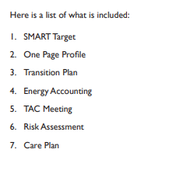
Early Years Transitions
Legislation
Supporting Independence
Developing Independence
Maintaining Self Esteem
Measuring Success
The settings

Slide 43
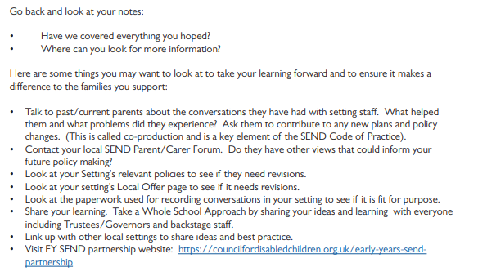
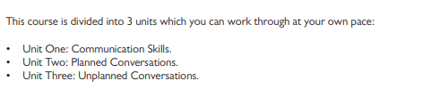
Having Difficult Conversations with Families

Slide 44
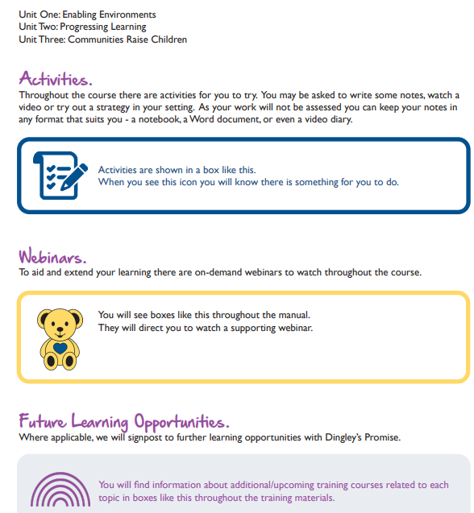
Introduction to Early Years Inclusive Practice

Slide 45
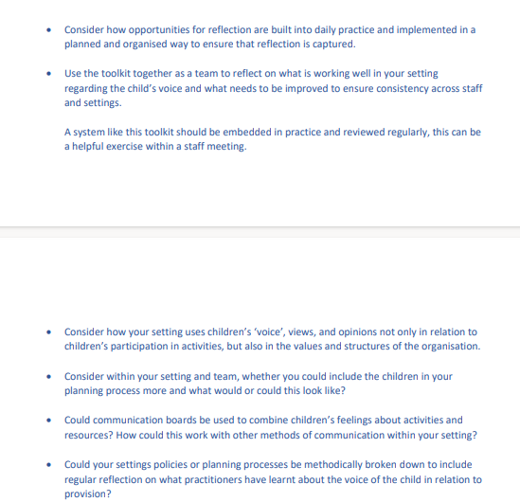
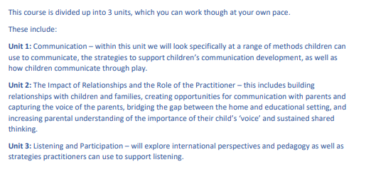
The Voice of the Child

Slide 46
Leadership and Management for Inclusion
The Duties of an Inclusive leader and manager
Leadership of SEND: Preparing for Inclusion
Management of SEND: Business Planning and Strategy
Management of SEND: Day to Day working
Risk assessment template
Inclusive Practice Checklist
Reflective Practice template

Slide 47

Why we need more Dingleys Promise in North Yorkshire
We are receiving more reports from parents saying that they have been turned away from a setting
Setting say that there has been a significant rise in the number of children with SEND
Settings state there are a number of difficulties in terms of available spaces for children with SEND
Manifesto 2023 v5 (dingley.org.uk)

Slide 48
Handy Information linked to deferred or delayed entry

Slide 49
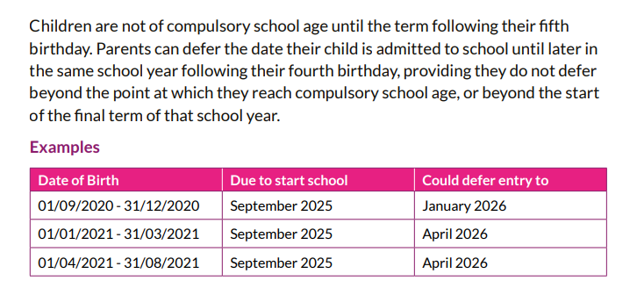
Deferred and Delayed Entry
Parents must apply for a school place in the normal way at the usual time. At the point that a parent has been offered a school place, they should liaise directly with the school to notify the school that their child’s entry to a reception class will be deferred until later in the same reception academic year group, when they reach statutory school age.
This cannot be beyond the point at which they reach compulsory school age, or beyond the start of the final term of that school year.

Slide 50
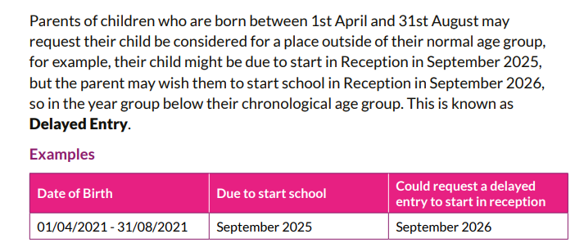
Delayed Entry for Summer Born Children
Placement outside a child’s chronological year group must be considered to be in the best interests of the child.
The decision could potentially have long-term effects and it is therefore important to establish the reasons for the request to delay starting school.
It is also important to anticipate what will happen when your child would be old enough to transfer to secondary school, to leave statutory education and the timing of any consequent examinations.

Slide 51
Points for Parents to Consider
Your preferred school may not have space in the following year to accommodate your child. Early years settings may not have a place for your child to remain in the setting.
You should discuss with your early years setting the implications on your eligibility to receive nursery education funding. The 30 hours entitlement ceases when the child reaches compulsory school age (the term after their fifth birthday.)
For more information, visit the following website: gov.uk/apply-30-hours-free-childcare
As your child matures they may realise that the rest of their class are of a different age, causing adverse emotional impact.
For example, when they are having their 16th birthday, all their peers will be having their 15th birthday. The social, emotional and educational impact of this should be carefully considered. Parents should consider the impact on friendship groups and peer-to-peer relationships.
Admission authorities (e.g. academies) will be the decision makers and may decide to decline a Delayed Entry request.
As the law currently stands, when your child transfers to another school, the admission authority for that school will make the decision on whether to allow them to continue to be educated out of their normal year group. You should ‘rehearse’ this conversation with the school before making your decision.

Slide 52
Points for Consideration
When a parent/carer delays their child’s admission to reception at a first or primary school, until the year after their expected admission, a request for Delayed Entry must be submitted before an application for the next phase of education is made.
So for example for a high school place, when your child starts year 5, rather than year 6, you must at that point request the Delayed Entry.
A child applying for a selective school (e.g. grammar school) may be subject to a weighting in their selective test due to being older than other children in their cohort.
If your child reaches school-leaving age before they have completed their Key Stage 4 curriculum, they may decide to leave school without completing formal examinations.
The expectation is that they will participate in employment or training up until the age of at least 19. If they wish to continue, their further education beyond the academic year of which they turn 18, there is no guarantee that their education establishment will be able to secure funding for that year.
Home to School Transport

Slide 53
Outcomes for Children who have delayed entry
The Education Endowment Fund has carried out a review of research that shows a negative impact on development and attainment of children who have been placed below their chronological age group. As your child matures, they may realise that the rest of their class are of a different age, causing adverse emotional impact
The admission authority of the school must make the decision based on the circumstances of each case and in the best interests of the child concerned.
Please be aware that even if delayed entry is agreed, the normal admission arrangements apply and there is no guarantee of a place. Who makes the decision?
The admission authority for each school must make the decision based on the circumstances of each case and in the best interests of the child concerned.
So, if the school is an academy, free, foundation or voluntary aided school, this will be the Governing Body/Academy Trust.
If the school is a community school or a voluntary controlled school, the Local Authority will ask the Head Teacher of the school to use the Policy on Delayed and Accelerated Transfer to make the assessment.

Slide 54
Schools need to consider
The parents views; Information about the child’s academic, social and emotional development;
Where relevant, their medical history and the views of a medical professional;
Whether they may naturally have fallen into a lower age group had they not been born prematurely; and / or Where relevant evidence from specialist (SEND, The Virtual School) agencies supporting the child.

Slide 55
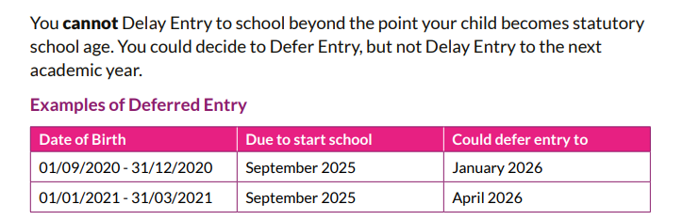
Can I request Delayed Entry if my child is NOT Summer Born?

Slide 56
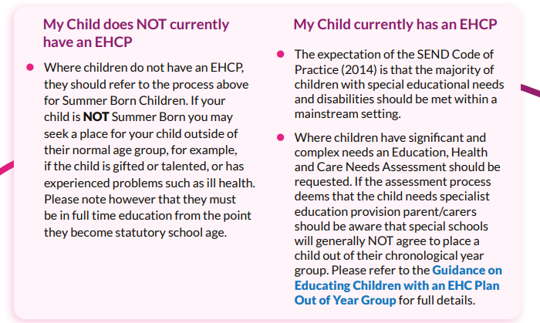
What if I believe my child has Special Educational Needs or has an Education Health Care Plan, can I request Delayed Entry?
The Local Authority view is that children with EHCP’ should be educated in their chronological year group.
This is supported by research into repeating a year which in general shows a negative effect in terms of both academic and emotional outcomes.
However, where requests are received for children with an EHCP to be educated out of year group, whether by delaying entry to school, if summer born, or by repeating a year

Slide 57
Topics for next SENCO Networks?
Dates are on NYES
What would you like to hear?
What would you like to discuss?
Currently trying to organise more face to face opportunities

