Slide 1
Early Years SENCO Network
9th October 2024

Slide 2

Agenda
Wrap around childcare – Elizabeth Roberts
Fine motor development
SEND Assessment Guidance and resources.
How the SEND Hub can support you and what a good referral should include.
Locality Board Updates – verbo, sandcastles
Resources available to support Early Years.

Slide 3
Autumn Term SENCo Network
Meeting the needs of children with SEND in wraparound childcare
Elizabeth Roberts

Slide 4

Wraparound Childcare Guidance for Schools and Trusts
All wraparound providers, including schools and trusts, should make wraparound inclusive and accessible for all children. This includes children with special education needs and disabilities and children considered vulnerable.
Wraparound Childcare: guidance for schools and trusts in England p22-23

Slide 5
What does the Equality Act 2010 say?
Under the Equality Act 2010, you must make reasonable adjustments for children with disabilities.
If a child with disabilities needs a reasonable adjustment to attend wraparound, childcare providers must pay for it, not parents.

Slide 6
When deciding whether an adjustment is reasonable, you may wish to consider:
whether the adjustment is essential in enabling a child equal access to the same provision as their peers
its practicality
the affordability of any one-off or ongoing costs
Where adjustments are deemed unreasonable by the wraparound provider but are necessary in order for the child to access the provision, parents may be asked to cover the associated costs.

Slide 7
To make sure wraparound provision is inclusive, consider:
Having an appropriate offer for children with SEND, including appropriate staff to child ratios
Making sure all staff are appropriately trained to deliver high quality, accessible and inclusive provision
Having a plan to ensure you can identify the needs of children with SEND
Speaking to families regularly to understand individual needs and how these may change
What transport arrangements may be necessary

Slide 8
Supporting SEND Provision:
Case study: School run provision, academy, Cheshire
“We are a really inclusive school and have a high demand from parents of children with SEND to use wraparound. We find that wraparound helps provide consistency for our children with additional needs. Our very experienced TAs work in our wraparound provision – they know the children and have the expertise to support all children who attend.” – Headteacher
Key message: If possible, consider the use of existing school staff to run wraparound – even if it just for the transition into wraparound at the end of the school day.

Slide 9
Supporting SEND Provision:
Case study: PVI provision on school site, Manchester
“If we have children with SEND who are moving into wraparound, we will always meet the club beforehand so that they can make an informed decision on what they would need to put in place to help that child. We have some children with SEND with EHCPs who are in wraparound for two or three nights a week. The team knows why they're SEND, what their needs are – they know the strategies that we use in school so they try to use those as well. A lot of it is just about communication.” – Headteacher
Key message: Communication between school, parents, wraparound staff and the child are key.

Slide 10

Dingley’s Promise Inclusion Training
Dingley’s Promise is passionate about giving every child with special educational needs and disabilities the best start in life.
Free online training
Introduction to Early Years Inclusive Practice
Early Years SEND Transitions
Managing Behaviours that Challenge
Having Difficult Conversations with Families
The Voice of the Child

Slide 11
Any questions?

Slide 12
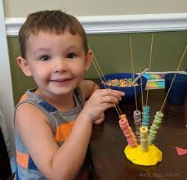
Fine Motor Development
Notes:
Fine motor skills - Help for early years providers - GOV.UK (education.gov.uk)
Hello and welcome to this On Demand Training on fine motor skills. This training will give information on what is fine motor skills, why are they important, especially in the early years, and ways in which yourself as a practitioner can support the development of fine motor skills including how your environment can encourage children to practise and rehearse these skills independently and confidently.

Slide 13

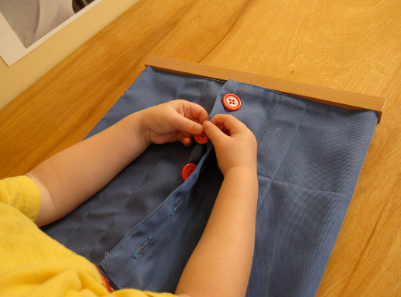
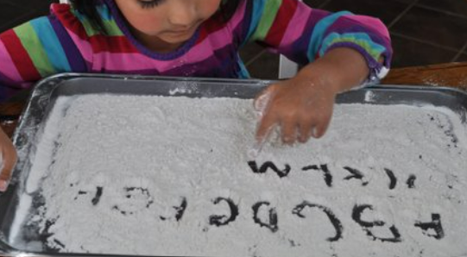
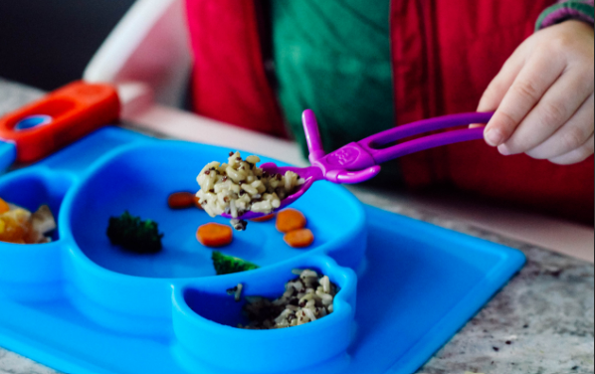
What is it?
The smaller muscles in our hands and fingers, lips, eyes and tongue.
Coordination between these muscles such as hand-eye coordination.
Notes:
We often talk about fine motor skills in the early years sector and most commonly this term is used when thinking about a child’s hands and fingers. However, fine motor skills also involves the development of the smaller muscles in a persons fingers, lips, eyes tongue. Developing fine motor control helps us develop co-ordination between these muscles such as hand-eye coordination.
Fine-motor skills involve the brain and nervous system communicating to the smaller muscles in the body to control movements. The development of fine motor skills supports children with everyday tasks such as fastening buttons, tying shoes laces, fastening zips, eating and writing. But how do we support these skills to develop?

Slide 14

Have you heard about 'The Story of Mr Tongue?

Slide 15
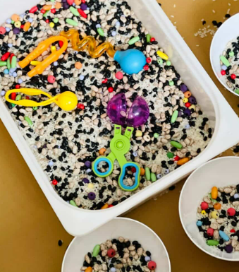
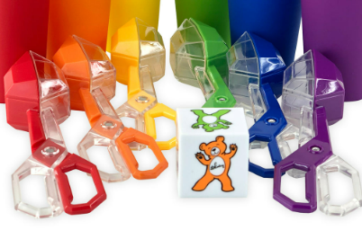
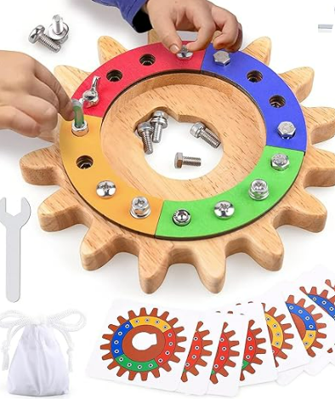

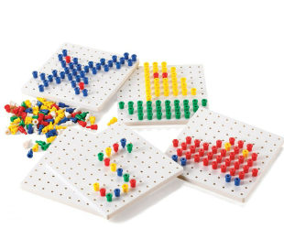

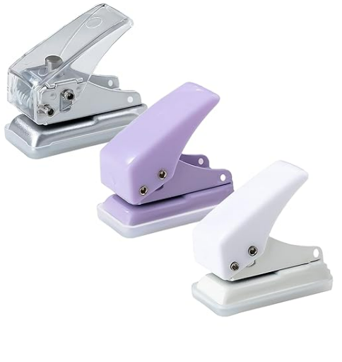

Fine motor activities
Scoops, tongues and tweezers
Messy play
Busy boards
Threading
Peg boards
Playdough
Hole punchers, scissors and pencils
Lego or Duplo
Notes:
Let’s take some time to think about the activities you could be offering in your setting to support children with their fine motor skill development, especially within your ordinarily available resources. There are many things that you may already have on your list, here are some other things too.

Slide 16
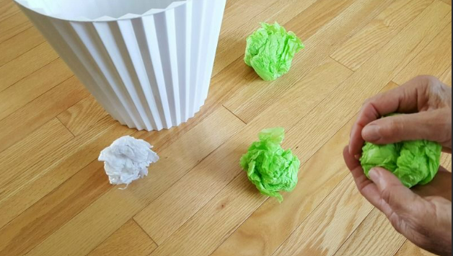
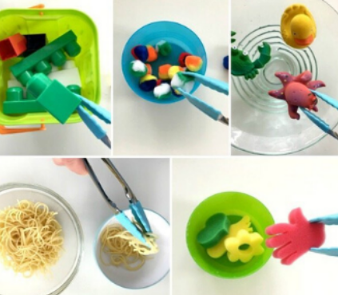

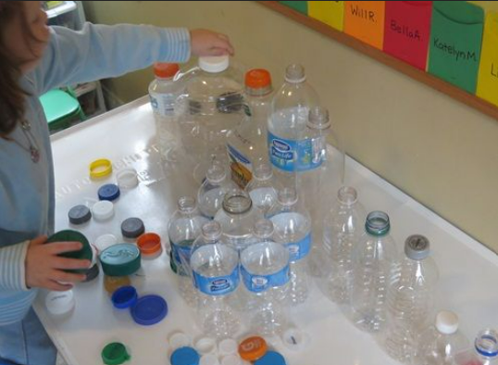
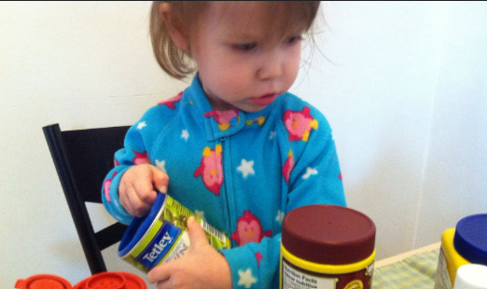
You don’t even need fancy toys…
Using spray bottles to water the flowers or wash windows.
Scrunching up paper
Using kitchen tongs to move items
Opening and closing lids on containers
Screwing lids on and off bottles.
Notes:
It is important to remember that you don’t always need to purchase new toys to support fine motor skills there are many everyday resources that you can use and adapt. Here are a few ideas…

Slide 17

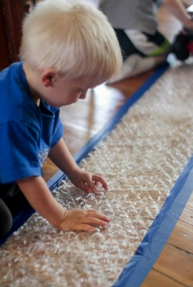
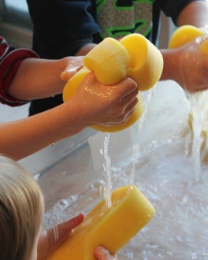
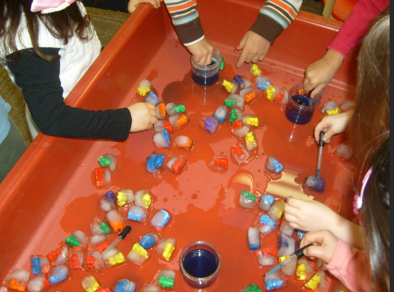
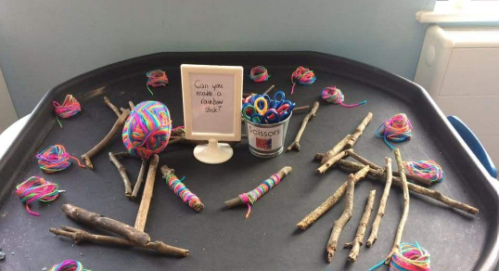
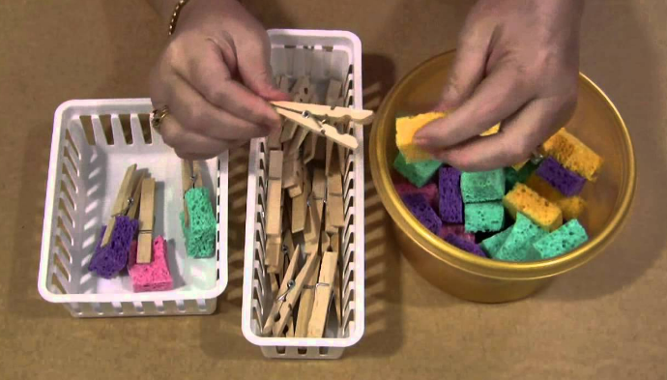
Pipe cleaners through a colander
Droppers in the water tray
Squeezing sponges
Popping bubble wrap
Threading Cheerios onto spaghetti
Winding wool around sticks
Using pegs

Slide 18


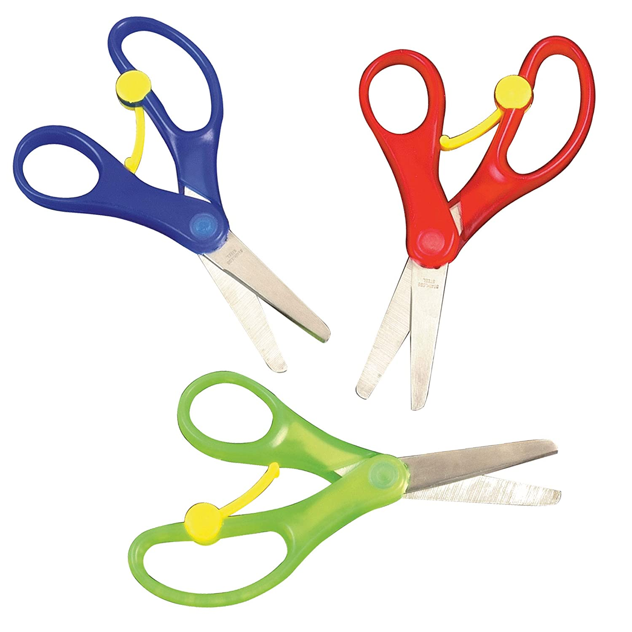
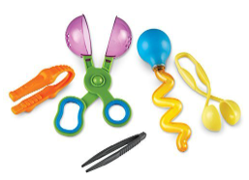
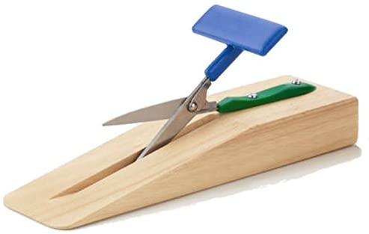
Graded materials to support with Fine motor skills.
Notes:
It is important to think about graded materials when setting up your environment. Some children my be able to typically access ‘regular’ scissors for example, but some children my not be ready for this stage yet. They may still be working using a palmer grasp of which the spring loaded scissors would developmentally support them the best. They may still be developing their bilateral skills (2 hands working together) of which the scissors mounted to the wooden block would support them at this stage.
We do offer further training on graded materials that covers a range of skills including threading, posting, stacking, joining and scooping.

Slide 19

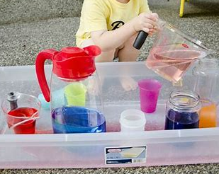
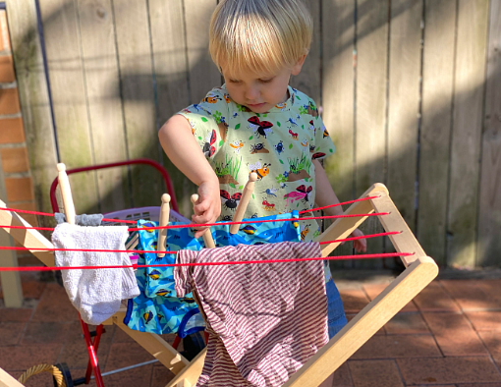
Purposeful Tasks and Routines
How can everyday routines support fine motor development?
Getting dressed and undressed
Mealtimes
Self-serving snack
Helping to hang out the washing
Notes:
Making time in your everyday routines to practice and rehearse skills such as putting on your coat, fastening zips and taking on and of your own shoes are all important and purposeful activities which can support fine motor skill development. In addition to this offering opportunities for children to independently self serve themselves water, milk or snack can promote independence whilst providing an opportunity to develop their fine motor skills. Peeling an orange for example can be hard work for little fingers!
Mealtimes is another great purposeful task for children to have a go at using both hands to cut up their own meals. Encouraging children to use both their hands at the same time will support a child’s bilateral skills. As well as their fine motor ones.
Other tasks around the home could be hanging out the washing, serving up meals using tongues, watering plants using a spray bottle gardening and many more.

Slide 20

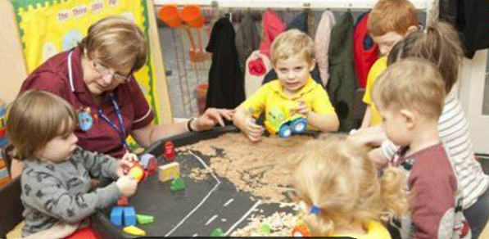
The importance of the adult role
Adults are a child’s first point of learning, so how can adults support fine motor development?.
Notes:
Children first begin learning from their main carers. They do this through watching their facial movements and responding by cooing and smiling. Developing their fine motor skills is no different. They are commonly watching what adults are doing, often wanting to copy their behaviours and actions.
It is crucial that as adults we are playing alongside the children, teaching them skills such how to use scissors, threading and manipulating materials in different ways. This could be by pushing together and pulling apart blocks, moulding malleable resources such as playdough into different shapes or making marks using different resources. Modelling how to use different resources and offering positive praise and encouragement can further support children when developing a new skill. If adults are genuinely interested, it is more likely the child will be willing to have a go and practice a new skill.

Slide 21
Please share your ideas in the chat box..
What does your setting do to support fine motor skill development?
Do you have any exciting ideas or resources to share?
Any questions are fine motor skill development?

Slide 22

Every teacher is a teacher of SEND
Every leader is a leader of SEND
Every governor is a governor of SEND
Every Inspector is an Inspector of SEND

Slide 23
SEND Assessment guidance and resources
Developed by the Department for Education in partnership with Dingley's Promise.
Developed to support the areas for C&I, C&L, SEMH and Sensory and Physical
1-page profile
Support and achievement play plans
SMART goals
Help for early years providers : SEND assessment guidance and resources (education.gov.uk)

Slide 24
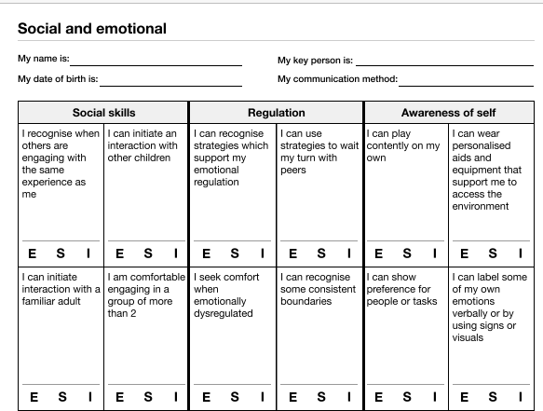

Slide 25
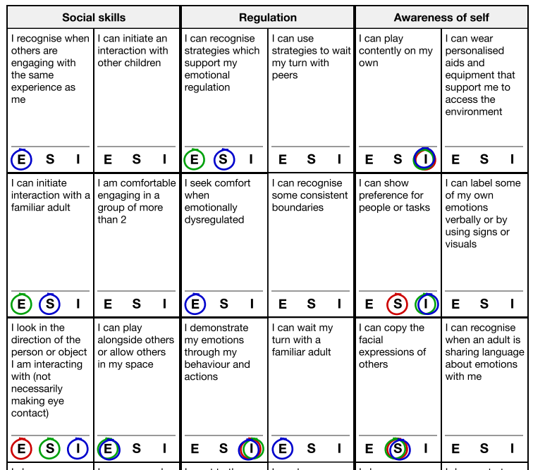

Slide 26
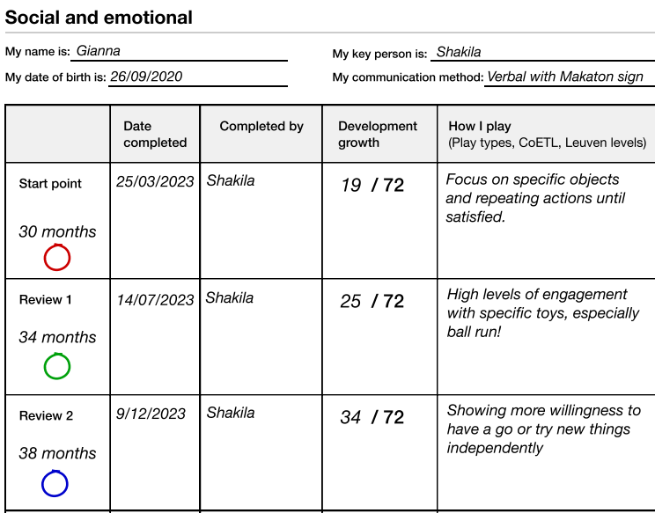

Slide 27
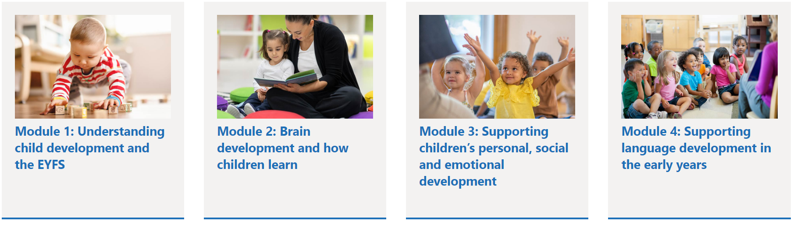


Slide 28
Remember hub teams are there to help
Hub referral and hub handbook:
SEND hubs | CYPSinfo (northyorks.gov.uk)
SEND - Hub Referral Form.docx (live.com)

Slide 29

Early Years Drop ins.
You said we heard... There will be specific Early Years drop ins.
You may wish to use this time to talk about; Individual Learning Provision Plans (ILPPs), smart targets, Hub referral forms, Education Health and Care Assessment Requests (EHCARs), Element 2 funding, provision, transition etc.

Slide 30
Your named Early Development Specialist Teachers (EDSTs) are...
Scarborough, Whitby and Ryedale – Stacey.gould@northyorks.gov.uk
Tracy.johnson-hughes@northyorks.gov.uk
Hambleton and Richmond – lorayne.farrington@northyorks.gov.uk
Selby – lynne.kilford@northyorks.gov.uk
Harrogate and Craven – Elizabeth.fawcett@northyorks.gov.uk

Slide 31
Hub Support
Direct support from:
EDSTs
Portage Practitioners in the home
Portage Practitioners in the setting
Portage Practitioners in the home and setting (hybrid)
EDSTs and Portage Practitioners (hybrid)
Maximum of 6 weeks, EDST. Up to 12 weeks, Portage
Notes:
-

Slide 32
Criteria for EDST and Portage
Portage:
Referral needs to say for portage
Delay in 2 or more areas
No cycles needed
If a child is accessing less than 15 hours of the 2 or 3-year old funded provision Portage is likely to happen in the home
If a child is below 2 years of age it is likely that they will be allocated Portage in the home
EDST:
completed 1 cycle of assess plan do review
Notes:
Don't need a diagnosis

Slide 33
Criteria for C & I and SEMH
Completed 2 cycles of assess plan do review.
C&I teams offer speech and language drop ins with a speech and language therapist. Contact your EDST to find out when these are running, we are happy to signpost.

Slide 34
What's useful for us on a referral:
State days and times child attends your setting
What support is wanted and from who
Refer to previous support from the Hub or any other agencies such as Early Help, OT, PT, SALT.
Professionals involved, including previous
Notes:
-Timings as morning times in one setting is very different to another
-Need to state portage as if panel feel more appropriate for other area and no cycles it will be a 'no'
-You don't have to refer any child with SEND. You may have the tools in your toolbox already. Think about previous hub support, may have similarites and

Slide 35
We feel Portage in the home would support Nieve with her development.
Barney attends nursery Wednesday 7:45am until 1pm.
Hilda is communicating using different sounds and coos such as 'eee' and 'oooo'. We have started using objects of reference with her, but she is not responding to these yet.
Olivia's behaviour has escalated over the last 6 weeks. When unpicking these outburst further using a STAR chart, we feel it may be linked to her processing skills or level of understanding of language.
We would like support with Albie's gross motor skills. He is not yet rolling over or reaching out for objects. We have already tried...
Jesse finds retaining information difficult. We are using simple language to support them, but they are still finding this difficult. We would like to know how else we can support them with their memory skills.
We are confident with supporting Millie's communication using Makaton but we would like further support with how to use visuals in the setting.

Slide 36

Updates – remember it's live
Home - Locality Boards (localityboardsnorthyorks.co.uk)

Slide 37

Verbo
Available to all areas on the locality board.
There are currently 18 training modules specific to Early Years including an introduction to Autism, supporting children who stammer, visual supports in practice and many more.
There are 63 videos/leaflets to support communication in practice, including taking turns with peers video, now and next board video, working with bilingual children leaflet and many more.
Screening tools for ages 2, 3 and 4 years, with automatically generated targets and activity recommendations
Progress tracking for individual children
Early Years Environment audit – how to achieve bronze, silver and gold.

Slide 38

Sandcastles Play Therapy
Therapeutic intervention for children aged 3+ years who have experienced adverse childhood experiences.
10-12 fully funded play sessions
For more information - Sandcastles Play Therapy - Locality Boards (localityboardsnorthyorks.co.uk)
Currently on the SWR locality board.
Please remember to keep checking your locality board for new resources in your areas.

Slide 39
Things to remember…
Sleep Charity
Dingley's promise
Solihull approach – free training
Stronger Practice hub
Early Years in Mind
Early Years Store Themes

Slide 40


Sleep support
The sleep charity can support families with difficulties around sleep and bedtime.
Link to the online referral form that families can use...
https://customervoice.microsoft.com/Pages/ResponsePage.aspx?id=tM8A_0RGPkqFmV1DXoOj23Y2TemtqQdKul-LKH5eWmBUMTlQMUROWkcxOTRQU0dGTkk4MFczWDk5Ui4u
There is a waiting list of about 2 months so please also direct them to the Helpline:
https://thesleepcharity.org.uk/national-sleep-helpline/

Slide 41
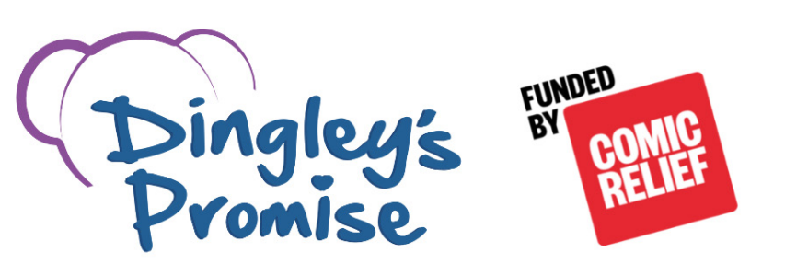
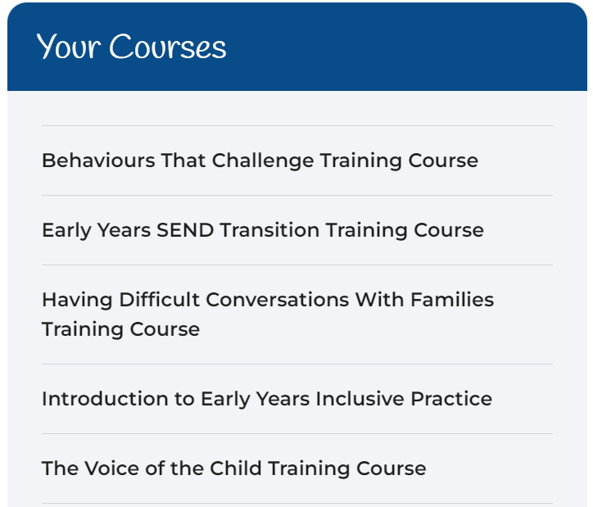
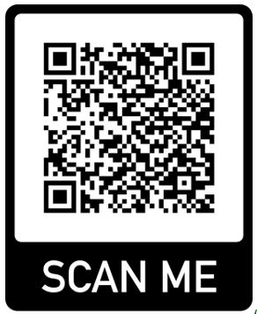

Dingley’s Promise – Early Years Inclusion Project (North Yorkshire)
Do you want access to cutting edge training?
Free online training for those working with young children (0-5 years)
All courses are online and are a mix of workbook, clips and activities.
Complete in any order and at your own pace.
Receive a certificate of completion for each course.
Get the Dingley’s Promise Kitemark!
North Yorkshire participants’ feedback
99% would recommend the training to colleagues
95% said they would do something different following the training
Register at:
https://dingley.org.uk/dingleys-promise-training/early-years-inclusion-programme/

Slide 42
Dear Parent/Carer
Here at Dingley’s Promise, we are working tirelessly for children in the early years with SEND and disabilities, and their families. Our work includes running specialist centers nationally, providing inclusion training for early years practitioners and developing strong links with local authorities to offer the support needed to improve sufficiency and the delivery of inclusive practice in their local areas.
Part of our work with local authorities involves reaching out to you, the parents and carers about your experiences when navigating the local authority system and finding a setting for your child. We need you to complete our survey. Your responses will highlight areas of success and areas where support is needed so we can focus our energies where it is most needed.
If your child already attends a setting complete this survey – https://www.surveymonkey.com/r/YTFMQ8B
If your child doesn’t currently attend a setting complete this survey - https://www.surveymonkey.com/r/K5K7NP7
If the links aren’t working for you, please let us know – training@dingley.org.uk
Thank you for taking the time to complete this survey. The information you provide will help us to facilitate much needed changes in the early years for children with SEND.
Kind regards
The Dingley’s Promise Team
Please share this letter with your families.

Slide 43


Solihull Approach
Online courses dedicated to improving emotional health and wellbeing in parents, children, teenagers, adults and grandparents.
Courses currently available to families.
Understanding your child: from toddler to teenager
Understanding your child with additional needs
Understanding your child’s feelings
Understanding your child’s mental health and wellbeing
Understanding the impact of the pandemic on your child.
Supporting transitions for your child.
Link to access - inourplace | Solihull Approach | Online courses

Slide 44

Stronger Practice Hub
Based in Scarborough and York
There is a Facebook group - 'Yorkshire and Humber together Stronger Practice Hub'
Contactable by email on sph@childhaven.n-yorks.sch.uk
Release case studies around early years practice
Offer open days to visit different settings
Networking opportunities

Slide 45
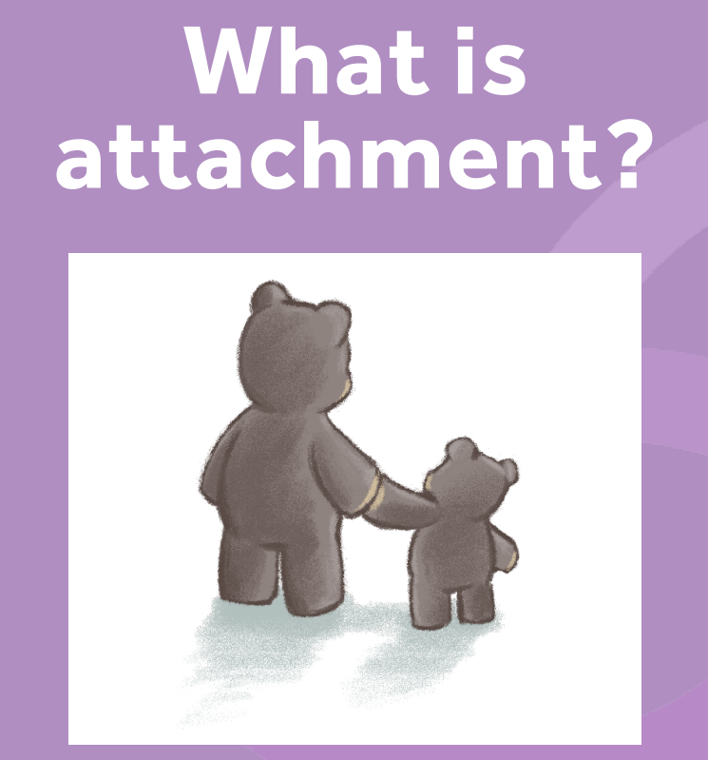

Early Years in Mind
Free online network for Eary years Practitioners
Supporting the mental health of babies, young children and their families.
Free resources on attachment, mental health, well-being, supporting relationships, ect...
Worth having a look...Early Years in Mind | Anna Freud

Slide 46
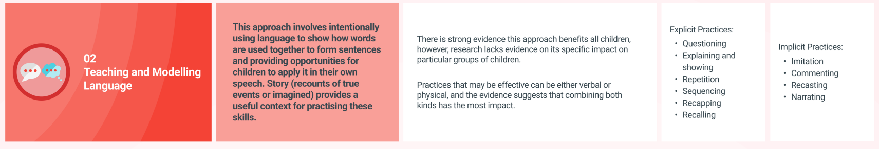
Early Years Store themes
Developed to support the DfE's stronger Practice Hubs programme.
Includes six key themes for younger children's learning and development. Communication and Language; Personal, Social and Emotional Development; Early Years Literacy; Early Mathematics; Self-regulation and Executive Function; Physical Development.
Offers research-based evidence and practice tips to support each area of development in your setting.
Early Years Evidence Store | EEF (educationendowmentfoundation.org.uk)

Slide 47
Next SENCO Network:
Please let us know what you would like us to cover in the next meeting.. Add your thoughts to the chat box or email lynne.kilford@northyorks.gov.uk
The next Early Years SENCo meeting will be on 12th February 2025

