Slide 1
Early Years SENCO Network
15th October 2025
Notes:
Welcome back to the new academic year

Slide 2


Agenda
Early Years Framework Updates – September 2025
  Safer eating
  Safe sleep
  Toothbrushing
New writing framework – July 2025
Education Inspection Framework (OFSTED) Changes – Nov 2025
Hub updates
Communication strategies
  Joint attention
  Intensive Interaction
  Use of questioning
Reminders
Guest speaker – Jayne Young, Occupational Therapist; Let's make sense together

Slide 3

Early Years Foundation Stage Framework – updates September 2025
Safer recruitment . (EYFS Statutory Framework for Group and School-Based Providers 2025: paragraph 3.18)
Absence procedures
Whistle blowing
Staff training requirements
Named DSL - (EYFS Statutory Framework 2025: paragraphs 3.6 for group settings/ paragraphs 3.7 for childminders)
Early Years Safeguarding Reforms from September 2025
Notes:
Safer recruitment – Settings must obtain and provide references for all new staff, in addition to existing checks. These have to be directly obtained by you, not applicant provided. References need to be childcare specific if applicants were in a childcare post
Absence procedures – When a child is absent and you haven’t been informed, it’s vital that you act in a timely manner. You must follow up with alternative emergency contacts if you cannot contact the parent / carer. That’s why it’s so important that you keep contact information up to date — it’s not just a formality, it’s a safeguarding measure. You also need to assess the level of risk. Is this absence unusual? Are there any known concerns? If you feel there’s a potential risk to the child’s welfare, you must escalate appropriately. That could mean requesting a police welfare check or contacting social services. Make sure parents are aware of your attendance policy. They need to understand what’s expected and what actions will be taken if their child is absent without explanation. Nursery isn't compulsory so parents don't always understand why they need to inform so don't
Whistle blowing - Providers/childminders must establish clear whistleblowing processes for staff to report safeguarding concerns. This includes outlining reporting methods and follow-up actions in their policies and procedures. Staff must be made aware of these systems and assured that their concerns will be taken seriously.
Staff training requirements - All staff must have the relevant training in safe guarding. There is lots of guidance around this including on the link on this slide. All staff must have first aid training (within 3 months of starting work) to be included in ratios.
Named DSL - Settings are required to have a DSL with specific responsibilities and training needs

Slide 4

Safer eating
(EYFS Statutory Framework 2025: paragraphs 3.62 - 3.72)
Paediatric First Aid (PFA) presences
Dietary requirements.
Supervision
Environment
Choking Prevention - Guide to how to prepare foods
Individualised Dietary Planning (include sensory sensitivities, texture aversions, swallowing difficulties)
New nutrition guidance - Help for early years providers : Nutrition
Notes:
First aid - A staff member with valid PFA training must be present whenever children are eating.
Detailed dietary requirements to be gathered and checked - allergies, intolerances and health needs before a child starts. Allergy action plans. All staff should have an awareness of the difference between allergies and intolerances. All staff trained to recognise symptoms of allergies and anaphylaxis, and understand appropriate responses. May need SEND specific training to support children with feeding difficulties or complex health needs.
Supervision - Children must be within sight and hearing during all meals and snacks. Assign a nominated staff member to check food and drink for each child. Need to consider those children that will only eat when wandering, use food to regulate
Environment – minimize distractions to create calm eating, appropriate seating, solid food introduction – consider developmental age not just chronological age. Consider culture
Choking - Food must be prepared in a way that minimizes choking risks, especially for children with developmental delays or oral motor difficulties. Pack-ups from home. Parents must be informed if their child has choked in your care. We have added a link on here which gives useful information about how to prepare foods to reduce choking. White bread, cheese
Individualised Dietary planning -
Nutrition guidance – A great resource that will guide you through the nutritional guidance for each ages and stage of development.
-

Slide 5

Safe sleep reminder
Prop feeding
Sleep checks
Environment
Co-sleeping
Links
  Safer sleep for babies - NYSCP
  Safe sleep general advice - NYSCP
Notes:
Promotion will be coming out about safe sleeping so something to look out for.
Prop feeding is where babies are left with bottle propped on buggy, cushion etc. What is supposed to happen is that baby turns their head when finished. NOT safe as risk of choking, aspiration and overfeeding. Feeding should not take place in a cot or sleep space – separate feeding from sleeping
Sleep checks - every 10minutes and logged
Environment. Babies must sleep on their backs, not inclined or on soft sleep surfaces – such as cushions, beanbags or nests. Temperature monitoring (16-20)
Co-sleeping. Know won't happen in settings but it is our duty to encourage safer sleeping. The safest way is not to co-sleep.
If you see worrying practice when they are in the home, we need to be confident to tell parents it isn't safe, and signpost parents to information. We just need to consider as part of our safeguarding thoughts.
, putting babies on their backs to sleep and not co sleeping and what you might be more likely to see in your work is "prop feeding" which is apparently where babies' bottles are propped on the side of their buggy/car seat/crib so they can feed themselves and then move their heads away when they are full. All agencies have been asked to be aware this is something people do but is not safe.

Slide 6


Sleep support
The sleep charity can support families with difficulties around sleep and bedtime.
Link to the online referral form that families can use...
https://customervoice.microsoft.com/Pages/ResponsePage.aspx?id=tM8A_0RGPkqFmV1DXoOj23Y2TemtqQdKul-LKH5eWmBUMTlQMUROWkcxOTRQU0dGTkk4MFczWDk5Ui4u
There is a waiting list of about 2 months so please also direct them to the Helpline:
https://thesleepcharity.org.uk/national-sleep-helpline/
Notes:
We highlight the sleep charity to some of the families that we work with

Slide 7


Brushing Teeth
-Movement and heavy work activities before tooth brushing
-Shoulder wrap or weighted toy on shoulders
-Allow child to sit
-Consider toothbrush – may need softer bristles, may need vibrating toothbrush
-Mirror
-Warm water is more calming than ice cold
-Background noise or music if child is sensitive to sound. Toothbrushing songs
-Unflavoured toothpaste
-Chew on wet flannel or chew toys to help calm their touch system
-Toothpaste for child without enamel (correlation between prematurity)
www.hdft.nhs.uk/services/oral-health-promotion-team​
​
Notes:
Lots of settings are now including teeth brushing as part of their daily routine – we know you had information at a previous senco net but a couple of years ago. We also thought it would be useful to consider those children who struggle. Mouths are very sensitive, sensory sensitivity, reduced dexterity. Some of this will be trial and error. Discuss with parents what works at home – might be that they need ideas too to support their child as struggling at home too

Slide 8
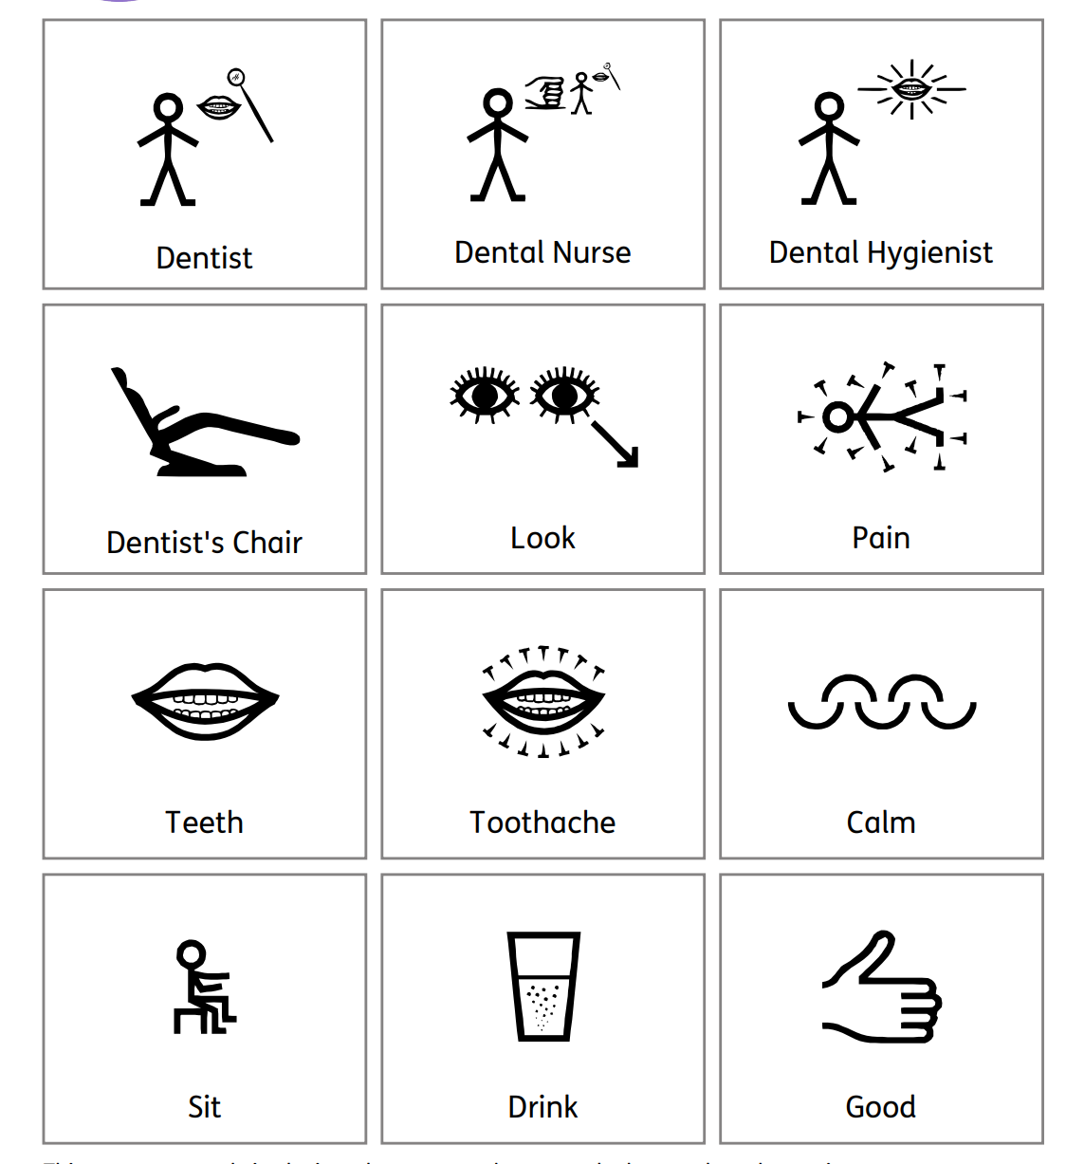
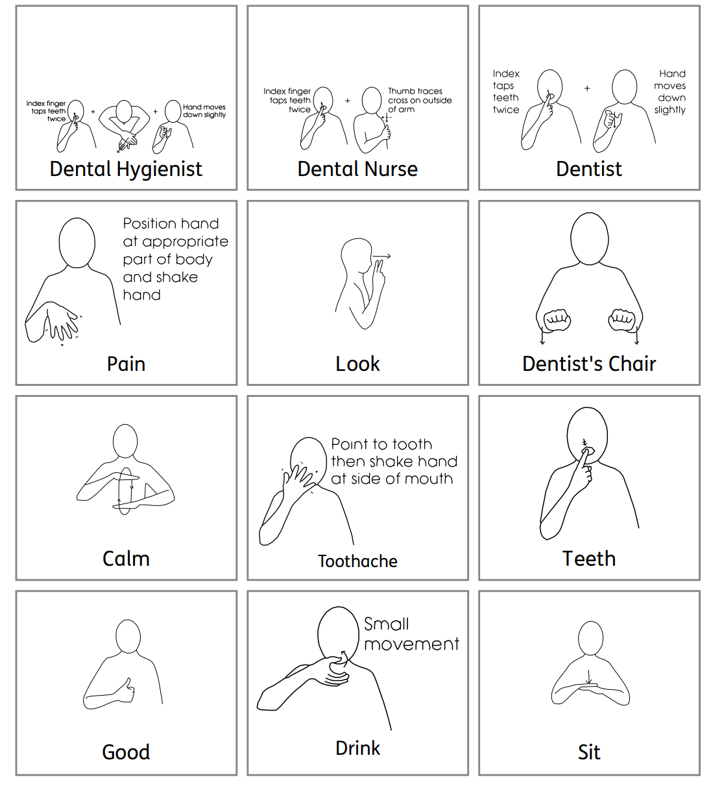
Dentist Makaton Prompt Cards
The Makaton Charity (2021)
Notes:
These are free resources to help improve communication at dental visits.
These are available online.

Slide 9
Resources
Public Health England – Oral care and people with learning disabilities
Oral care and people with learning disabilities - GOV.UK (www.gov.uk)
National Autistic Society – Advice on going to the dentist
Parents and families (autism.org.uk)
British Society of Paediatric Dentistry –
Advice for parents of children with autism BSPD Advice for parents of children with autism Jan 17.pdf
Notes:
Maybe useful to share with parents. Discusses legal obligation for dentists to make reasonable adjustements. Poor oral health can lead to pain and discomfort.

Slide 10

Writing Framework Updates – July 2025
Key Guidance for Nursery Settings
Focus on Foundational Skills - Nurseries emphasize oral language, physical readiness, and mark making over formal writing.
Physical Readiness Activities- Activities like playdough, climbing, and painting build muscle control for handwriting.
Play-Based Learning Integration - Writing opportunities should be meaningful, linked to interests, and embedded in play.
Inclusive and Individualized Support - Settings must support diverse needs by observing progress and collaborating with specialists.
  Use of assisted technology - Use of assistive technology for children with motor or sensory difficulties.
  Adapted teaching - Adapt teaching methods and environments to ensure access without lowering expectations.
  https://eycp.essex.gov.uk/media/2619/9957-early-years-writing-pathway-document-v4-accessible.pdf
Notes:
The Writing Framework (September 2025) provides essential guidance for nursery settings to support early writing development in young children. It clearly states that there is no expectation for formal writing in nursery. Instead, the focus should be on foundational skills such as oral language development, physical readiness, and mark making. Children should be encouraged to engage in dialogue, storytelling, and the use of rich vocabulary, as spoken language is a critical precursor to writing.
Physical readiness is another key area, with the framework recommending activities like playdough manipulation, climbing, and painting to help develop the muscle control necessary for writing. These activities support hand strength, posture, and grip, which are all essential for future handwriting skills. The framework also emphasizes the importance of embedding writing opportunities within meaningful, play-based learning experiences. Writing should be linked to children’s interests and integrated across various areas of provision to make it purposeful and engaging.
Recognizing and celebrating individual progress is vital. The framework acknowledges that children develop at different rates and advises practitioners to observe and respond to each child’s developmental stage. Forcing formal writing too early can create long-term barriers, so small steps in mark making and early writing should be acknowledged and encouraged.
Inclusive practice is a cornerstone of the guidance. The framework aligns with the Early Years Foundation Stage (EYFS) and the SEND Code of Practice, emphasizing the importance of early identification of additional needs. It encourages the creation of accessible environments and collaboration with SENCOs and other specialists to ensure all children receive the support they need. This holistic, child-centred approach ensures that nursery settings lay strong foundations for writing, tailored to the unique needs and pace of each child.

Slide 11

OFSTED Framework - Summary of Changes Relevant to SEND in Early Years
Inclusion as Evaluation Area- Inclusion is now a distinct inspection area, focusing on meeting the needs of children with SEND in early years settings.
New 5-Point Grading Scale- Introduced a detailed 5-point grading scale for evaluations, enhancing clarity on SEND support quality.
Safeguarding Emphasis - Safeguarding now has a dedicated grade to ensure thorough assessment of children’s safety and well-being.
Separate Grading for Early Years Provision - Early years provisions in schools, including nursery classes, will be graded separately to assess SEND support effectively.
Contextualised information - Inspection reports will now include contextual data about the setting, including SEND and deprivation figures.
Early years inspection toolkit
Notes:
The Education Inspection Framework (EIF) for use from November 2025 introduces several key updates that are particularly relevant to Special Educational Needs and Disabilities (SEND) in the Early Years sector. One of the most significant changes is the introduction of 'Inclusion' as a distinct evaluation area in inspections. This means that inspectors will specifically assess how well early years settings identify and meet the needs of children with SEND. The framework emphasises inclusive practices and the importance of adapting the curriculum and teaching methods to support diverse learning needs to break down any barriers children have when accessing a broad and rich education.
Another major update is the implementation of a new 5-point grading scale for each evaluation area. The scale includes: Exceptional, Strong standard, Expected standard, Needs attention, and Urgent improvement. This change allows for more nuanced (subtle) reporting and provides clearer insights into how well a setting supports children with SEND. Notably, the framework has removed the overall effectiveness grade, focusing instead on individual evaluation areas.
Safeguarding has also been given increased prominence, with a separate grade of either 'Met' or 'Not met'. This ensures that the safety and well-being of children with SEND are thoroughly evaluated during inspections. The framework outlines specific evaluation areas for early years providers, which now include: Safeguarding, Inclusion, Curriculum and Teaching, Achievement, Behaviour, Attitudes and Establishing Routines, Children’s Welfare and Well-being, and Leadership and Governance.
Additionally, for schools that offer early years provision, such as nursery classes, the framework confirms that this provision will be graded separately. This includes provision for 2- and 3-year-olds, ensuring that SEND support in these age groups is specifically assessed. These updates reflect Ofsted’s commitment to raising standards and improving outcomes for all learners, particularly those who face barriers to learning and well-being.
Overall, the revised EIF underscores the importance of high-quality, inclusive education in the early years and provides a more detailed and transparent approach to evaluating how settings support children with SEND.

Slide 12

Changes to SLCN team in the SEND hubs
Historically you may have seen the SLCN team in your setting however the focus now is on statutory work, TMPs, No Wrong Door
Remember if just speech delay (speech sounds), look at NHS Speech and Language pathway
If speech and another area of delay (could be social interaction) – ensure this is clear on hub referral

Slide 13

Early Years Drop ins.
You said we heard... There will be specific Early Years drop ins.
You may wish to use this time to talk about; Individual Learning Provision Plans (ILPPs), smart targets, Hub referral forms, Education Health and Care Assessment Requests (EHCARs), Element 2 funding, provision, transition etc.

Slide 14
Your named Early Development Specialist Teachers (EDSTs) are...
Scarborough, Whitby and Ryedale – Stacey.gould@northyorks.gov.uk
Tracy.johnson-hughes@northyorks.gov.uk emma.jones@northyorks.gov.uk
Hambleton and Richmondshire – Elizabeth.fawcett@northyorks.gov.uk
Selby – katie.heaven-terry@northyorks.gov.uk
Harrogate, Knaresborough, Ripon and Craven – lynne.kilford@northyorks.gov.uk

Slide 15
Communication Strategies
Joint Attention
Intensive Interaction
Use of questioning
Notes:
With the changes to the SLCN team we have included some reminders which the SEND Hub often come out and talk about for children with communication delays.

Slide 16


What is Joint Attention?
An early-developing social communicative skill of two people paying attention to the same thing intentionally- sharing an interest in the same object or event using verbal or non-verbal gestures.
Often a child will be showing signs of joint attention by 12 months of age
Notes:
Sharing a purpose-communicating to each other that they have seen the cake and share an interest in the same item using gaze. Might be shouting “hey check out that delicious cake…but that’s not needed"
Staff room food on the table, last cake-look at your friends across the table, back at the cake and the polite conversation starts about who wants it? Shall we half it?

Slide 17
Video
Notes:
Great example of joint/shared attention
Child looking at puzzle piece, looking at Mum, sharing the same purpose/intention-label and place the pieces, feedback from mum.

Slide 18
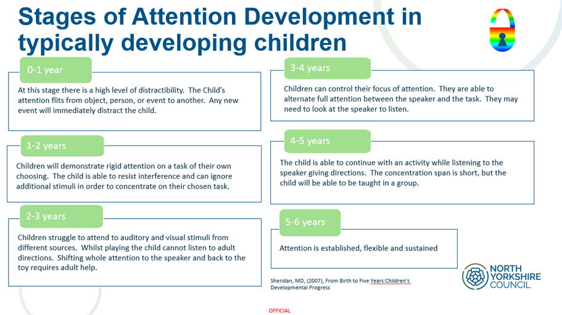

Slide 19
Ways to develop joint attention
Playing peek-a-boo
Using novelty objects
Singing songs
Sharing genuine interest in an activity – SST
Copy boxes -Enhancing Early Years SEND Children’s Development with the Copy Box Approach – That SEND Teacher
Ready, steady, go - Ready, Steady, Go! Fun anticipation games for toddlers - BBC Tiny Happy People

Slide 20
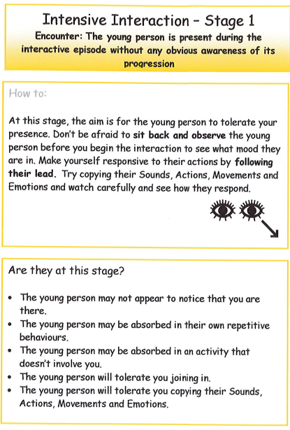
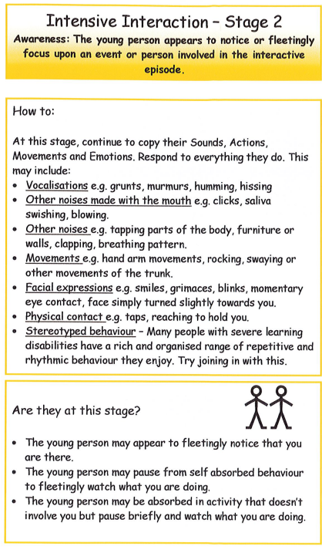
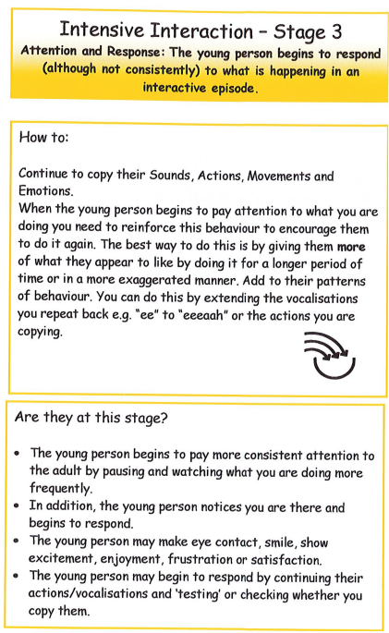
Intensive Interaction
There are 7 stages; but we frequently share stages 1-3 with settings to support children.

Slide 21

Use of questioning...
Sometimes asking too many questions can cause a child to shut down for a variety of reasons...
Slow processing
Not understanding the question
Not having the language or tools to respond
Or simply being worried about getting the question wrong.
SST can promote a collaboration between an adult and a child to explore something together.
Notes:
It is so easy as a practitioner to fall into the trap of asking question after question after question and forgetting how to sit back and truly tune into a child's play.
Sometimes asking too many questions can make a child shut down, this could be for a variety of reasons from slow processing, to not understanding the question, to not having the language to respond to a question, forgetting the question or simply being worried about answering the question incorrectly.
Sustained Shared Thinking can promote a collaboration between an adult and a child to discover something new or explore something in a different way.

Slide 22
Sustained Shared Thinking
There are some key elements in there:
Working together – The teacher isn’t just presenting information for the child to learn. It’s a partnership, and information flows both ways.
An intellectual way – The thinking can be practical or theoretical, but it should involve deep thinking and coming to solutions or conclusions.
Develop and extend – Sustained Shared Thinking can’t be a short dialogue. The thinking has to be extended to make sure deep-level thinking takes place and the interaction is memorable for the child.
Another couple of key features are active listening and positive questioning. That means that you’re really deeply engaging with what the child is doing or saying on their level, and that you’re asking the right questions or using a different prompt.
What is Sustained Shared Thinking?
In the simplest sense, Sustained Shared Thinking is best described as one of those moments with a child where everything else around you just stops.
You’re so absorbed with the conversation or exploration, that the act of working together and taking in what you’re learning about the child is all that matters.
Notes:
The official definition of Sustained Shared Thinking can be found in the two influential studies that birthed it, Researching Effective Pedagogy in the Early Years (REPEY), and The Effective Provision of Pre-School Education (EPPE). The studies, which looked into the development of thousands of children, explain Sustained Shared Thinking as:
Link for further reading:
https://famly.co/blog/management/promote-sustained-shared-thinking-kathy-brodie/

Slide 23
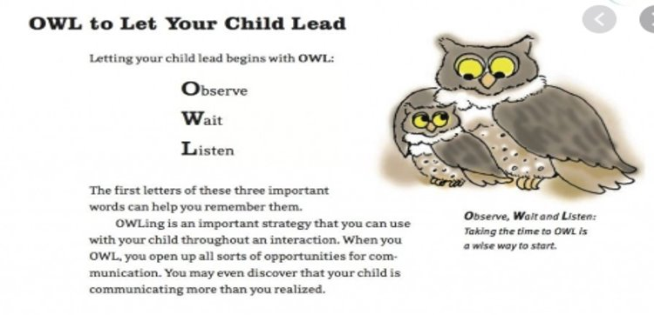
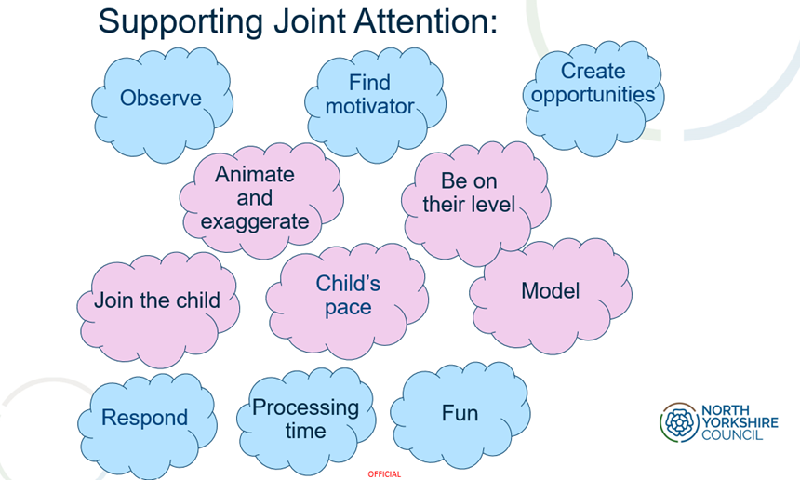
So how might this look in practice?
Playing alongside – be at their level. Interact with them at their developmental stage.
Tune in – listen carefully to what is said, watch the child's action – what are they really exploring in their play?
Add a resource – for example if digging fossils in the sand add a paint brush to brush away some sand from the object
Suggesting – what might happen if we...
Think out loud - "If I mix red with yellow I might get a new colour..."

Slide 24
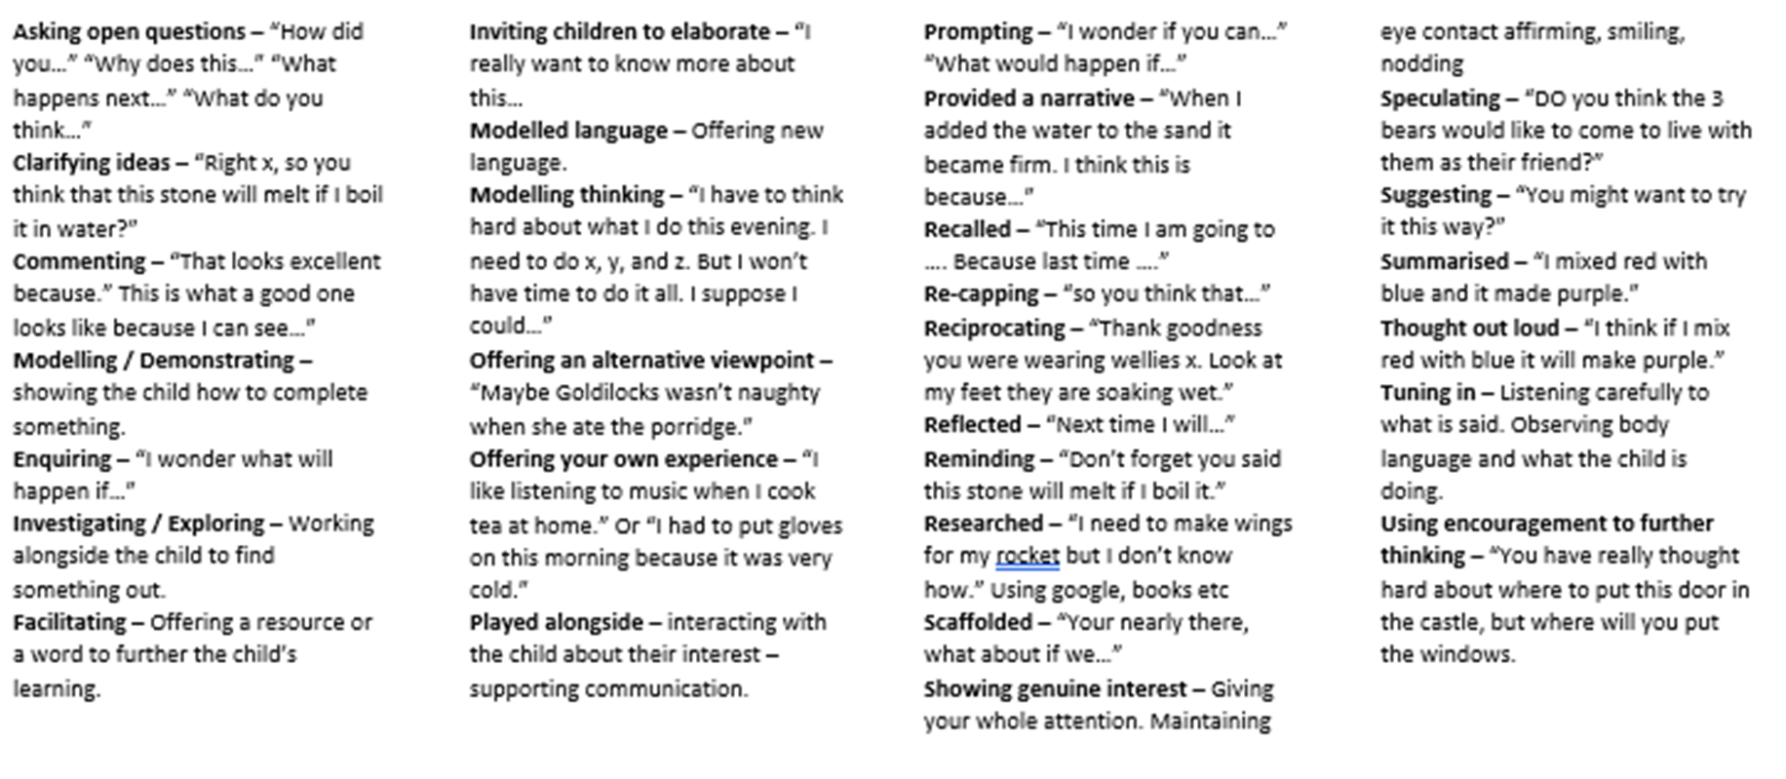
More useful prompts for practitioners, for all children.

Slide 25

SENCo networks – Taken from the primary network slides 87-93 follow this link for the live links

Slide 26
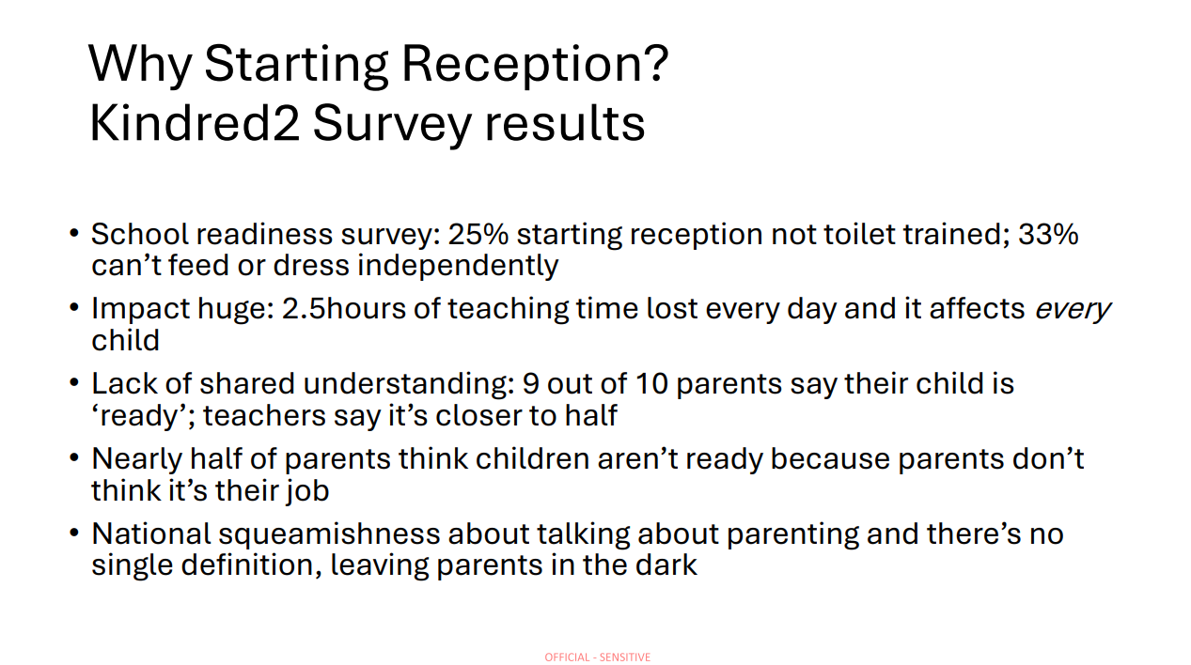

Slide 27
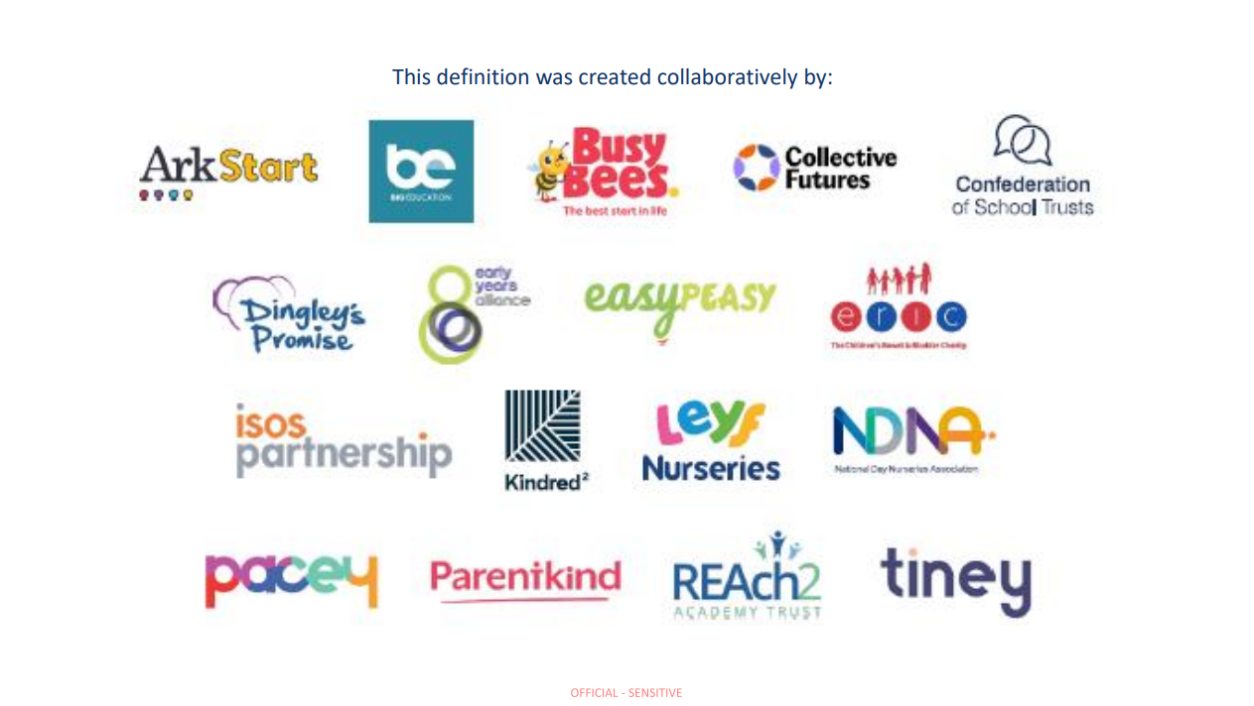

Slide 28
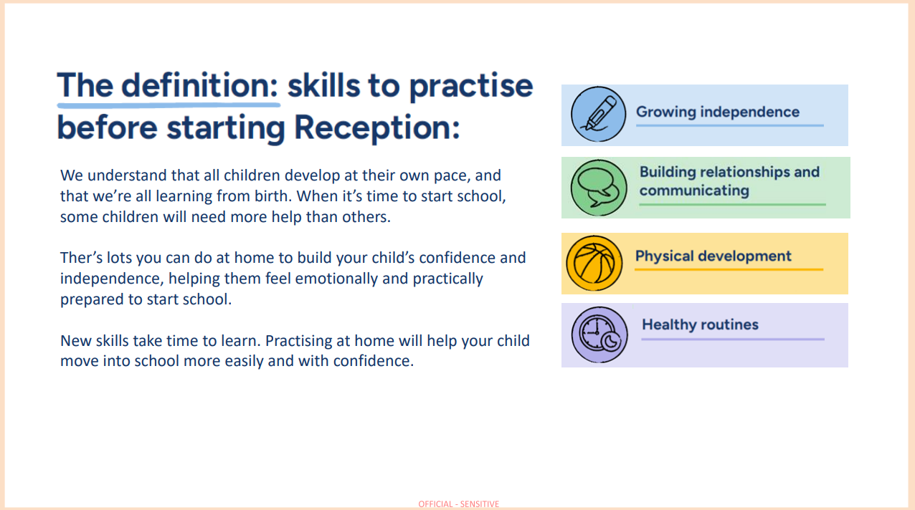

Slide 29
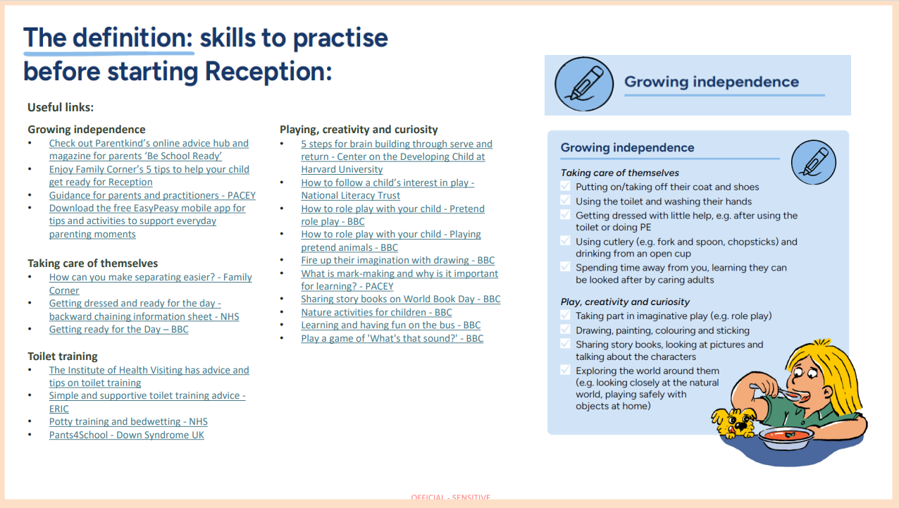

Slide 30
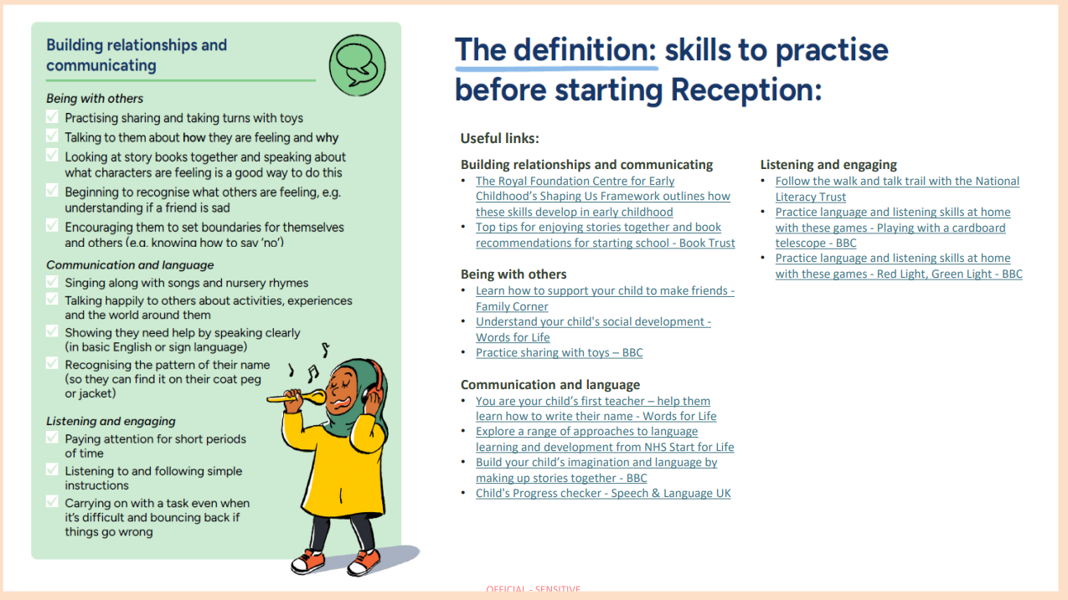

Slide 31
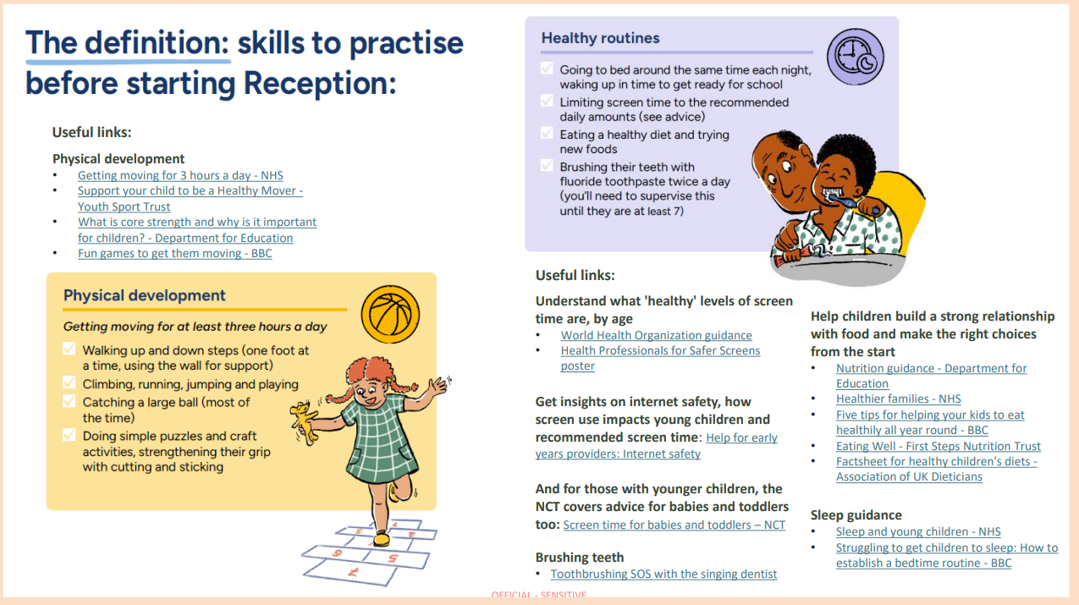

Slide 32
Things to remember…
Locality boards
Dingley's promise- 2 new titles have been released
Solihull approach – free training
Stronger Practice hub
Early Years in Mind
Early Years Store Themes
The go-to
NYES- Unlocking digital online training is now FREE for all for the next year

Slide 33

Updates – remember it's live
Home - Locality Boards (localityboardsnorthyorks.co.uk)

Slide 34
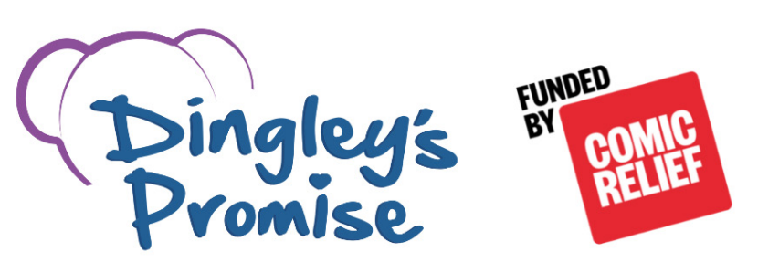

Dingley’s Promise – Early Years Inclusion Project (North Yorkshire)
Do you want access to cutting edge training?
Free online training for those working with young children (0-5 years)
All courses are online and are a mix of workbook, clips and activities.
Complete in any order and at your own pace.
Receive a certificate of completion for each course.
Get the Dingley’s Promise Kitemark!
There is a new module!
Module 8: Supporting individual differences and needs now available and covers:
an introduction to special educational needs and disabilities (SEND) legislation and guidance, and how it applies to education practice
the impact of knowledge and learning gaps on children’s development and what action to take, including making a referral when needed
the importance of your role in supporting children’s individual differences and needs, how to create an inclusive environment and build effective partnerships
Register at:
https://dingley.org.uk/dingleys-promise-training/early-years-inclusion-programme/
Notes:
Early Years Transitions
Having difficult conversations with families
Inclusive approach to early years curriculum and assessment
Intersections within early years practice
Introduction to early years inclusive practice
Leadership and management for inclusion
Managing behaviours that challenge
Supporting communication development in early years children
The voice of the child

Slide 35


Solihull Approach
Online courses dedicated to improving emotional health and wellbeing in parents, children, teenagers, adults and grandparents.
Courses currently available to families.
Understanding your child: from toddler to teenager
Understanding your child with additional needs
Understanding your child’s feelings
Understanding your child’s mental health and wellbeing
Understanding the impact of the pandemic on your child.
Supporting transitions for your child.
Link to access - inourplace | Solihull Approach | Online courses

Slide 36

Stronger Practice Hub
Based in Scarborough and York
There is a Facebook group - 'Yorkshire and Humber together Stronger Practice Hub'
Contactable by email on sph@childhaven.n-yorks.sch.uk
Release case studies around early years practice
Offer open days to visit different settings
Networking opportunities

Slide 37
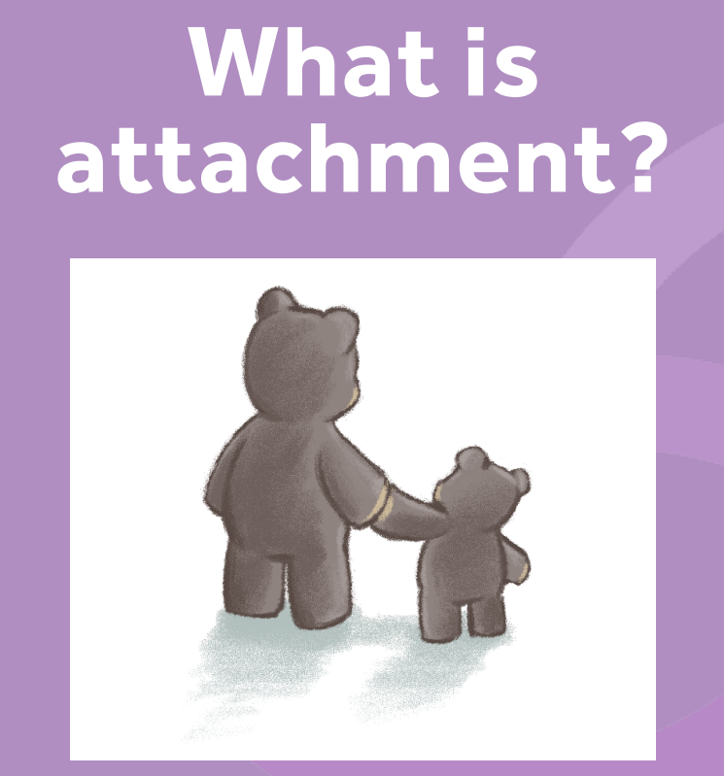

Early Years in Mind
Free online network for Eary years Practitioners
Supporting the mental health of babies, young children and their families.
Free resources on attachment, mental health, well-being, supporting relationships, ect...
Worth having a look...Early Years in Mind | Anna Freud

Slide 38
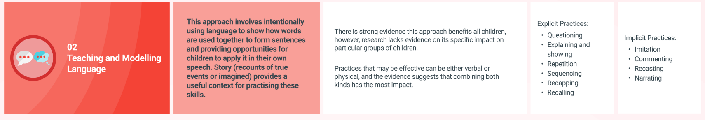
Early Years Store themes
Developed to support the DfE's stronger Practice Hubs programme.
Includes six key themes for younger children's learning and development. Communication and Language; Personal, Social and Emotional Development; Early Years Literacy; Early Mathematics; Self-regulation and Executive Function; Physical Development.
Offers research-based evidence and practice tips to support each area of development in your setting.
Early Years Evidence Store | EEF (educationendowmentfoundation.org.uk)

Slide 39

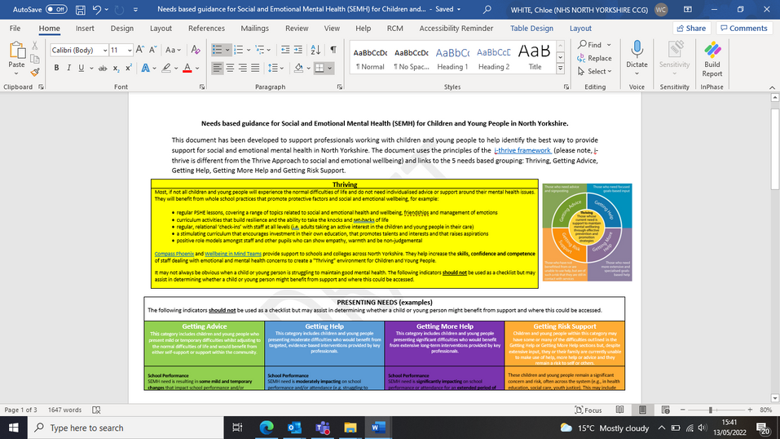
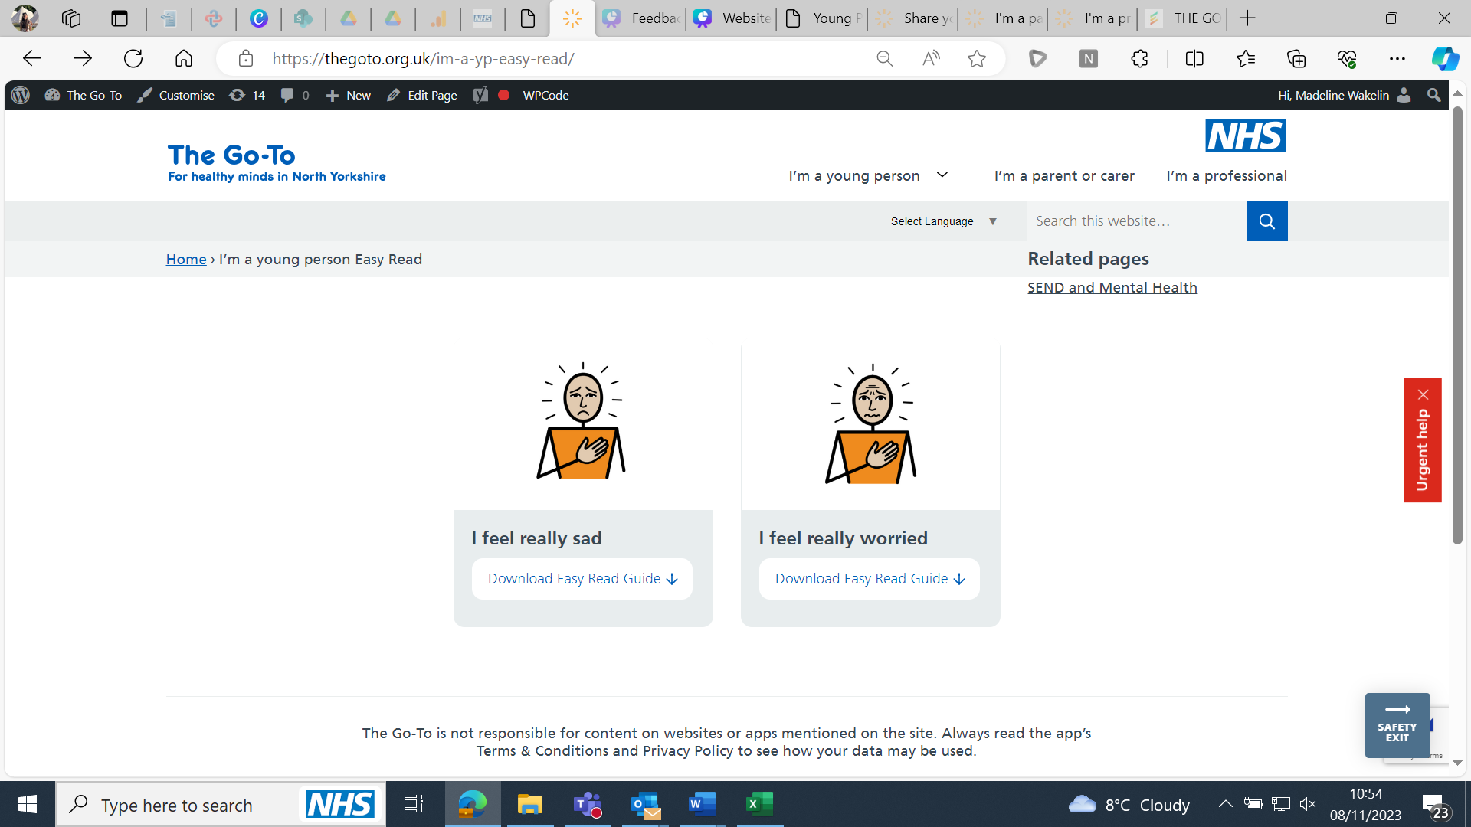

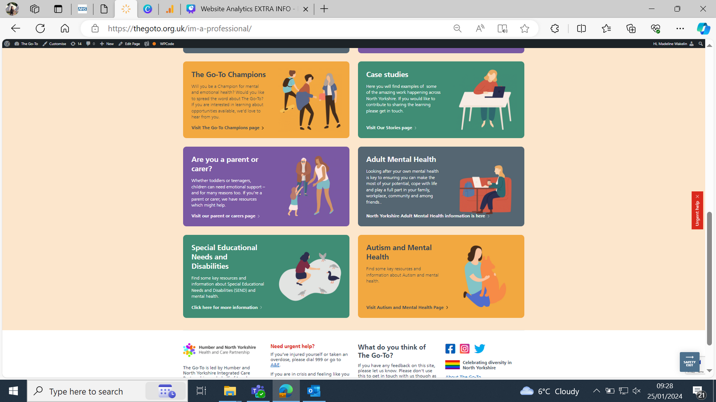
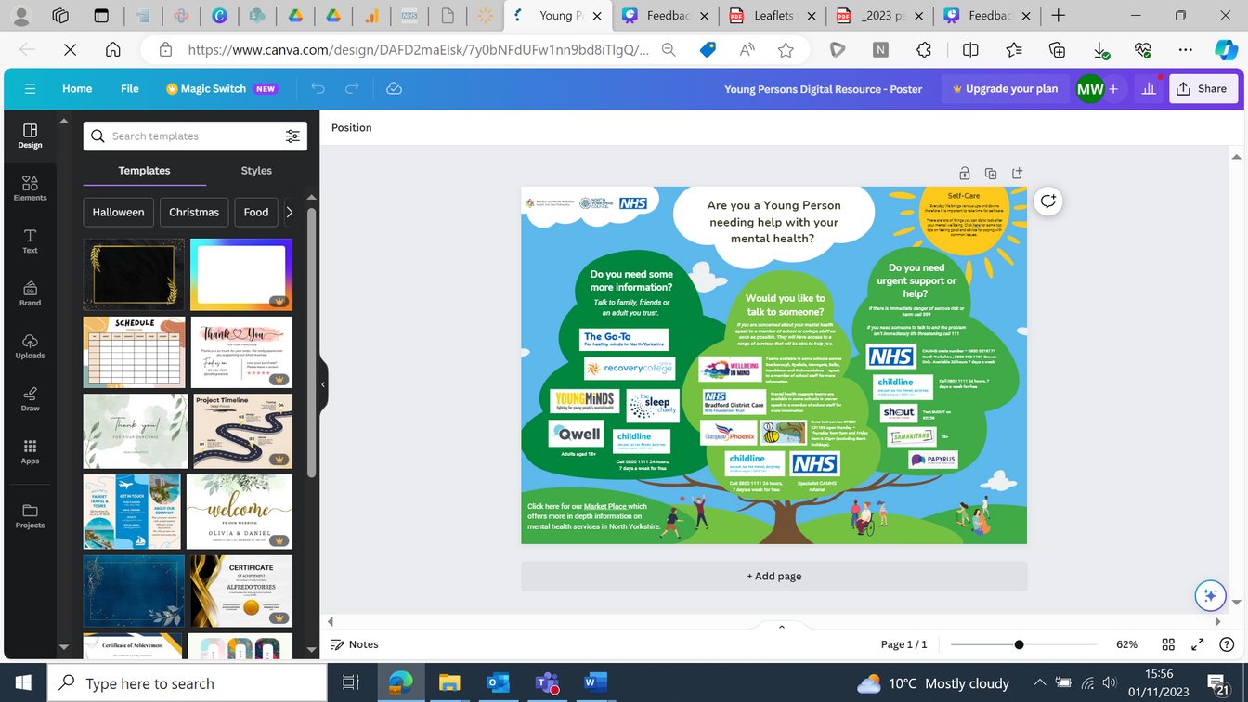
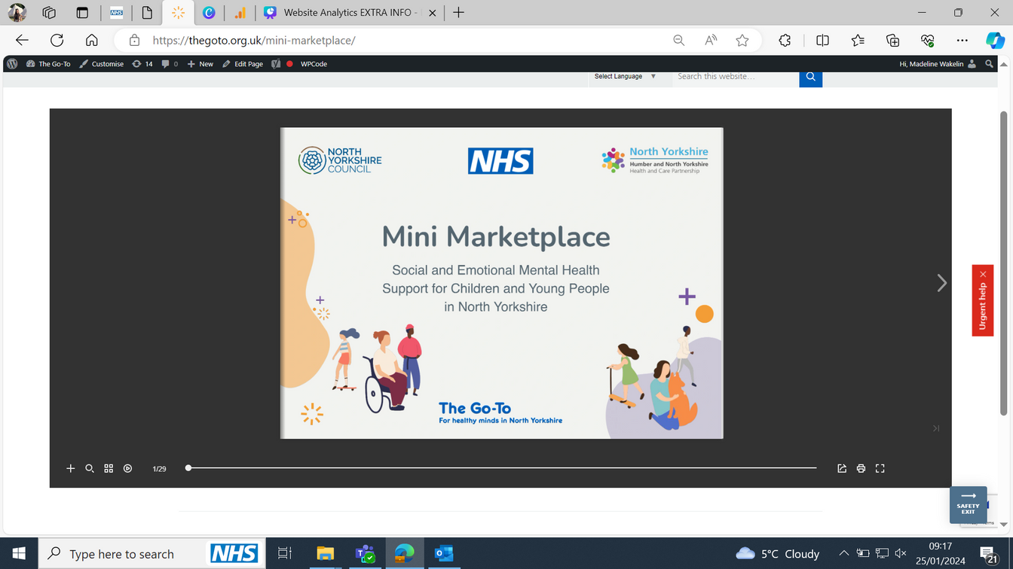
NEEDS BASED
GUIDANCE
FOR
PROFESSIONALS
The Go-To is the home of wellbeing and mental health for young people in North Yorkshire. We're here to help you find the right help and support for you, to help you stay well, whatever is going on in your life.
The website is split into three sections; young people, parents/carers and professionals.
I’M A YOUNG
PERSON
EASY READ
GUIDE
MINI MARKETPLACE
FLIPBOOK
YOUNG
PERSONS
GUIDE

Slide 40

The centre for early childhood explainer series.
A great resource for some small bitesize videos around supporting a child's SEMH needs.
Videos include...
How we grow an emotionally healthy brain
Noticing and navigating feelings
Managing big feelings together
Many more – check it out!
The Centre for Early Childhood Explainer Series - YouTube

Slide 41
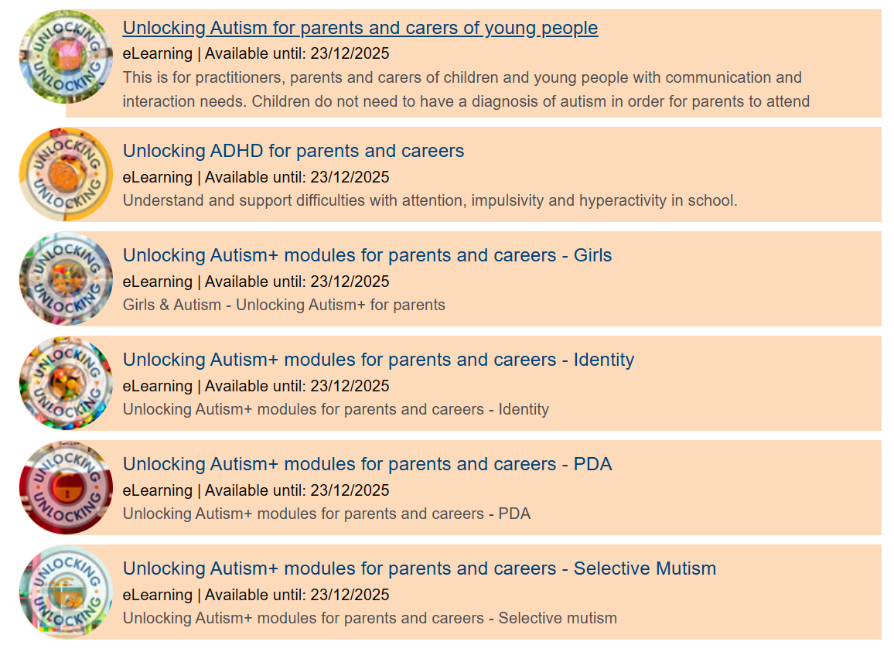
Unlocking Digital Online Training
Free training via NYES for the next year. A taster of what is on offer...
For parents For settings
Portage Training bundle – 10-minute videos on early skills. – Unlocking Portage Training Bundle | NYES Info
Unlocking Cognition and Learning Bundle – working memory, executive functioning, fine motor skills and handwriting.
Unlocking Ealy Years Bundle – fine and gross motor skills, musical interaction and using visuals

Slide 42
Next SENCO Network:
Please let us know what you would like us to cover in the next meeting.. Add your thoughts to the chat box or email lynne.kilford@northyorks.gov.uk
The next Early Years SENCo meeting will be on 4th February 2026

Slide 43

Let’s Make Sense Together Service
Developing a virtual service for children and young people with sensory processing differences
11am slot
October 2025
                Jayne Young
                Clinical Lead Occupational Therapist
                Autism and Sensory Processing
                Jayne.young7@nhs.net

Slide 44
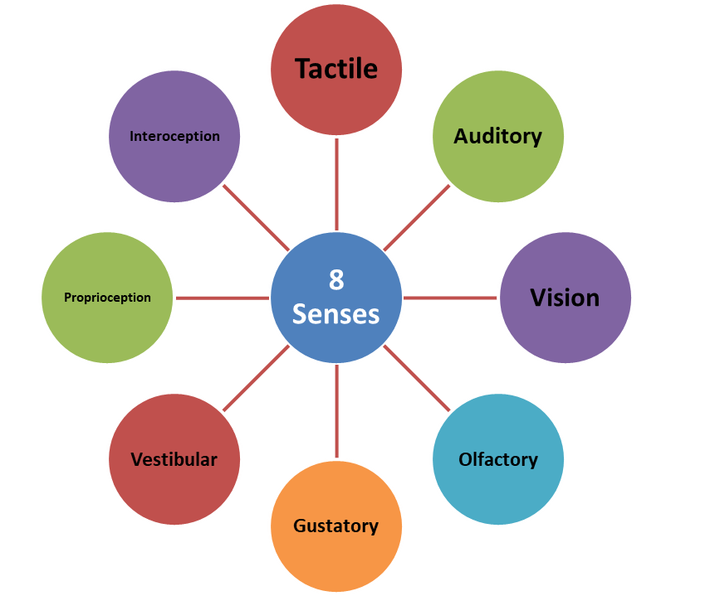
Sensory Processing in a Flash!
Sensory Processing is:
The ability to register, discriminate, adapt and respond appropriately, both physically and emotionally to sensory input from our bodies and the environment
Our brain gains information from the 8 senses and determines how we respond and use this information.
Our response could be over responsive, under responsive or ‘just right’.
The brain is processing this information all the time but it is only when a sensory response has a negative impact on our ability to function that it become a ‘Sensory Processing Difference or Difficulty’. Sometimes we may also hear that people have sensory processing preferences – but again it is only when it impacts on our function that it becomes a difficulty or problem.

Slide 45
Let’s Make Sense Together Service
Developing a virtual service for children and young people with sensory processing differences
Information gathered at the start of the service improvement
Why?
We found that around 60% of our routine referrals to Occupational Therapy in the York & Selby and Scarborough, Whitby, Ryedale areas are for children and young people with sensory processing differences.
Patients would wait on a list until they would usually, have a virtual appointment with parents only and advice given for home and school in a written format.
The advice we give in these appointments is often the same for all or very similar.
Although valuable information was shared there was just written advice and often the same or similar advice would be shared
Waiting times grew during covid and with reduced staff availability
Evidence base shows that the most effective way of supporting and helping a child with sensory processing differences is through changes in the environment and access to appropriate sensory activities and management strategies throughout activities of daily living.
Sensory processing differences need to be understood by all those adults around a child to make the difference for them. This was not possible in our previous service model

Slide 46
Our vision was for a sensory virtual service aligning with the current shift toward digital healthcare solutions and with a strong evidence base. We hope the approach outlined could have a profound impact on both the individual child and the broader community that supports them.
Here’s how we hope to achieve this
1. Accessible, On-Demand Support for Parents, Carers and other adults
Many parents need help at different times, and sensory needs can vary widely. Having access to information and guidance at any hour could make this easier
2. Speed up the ability for adults to access the right support at the right time
The sooner sensory support is provided, the better the outcome for the child. Early intervention can prevent more complicated issues down the line.
3. Wider 'Village' Support
Sensory needs don't exist in isolation and aren’t limited to one place or time. More than parents and teachers need to know how to support this. Sensory information needs to be available for all and be clear and evidence based
4. Training for Schools and Educational Settings
Schools play a critical role in shaping the child's experience with sensory issues, and having a sensory-friendly learning environment can significantly improve academic and social outcomes. Our online resources are available for all schools
6. Universal, Accessible Information
Having 24/7 access to advice and strategies along with written material to support this. Hopefully enabling support to be given earlier and without having to wait for referrals.
We are also aware that the provision for supporting children and you people who have sensory related behaviours or have sensory needs triggered by emotions, doesn’t have OT clinicians as part of the other services. Therefore, this information can be used by other professionals to inform their practice and for them to share with their clients. We hope this information will help support in training and understanding in other services of sensory processing needs.

Slide 47
Summary of feedback from meeting with North Yorkshire Parent Carer Voice & York Parent Carer Forum:
‘Sometimes just affirmation or feedback that we are doing the right things’
Support when school don’t agree the child has sensory problems (for example they mask at school and all the difficulties they hold in from triggers during the day are let out when they get home)
Schools to understand that sensory movement breaks are for regulation and not a reward and they shouldn’t be removed as punishment – child often needs these more at times of poor behaviour or reduced function because they a dysregulated.
Sometimes a child needs time away from sensory input to regulate – not just seek sensory input or sensory based activity
Parents need schools to understand and to be advised to follow the sensory training virtual programme as part of the sensory offer
Keen to ensure the information for schools was well presented and included their concerns – they would like to support with creating some voice clips from parents, children and young people to help with understanding and they would apply for some charity funds to support this if needed.
It was felt that the launch of the package needs to be strong and include information out to those who may have come through the service before as this would give longer support as it is available freely and without referral
Pleased the case would be open for 3 months to give time for feedback and discussion with a therapist if there were to be a concern
JY explained there would be a form to complete with the pack to support the discussion if a further appointment was needed or to be sent with a referral from a medical professional so that the triaging OT is aware if they have accessed the online material and suggestions. This was felt to be helpful and supporting the parent
Parents felt that a paper document of some of the information may be helpful for some families and should be offered in the first phone call.
It was suggested that a helpline would be brilliant for this service e.g. open for 2 hours on a Tuesday – JY explained this probably not possible straight away but has been discussed a suggested and would take this back to service managers also.
If helpline not available, then a frequently asked questions section would be helpful
As well as being available in different languages and subtitles could we consider a BSL interpreter for the videos also
We shared our initial video with PCV and PCF for feedback before we continued with the following videos

Slide 48
Let’s Make Sense Together Service Videos
Parent and carers introduction to Lets Make Sense together
Teachers and education settings- Introduction to Let’s Make Sense Together
Understanding our senses (for parents, carers and schools)
Sensory Modulation and Processing (for parents, carers and schools)
Calming and regulation strategies (for parents, carers and schools)
Supporting self care challenges (parents and carers)
Supporting children and young people who are sensitive to noise (for parents, carers and education)
Supporting children and young people with sensory feeding differences (for parents, carers)
Supporting children and young people with interoceptive differences (for parents, carers, education)
Supporting children and young people with sensory processing differences in primary school (for schools)
Supporting children and young people with sensory processing difficulties in secondary school (for school)
Supporting children and young people with school transitions
Closing video LMST

Slide 49
Let’s Make Sense Together Service
Routine patient journey for those referred to York and Scarborough Children’s Therapy Service
Referral made by medical professional – for a child with a physical functional difficulty
Referral received and triaged as usual, admin to make appointment with Generic Therapy Assistant (GTA)
Call to parents from GTA
  Give details on sensory service, how to access virtual content etc and next steps
  Consent gained for team to contact school or setting (if appropriate) to share they have been referred and to send information to access
  Text with the link could be sent during the call
  Letter and or/email sent with the full written details of how to access the LMST resources
  Details on how to contact in the next 3 months if further advice needed. If no contact, patient will be discharged at 3 months
If contact made in 3 month period a telephone or virtual appointment will be made a member of the LMST team
  Solution focused appointment
  Brief report (if needed)
  Direction back to videos if appropriate
  Any further action if clinically indicated
  Referral on to other services if needed
  Discussion with school if needed

Slide 50
LMST service provision in Tiers:
Tier 1
Universal
Parents and schools access the videos and written advice on The Let's Make Sense Together page on Healthier Together Website
Tier 2
Targeted
Parents seek a medical referral to Occupational Therapy at York & Scarborough Teaching Hospitals NHS Foundation Trust where there is a physical impact on a child's functional ability. Parents supported to access the advice on Let's Make Sense Together and care open for 3 months so further advice can be accessed if needed
Tier 3
Specialist
Medical referral to Occupational Therapy at York & Scarborough Teaching Hospitals NHS Foundation Trust where there is a physical impact on a child's functional ability. They have accessed the virtual information, but further advice is needed and /or it is indicated that OT is able to advise further in a solution focused approach.

Slide 51
York and Scarborough link:
https://www.yorkhospitals.nhs.uk/childrens-centre/your-childs-hospital-journey/therapy-services/occupational-therapy/lets-make-sense-together/
ICB and other services link to Healthier Together:
https://www.hnyhealthiertogether.nhs.uk/parentscarers/your-childs-development/lets-make-sense-together
Please be aware that the videos accessed are the same for each other links, however the referral into the York and Scarborough team gives the additional support if needed around a physical, functional difference or need.

Slide 52

Our Service flyer for those in the YSTHFT service criteria

Slide 53

The flyer for those in the wider ICB and also where a child may not meet our service criteria.
Also, over the rest of the UK if accessed

Slide 54
Further thoughts on the future…..
To gather data from new provision to support further service improvement within OT service and wider
We have had many thoughts for service in the future to include (but will all need additional funding):
  Producing a virtual package specifically for teenagers
  Additional training into schools
  Information based at a lower pre-school age
  Update of current videos and information in line with any changes in evidence base or new research

Slide 55

Questions?
Thank you all for listening.
I am happy to answer any questions to the best of my ability.
Should you have any questions you wish to email me, please do so:
jayne.young7@nhs.net

Slide 56

Supporting children and young people with sensory processing differences in North Yorkshire and York

Slide 57
Supporting children and young people with sensory processing differences in North Yorkshire and York
The document includes a description of sensory processing that has been agreed by all OTs and other professionals involved in the piece of work
Key support for those with sensory processing differences
Key take home messages
Ithrive document with the 4 areas:
  Getting advice
  Getting help
  Getting more help
  Getting risk support

Slide 58
Presentation slides and handouts
All presentation slides and handouts will be available on CYPSinfo SENCO Networks.
All previous presentations can be located here.
NYES Early Years Page will be launched soon!

