Slide 1
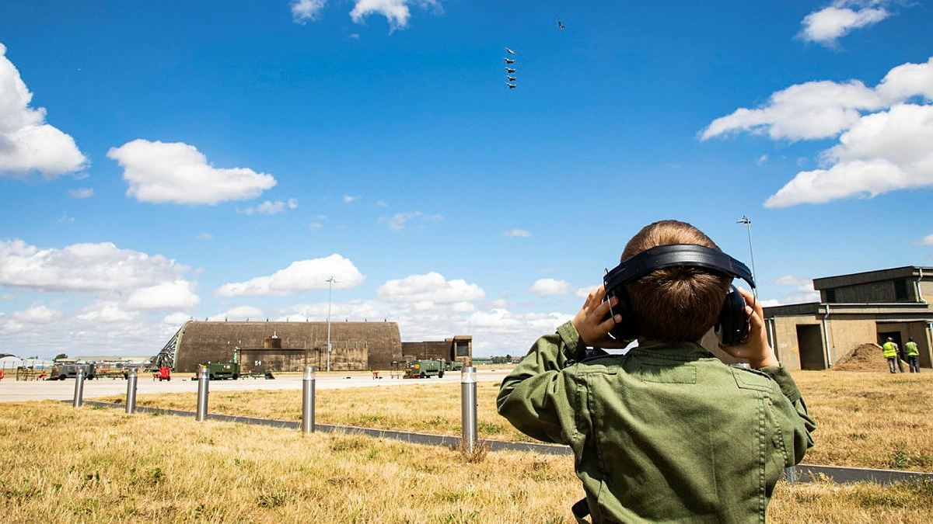
Between Education Systems Transitions toolkit
ADES Armed Forces Lead Officers’ Group – 3 June 2026
Ed Harris

Slide 2

Background
Developed jointly by schools and stakeholders across the four nations of the UK
Created to support and add value to educators’ current practice
Addresses the distinct challenges armed forces children may face when moving between education systems
  Includes selected examples of practice and helpful resources linked to themed activities to support transitions between education systems

Slide 3

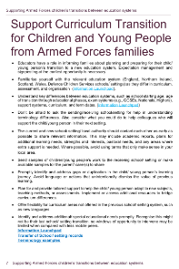
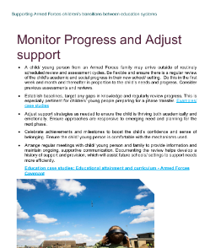
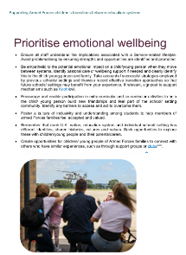
Transition activity themes
Be Armed Forces Aware and Informed
Welcome Service Families and Acknowledge the Importance of Goodbyes
Build strong partnerships with Armed Forces families
Support Curriculum Transition for children and young people from Armed Forces Families
Prioritise emotional wellbeing
Monitor progress and adjust support
Plan for future transition
Acknowledge diversity in the Service community

Slide 4
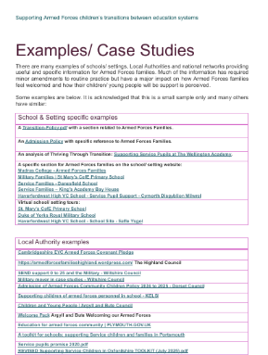
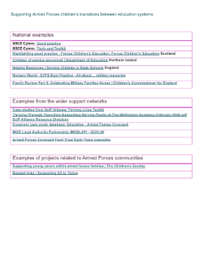
Case Studies/Examples of Practice
Embedded links to examples of practice set within thematic activity, plus a full set in the appendix – ordered into school/setting; local authority and national

Slide 5
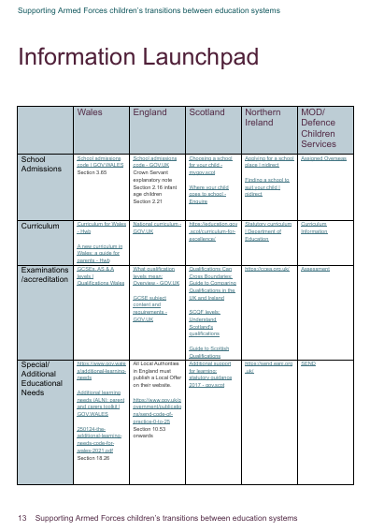
Information launchpad
Curated resources categorised into core knowledge areas by nation
  School admissions
  Curriculum
  Examinations/assessments
  Special/Additional educational needs
  Professional development resources
  Armed forces children/young people guidance sources

Slide 6
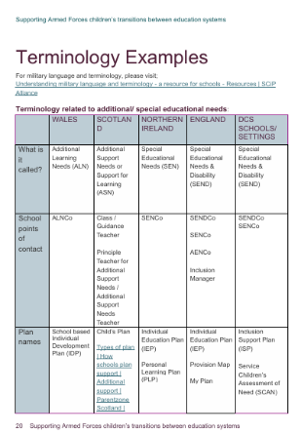
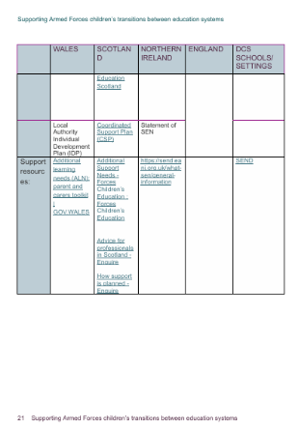
Differences in Terminology across the UK
Designed to provide educators with a shortcut to understand the differences in key education terminology across the UK

Slide 7
Explore the Toolkit
Explore the Toolkit at Transition Toolkit for Educators
Help the development and improvement of the toolkit by sharing your school’s practice at RC-DCS-HQ-EPT@mod.gov.uk

