Slide 1

School Food Standards Consultation
May 2026

Slide 2
Consultation
Deadline for responding is 12th June 2026.
Following the consultation period, the changes are proposed to come into effect in September 2027 in primary schools, and September 2028 for secondary schools.
These standards will cover the whole school day, including a specific set of standards for breakfast provision.
Link to full proposed changes School food standards: updating the legislative framework government consultation
The consultation is open to complete by: Parents, school staff, school and trust leaders and governing bodies, local authorities, school food providers, catering managers and chefs/cooks, food manufacturers and suppliers, public health professionals, nutritionists and dietitians working with schools, Holiday, Activities and Food (HAF programme) providers, Private, Voluntary and Independent Providers (PVIs) delivering wraparound or holiday childcare services School Food Standards: updating the legislative framework - Department for Education - Citizen Space

Slide 3
Increasing fibre
Ensuring one or more portions of vegetables or salad as an accompaniment to all main meal options every day including grab and go.
Ensuring all desserts are accompanied by or contain a portion of fruit.
Including a fruit-only day for dessert at least once per week in primary schools.
Increasing the fibre content of starchy foods by moving to higher fibre breads and at least 50% wholewheat / brown versions of rice and pasta.
Requiring at least one portion of pulses (not including baked beans) within or alongside all menu options on one day a week.

Slide 4
Reducing sugar
Restricting the frequency of sweetened baked products and desserts (changing in stages for secondary schools).
• Removing fruit juice and combination drinks from school meals services.
• Allowing only plain water, semi-skimmed or skimmed milk, lactose-free milk and some plant-based drinks in primary and secondary schools (changing in stages for secondary schools). Plus, sugar-free flavoured still water, fruit-flavoured no added sugar still drinks, tea and coffee with no syrups or extras allowed in secondary schools.
• Restricting sugar, honey and syrups from being added to food or drinks during or after preparation.

Slide 5
Restricting foods higher in fat, sugar and salt
No longer permitting deep fried foods.
• Setting limits to how often certain foods can be served, such as processed meat and batter-coated items and restricting the levels of sugar and salt in condiments and spreads to further restrict options higher in fat, sugar and salt.
• Restricting the use of cheese as a main ingredient every day (changing in stages for secondary schools).
• Setting sugar limits for yoghurts and plant-based yoghurts.
• Restricting snacks to fruit, vegetables, savoury crackers and breadsticks only.

Slide 6
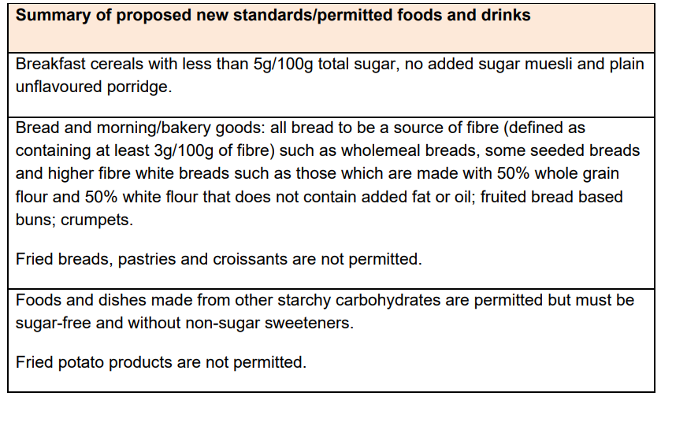
Breakfast Standards

Slide 7
Compliance for standards
Lead governor is appointed with designated responsibility for school food.
Recommend that governors work with the senior leadership team to develop a whole‑school food policy.
Propose that all schools be required to publish their food policy and menus on their websites.

