Slide 1
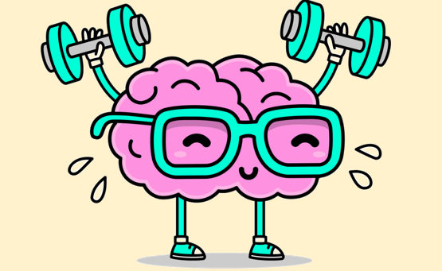

Welcome: Spring 2 Wellbeing Assembly
Notes:
Hello and Welcome to today’s wellbeing assembly - for those of you who haven’t seen me before – my name is Clare and I’ll be taking you through this assembly today.
When we feel happy, healthy and content, we have what we call, ‘Positive Wellbeing’ but we do need to work at achieving this just like we do with our physical health. This is one of the reasons we are doing this assembly now.
A good way to support our wellbeing is to practise breathing techniques to help keep up calm and able to cope with whatever comes our way.

Slide 2
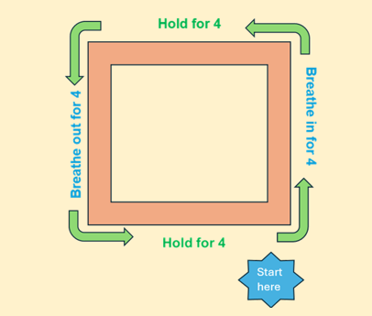
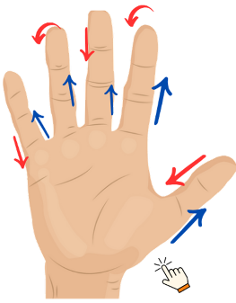
Breathing techniques - recap
Notes:
In Autumn 1 we looked at square breathing where we can find any square in a room and follow the lines as we breathe in, hold for one line, then breathe out for one line and hold for the 4th line.
Then before Christmas, we used hand breathing to go up our thumb while breathing in and then breathing out as we go down our thumb then repeating on our fingers.
The more we practise these, the easier they get and they really help us to regulate focus on the present moment.
The great thing is you can do them as many times as you need.

Slide 3
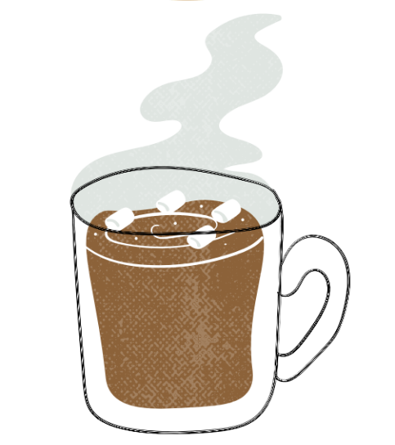
Hot Chocolate Breathing
Notes:
Today, I’d like us to practise something called ‘Hot Chocolate Breathing’.
First-of-all: I’d like you to imagine you have a cup of hot chocolate (or squash or whatever drink you like really)
Slowly breathe in through your nose and pretend you are smelling the hot chocolate.
Savour the smell for a moment by pausing and holding your breath,
Then slowly & gently breathe out through your mouth.
Imagine cooling the hot chocolate down or making gentle ripples on the top of your drink.
You can repeat this as many times as you need.

Slide 4

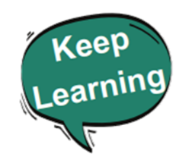

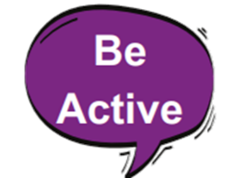
The 5 Ways to Wellbeing
Notes:
Right, so moving on – the assemblies we look at focus on the 5 ways to wellbeing.
These are 5 things that experts have found are beneficial/helpful for our mental health.
We’ve already looked at ‘Connect’ and ‘Give’
Hopefully, you were able give some of your time and energy to people you care about over the Christmas holiday.
Today we are skipping on to ‘keep Learning’

Slide 5
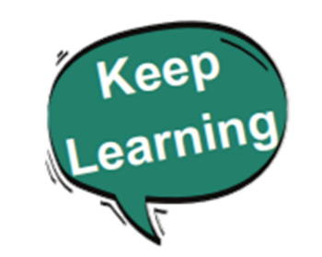
Why is learning good for our mental health?
Why do you think it’s good for our mental health to keep learning?
Notes:
Over to you – take a moment in your head or if you have time to pause me and have a chat about why you think learning is good for our mental health?

Slide 6

Brian Power!
Notes:
Let’s see if you are right.
Lots of us feel learning is a real pain but actually it is really good for us!
Each time we learn it Improves our brain health – learning creates new pathways in the brain (called ‘Neural Connections’) these connections strengthen the brain’s ability to cope with aging – a bit like using any other muscle in our body – it gets stronger the more we use it. (University of California. Irvine)
Learning – if it’s pitched at the right level, can also reduce stress as it distract us from things that are bothering us. (MindWell leeds and Grand Rising Behavioural Health)

Slide 7
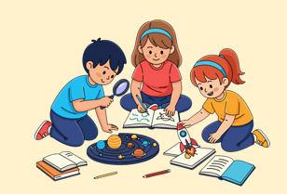
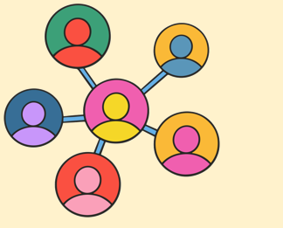
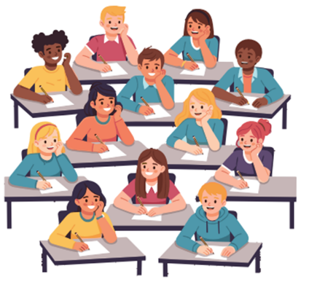
Learning in a group
Notes:
Whether the group you learn like this – pic 1
Or like this – pic 2
The act of learning with others or alongside others in the same class or group is beneficial.
It helps us to connect with others which helps us to boost wellbeing and avoid loneliness. (NHS)
These social connections are really important and link back to the assembly we first did on ‘connect at the start of the year.

Slide 8
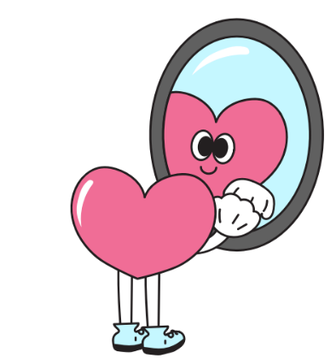

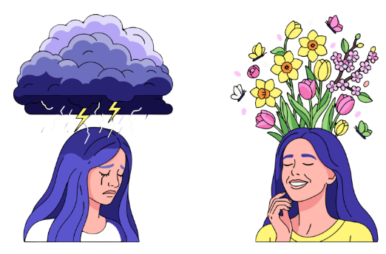
Can boost self esteem
Notes:
Learning can boost our self esteem and confidence – we can feel a sense of accomplishment when we achieve our goals or learn something new which in tern increases our self worth (NHS and Mindwell Leeds)
This links to feeling proud of ourselves.
Learning also enhances our mood as when we learn, our brains release dopamine. Dopamine is a feel good chemical which boosts our motivation. (Change mental Health)

Slide 9
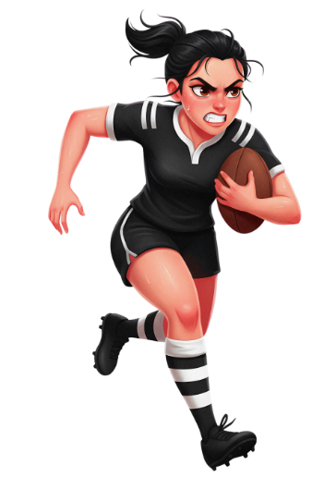
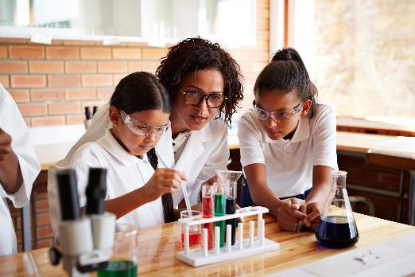
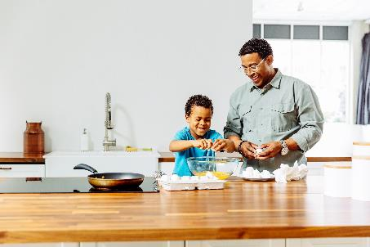




Try new things
Notes:
Learning doesn’t just have to be at school – it can be:
A new skill in a sport you already do
Something in school or a club you are part of
It could be a new recipe of something you haven’t made before with someone in your family
A new dance routine or song lyric you are practising your self
It could be learning how about a subject you are interested in like a different culture or an animal you’d like to more about.

Slide 10
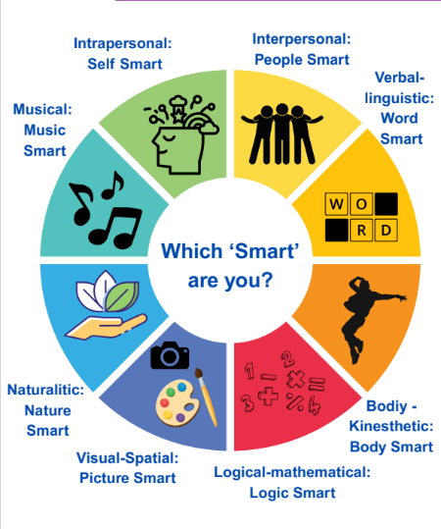
You can learn in loads of different ways
Notes:
For the last bit of our time together – I’d like to share this resource which I’ve sent to your school, is a brilliant reminder of all the different ways we learn.
I’ll zoom in on the top half first to show you what I mean…
https://compass-uk.org/wp-content/uploads/2025/11/Multiple-Intelligences-Resource.pdf

Slide 11
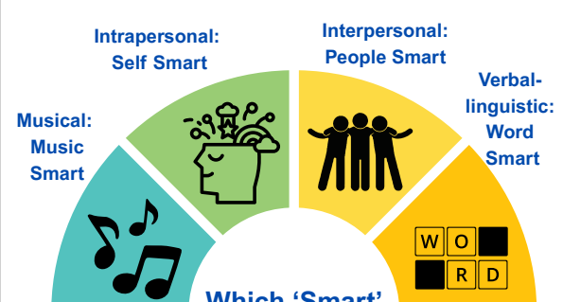
You can learn in loads of different ways
Notes:
We all learn in different ways.
Start with the orange segment labeled "word." on the right hand side
Some of us find reading and writing easy, but others may struggle, making school difficult since so much involves these skills.
You might learn better in another way, like:
People Smart: You connect easily with others and work well in teams.
Self Smart: You’re great at understanding your own feelings.
Music Smart: You play an instrument or love singing along to songs.

Slide 12
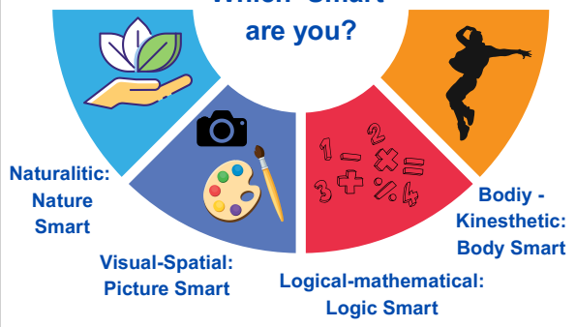
You can learn in loads of different ways
Notes:
If we take the bottom half of the circle – and start in the light blue one on the left –
Nature Smart: You know how to care for plants or animals.
Picture Smart: You’re creative and have a good eye for details.
Math Smart: You excel at problem-solving and logical thinking.
Body Smart - Maybe you learn better by physically doing something – by moving and creating shapes with your body or being part of a sports team.
Everyone has a different strength—which would you say is yours?

Slide 13

Next steps
?
What will you do to work to the theme of ‘learn’ this half term?
Notes:
However you like to learn - What will you do to work towards the theme of ‘learning’ this half term?
We have sent the Multiple intelligence resource with ideas and activities to your school linked to learning and showing our different learning styles
Please ask a member of school staff if you’d like a copy of these.
Thank you for listening and we’ll see you for the next wellbeing assembly after the Easter holidays .

Slide 14
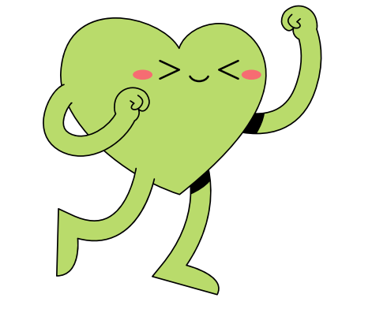
Remember: Learning is good for you! It can:
Boost self esteem
Enhance Mood
Reduce Stress & distract us from things Give a sense of purpose
Help us connect to others
Improves brain health
Notes:
However you learn best and whatever you learn – learning is good for your mental health.
It can:
Boost self esteem and confidence
Enhances Mood
Reduce Stress and be a healthy distraction
Give a sense of purpose & direction
Help us connect to others
Improves brain health

