Slide 1

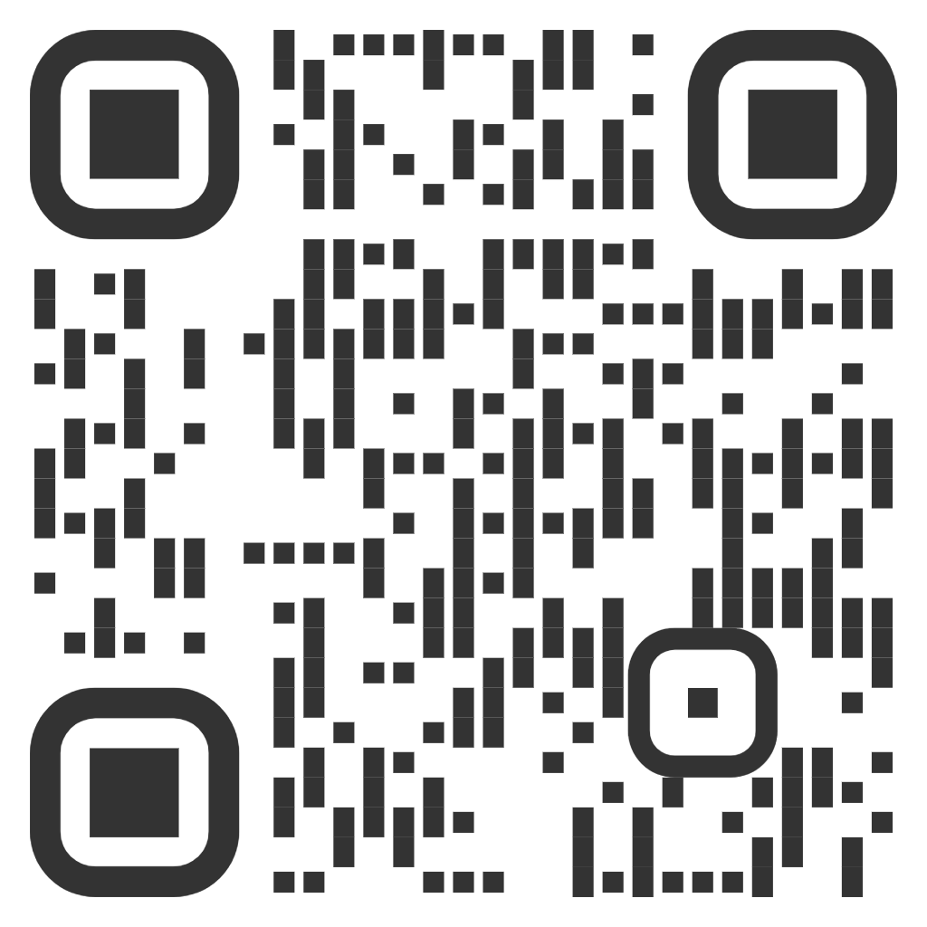
Let’s Talk Active!
Fill in the survey to tell us; if you are physically active, what is important to you about being active, and any barriers you face. www.northyorks.gov.uk/LetsTalk
Or scan the QR code
Survey closes
4 November 2024

