Slide 1



2025 EYFS safeguarding changes. What all settings need to know.
Rachel Buckler and
Ann Marie Christian

Slide 2

Direction of travel.
Recognition of poor or unsafe practice in the early years.
DfE consultation summer 2024.
Revised EYFS September 2025.

Slide 3
Key areas of change
Safeguarding training criteria
Child Absences
Safer Eating practices
Paediatric First Aid training
Safer Recruitment
Whistleblowing
Toileting and intimate hygiene

Slide 4
Safeguarding training
Training must be renewed every two years.
Providers may consider whether any staff need to undertake annual refresher training during any two-year period to help maintain basic skills and keep up to date with any changes to safeguarding procedures or as a result of any safeguarding concerns that occur in the setting.
Providers must ensure that all practitioners are trained in line with the criteria set out in Annex C.
The DSL must attend a training course consistent with the criteria set out in Annex C.

Slide 5
Early Years Foundation Stage statutory framework (2025)
Safeguarding training
Policy
MUST include details of how training is delivered and how practitioners are supported to put this into practice.
Frequency of training and how dynamic management approaches determines targeted support and training for staff.
Practice
Training meets the requirements of Annex C and is authentically sourced and delivered.
Informed by advice from the LA / LSP.
Management systems and processes support individuals learning and respond appropriately.

Slide 6
Role of the Designated Safeguarding Lead, Responsive and reactive.
Effective safeguarding training.
Categories, abuse, harm, neglect and working in a way that identifies early the signs of abuse and neglect.
‘reasons to suspect abuse or neglect outside the setting’ for example at home‘ or that a child may experience ‘emotional abuse or physical abuse because of witnessing domestic abuse or coercive control’.

Slide 7
Role of the Designated Safeguarding Lead, Responsive and reactive.
Take advice from the LA/LSP on appropriate training.
Building a safer organisational culture.
Develop and implement polices and procedures.
Local child protection procedures, liaising with children’s services and LSP.
Be able to refer and escalate concerns.
Manage allegations.

Slide 8
Child absences
Concerns about children’s safety and welfare.
Providers must follow up on absences in a timely manner. If a child is absent for a prolonged period of time, or if a child is absent without notification from the parent or carer, attempts must be made to contact the child’s parents and/or carers and alternative emergency contacts. Providers must consider patterns and trends in a child’s absences and their personal circumstances and use their professional judgement when deciding if their absence should be considered as prolonged. Consideration must be given to the child’s vulnerability, parent’s and/or carer’s vulnerability and their home life. Any concerns must be referred to local children’s social care services and/or a police welfare check requested.

Slide 9
Child absences
Information about the child.
Where possible, settings should hold more than two emergency contact numbers for each child.

Slide 10
Early Years Foundation Stage statutory framework (2025)
Child absences
Policy
Providers/Childminders must have an attendance policy that they share with parents and/or carers.
Practice
All absences must be followed up in accordance with the EYFS.
Staff should be trained to understand vulnerability, know how to respond to safeguarding concerns, they should be curious.
Emergency contact details need to be revisited regularly.

Slide 11
Safer eating practices
Food and drinking facilities.
PFA qualified staff in the room.
Obtain information before the child admitted.
Ongoing discussions with parents/professionals – up-to-date.
Staff awareness treatments for allergies and anaphylaxis.

Slide 12
Safer eating practices
Discussions with parents/carers about introducing solid foods.
Food preparation suitable for each child’s needs.
Children seated whilst eating.
Be within sight and hearing of staff.
Record any choking incidents that require interventions.

Slide 13

EYFS nutrition guidance
From September 2025 a new requirement within the safeguarding and welfare requirements will state that providers should have ‘regard to the nutrition guidance’ meaning that they ‘must take the guidance into account unless there is good reason not to’.

Slide 14
Early Years Foundation Stage statutory framework (2025)
Safer eating practices
Policy
Have regard to the EYFS nutrition guidance.
State how safe eating processes and dietary requirements are managed within the setting.
Partnerships with parents/carers and other professionals.
Information sharing.
Practice
Robust procedures and systems in place.
Regular communication between the setting and parents/carers.
Staff training including PFA, inductions and team meetings.
Adequate supervision of children.

Slide 15
Paediatric first aid training
Staff:child ratios
Suitable students on long term placements and volunteers (aged 17 or over) and staff working as apprentices in early education (aged 16 or over) may be included in the ratios at the level below their level of study, if the provider is satisfied that they are competent and responsible and if they hold a valid and current PFA qualification.
Paediatric first aid.
[Providers/Childminders] are responsible for identifying and selecting a competent training provider to deliver their PFA training.

Slide 16
Early Years Foundation Stage statutory framework (2025)
Paediatric first aid
Policy
How ratios are implemented and applied.
Health and safety – PFA training.
Practice
Meets the requirements of the EYFS, PFA trained staff, ratios.
Effective deployment.
Consider dynamic risk assessment, environment, children, staff.
Confident practitioners.

Slide 17

Think about it!
To what extent are leaders and managers ready and prepared to adopt the changes regarding safeguarding training, child absences, safer food and PFA training?
Completely.
Partially, if so, where are the gaps?
Where changes are required, we have yet to adopt polices and procedures and share them with colleagues and parents / carers.

Slide 18
Safer Recruitment
New EYFS wording Providers/Childminders who are employing assistants MUST obtain a reference before employment.
Providers must record information about staff qualifications and the identity checks, vetting processes and references that have been completed (including the criminal records check reference number, the date a check was obtained and details of who obtained it).
Ensure that only suitable individuals are recruited.

Slide 19
Early Years Foundation Stage statutory framework (2025)
Safer recruitment
Policy
State the following of safer recruitment procedures and processes.
Must include ‘procedures to follow to check the suitability of new recruits.
‘References should be provided for previous employees upon request in a timely manner’.
Practice
Adhere to the EYFS.
Attend accredited safer recruitment training.
Embed safer recruitment policy and principles consistently across the setting/organisation.

Slide 20
Early Years Foundation Stage statutory framework (2025)
Safer recruitment
Policy
Revise annually.
Familiarise staff with the content.
Practice
A skilled individual who can oversee and coordinate the recruitment process from advert to induction process
Bespoke interview questions, including whistleblowing, child disclosures, and the Prevent Duty.

Slide 21
Whistleblowing
Providers must put appropriate whistleblowing procedures in place for staff to raise concerns about poor or unsafe practice in the setting’s safeguarding provision. This must include when and how to report concerns and the process that will be followed after staff report concerns.
Must ensure staff are aware of the setting’s whistleblowing procedures and must ensure all staff feel able to raise concerns about poor or unsafe practice and know that such concerns will be taken seriously by the senior leadership team.
Where a staff member feels unable to raise an issue with their employer, or feels that their genuine concerns are not being addressed, other channels are open to them.

Slide 22
Early Years Foundation Stage statutory framework (2025)
Whistleblowing
Policy
State a clear expectation of how whistleblowing will be enabled for all practitioners. Staff must feel able to raise concerns about poor practice.
Practice
A belief that ‘it could happen here’.
Communicated through inductions, training, supervision and team meetings.
Clarity and signposting to external organisations that staff can access in order to whistle blow.

Slide 23
Early Years Foundation Stage statutory framework (2025)
Whistleblowing
Policy
Staff to familiarise themselves with whistleblowing of both internal and external.
Practice
Have a safeguarding board in the staff room and have the names of the LADO and procedures.

Slide 24
Toilet and intimate hygiene
New EYFS wording, toilet and intimate hygiene.
Children’s privacy is considered and balanced with safeguarding and support needs when changing nappies and toileting.

Slide 25
Early Years Foundation Stage statutory framework (2025)
Toilet and intimate hygiene
Policy
Intimate care procedures and routines should include the new EYFS wording.
Lone working arrangements considered.
Practice
Respectful engagements are fostered between children and adults who care for them.
Environments where children are toileted and changed are conducive to privacy, they enable safe and respectful practices to take place.

Slide 26
Early Years Foundation Stage statutory framework (2025)
Toilet and intimate hygiene
Policy
Staff to follow the procedure in the policy and complete the necessary paperwork.
Practice
Remind staff in training
Create an ongoing culture of vigilance.
Privacy is balanced with safeguarding, transparency and respect.

Slide 27
Think about it!
To what extent are leaders and managers ready and prepared to adopt the changes regarding safer recruitment, whistleblowing and toilet and intimate hygiene?
Completely.
Partially, if so where are the gaps.
Where changes are required, we have yet to adopt polices and procedures and share them with colleagues and parents / carers.

Slide 28

Any questions?

Slide 29
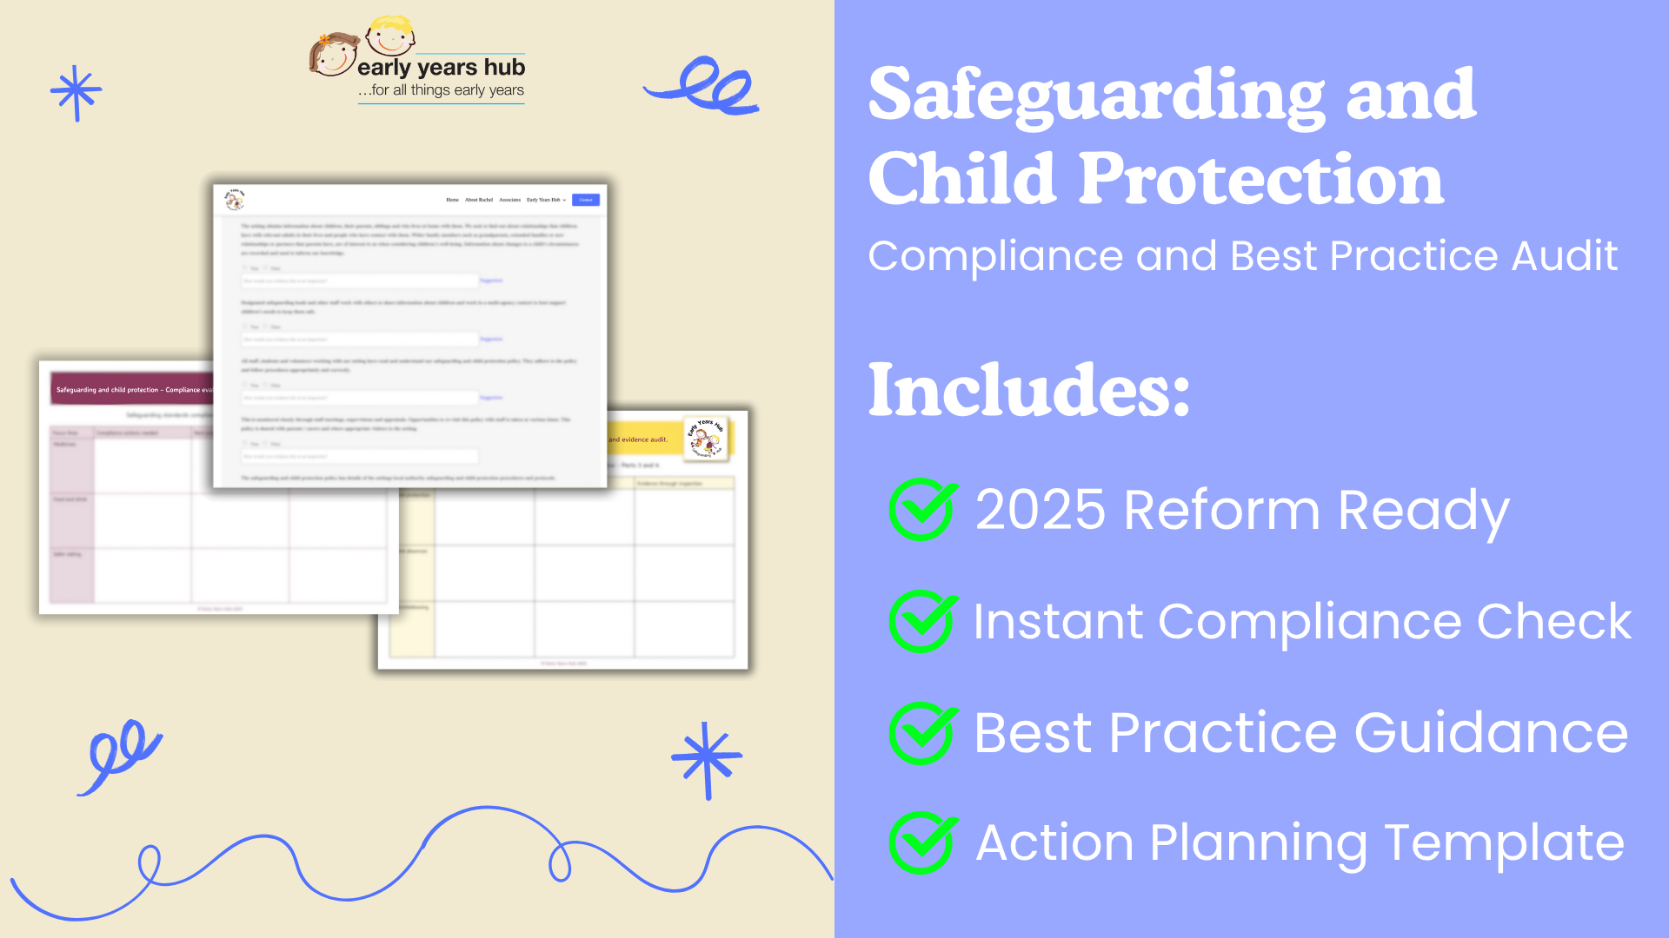
Audit tool and planner rachelbuckler.co.uk

Slide 30
Thank you!
Rachel@rachelbuckler.co.uk
amc@annmariechristian.com

