Slide 1
Dingley’s Promise
How to Sign Up

Slide 2

Dingley’s Promise Training
Designed for Early Years Practitioners but some are useful for parents too
Free to anyone living/ working in North Yorkshire.
If a parent living outside of North Yorks can use a NYC setting/ school postcode to register.
Short Courses - Dingley's Promise
Introduction to Early Years Inclusive Practice
Early Years SEND Transitions
Behaviours that Challenge
The Voice of the Child
Having Difficult Conversations with Families
Intersections within Early years
Leadership and Management for Inclusion
Resources for Local Authorities - Dingley's Promise
We always ensure we signpost Your Family Toolkit and Solihull parenting
Notes:
We always promote Solihull Parenting
Your Family Toolkit
Training includes:
Introduction to Early Years Inclusive Practice
Early Years SEND Transitions
Behaviours that Challenge
The Voice of the Child
Having Difficult Conversations with Families
Intersections within Early years
Leadership and Management for Inclusion

Slide 3
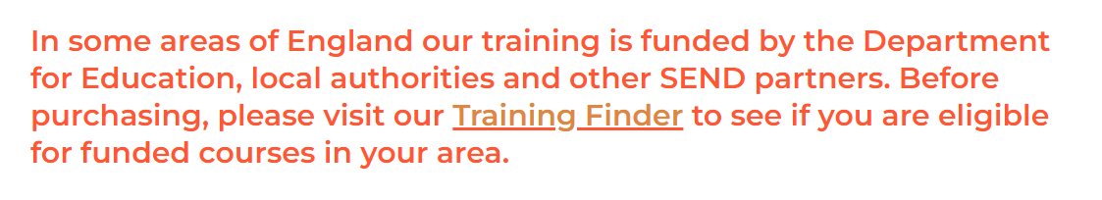
How to sign up to Dingley’s Promise
Training - Dingley's Promise
From the Menu: Click on Short Courses. You will then see this box. Click on Training Finder

Slide 4
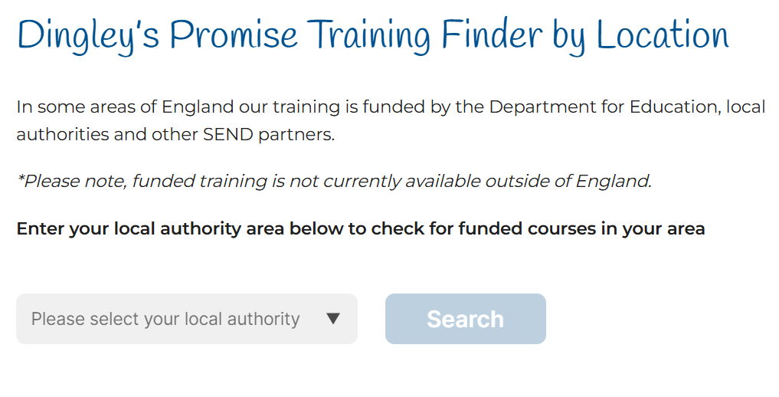
You will see this:
Select North Yorkshire from the drop down box and click search

Slide 5
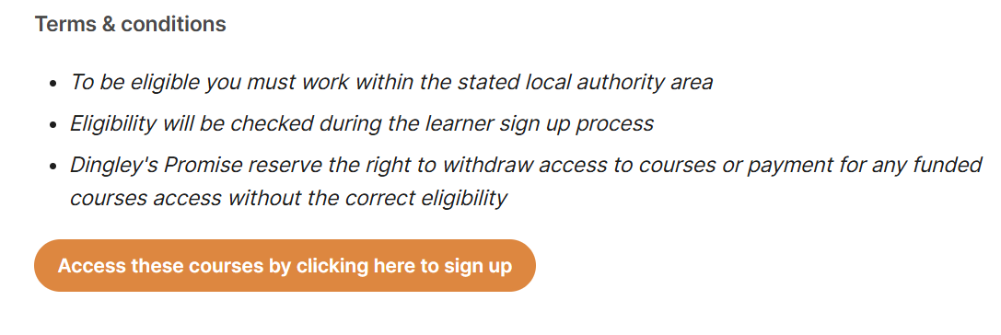
Click on the access these courses. You will then be able to sign up

